Slide 1

ADAPTATION OF CONSTRUCTION CONTRACTS
TO THE CHANGED CIRCUMSTANCES
ÇAĞRI CEM
TAHAN–CEM ATTORNEY PARTNERSHIP
cagricem@tahan-cem.av.tr

Slide 2
RECENT GLOBAL DEVELOPMENTS
THAT LED TO CHANGES IN CONSTRUCTION
SHARP PRICE INCREASE
IN CONSTRUCTION MATERIALS
2021 ONWARDS
GLOBAL HYPERINFLATION
2021 ONWARDS
UKRAINE – RUSSIA
WAR
2022 FEBRUARY ONWARDS
INCREASED
MANPOWER COSTS
COVID 19 PANDEMIC
2019 to 2022
SHARP INCREASE
IN FUEL COSTS
2021 ONWARDS
GLOBAL
CHIP SHORTAGE
2020 ONWARDS

Slide 3

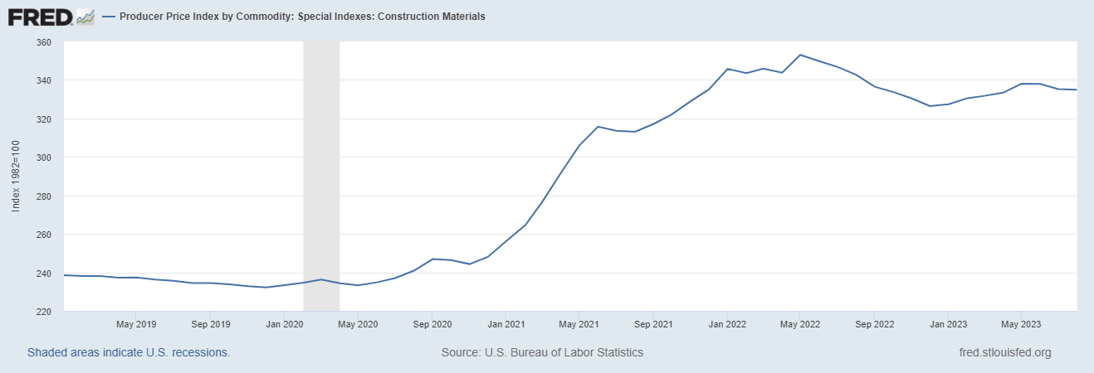

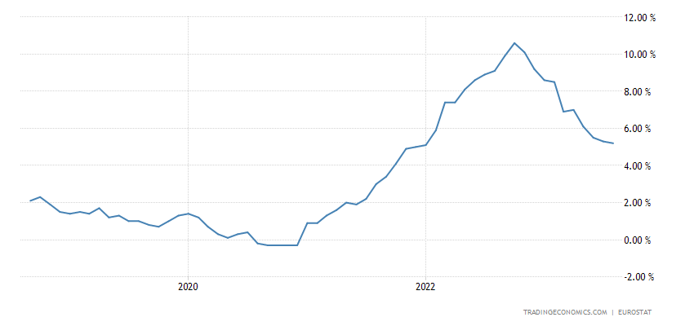
Sharp Price
Increase
in Construction
Materials
Eurozone Inflation
( EUROSTAT )

Slide 4
RECENT GLOBAL DEVELOPMENTS
THAT LED TO CHANGES IN CONSTRUCTION
It is possible to split the effects in TWO MAJOR SUB-CATEGORIES:
1 - COST EFFECTS / COST OVERRUN:
Contract Prices (or even Escalation Formulas, if there are any) are not sufficient to cover the cost overruns. We witness that in some jurisdictions, the Governments introduced several legal measures to cope with cost overruns for public procurement contracts.

Slide 5
RECENT GLOBAL DEVELOPMENTS
THAT LED TO CHANGES IN CONSTRUCTION
It is possible to split the effects in TWO MAJOR SUB-CATEGORIES:
1 - COST EFFECTS / COST OVERRUN:
Contract Prices (or even Escalation Formulas, if there are any) are not sufficient to cover the cost overruns. We witness that in some jurisdictions, the Governments introduced several legal measures to cope with cost overruns for public procurement contracts.
2 - TIME EFFECTS / EXTENDED CONTRACT TERM:
Due to shortage in supply chains and slow-downs in construction pace, construction periods are extended beyond the envisaged programme. Financial incapabilities also affected the completion periods.

Slide 6

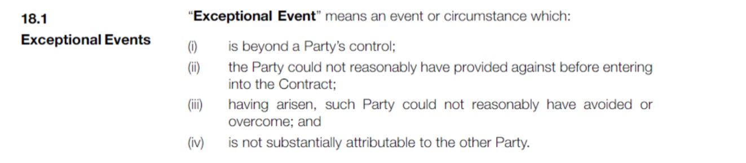


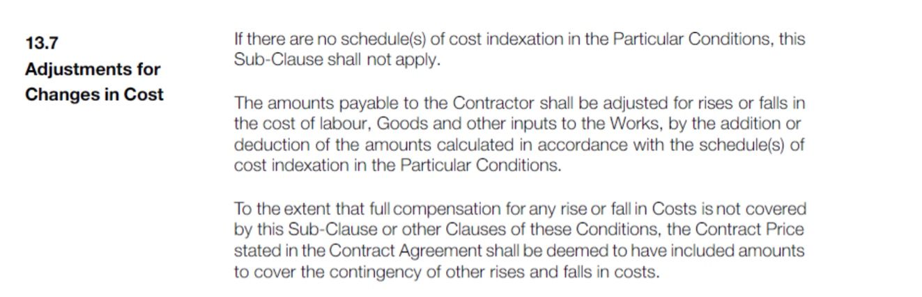
ARE CONTRACTUAL PROVISIONS
SUFFICIENT TO COPE WITH THE NEGATIVE EFFECTS?
Contract Provisions that the Contractors usually try to rely upon for remedy:
Force Majeure /
Exceptional Event
(FIDIC 2017 Art. 18/1)
Adjustment for
Changes in Costs
(FIDIC 2017 Art. 13.7/13.8)

Slide 7
ADAPTATION OF CONTRACT
Adaptation of Contract terms can be achieved through the “hardship doctrine”.
Hardship generally requires 4 fundamental conditions:
Extraordinary events/changes shall take place after the execution of the Contract;
Events / changes shall be unforeseeable at time of execution of the Contract;
Changes shall be outside the control of the affected party;
Continuance of the Contract with the existing terms shall become unbearable for the aggrieved party / balance of interest shall be drastically shifted.

Slide 8
SOURCES OF HARDSHIP DOCTRINE:
1- Hardship regulations might be embedded
into the Contracts / ICC Hardship Clause
2- Hardship provisions might be found under
the applicable law to the Contract (mostly in Civil Law jurisdictions)
3- International Commercial Principles (lex mercatoria) may enable hardship

Slide 9
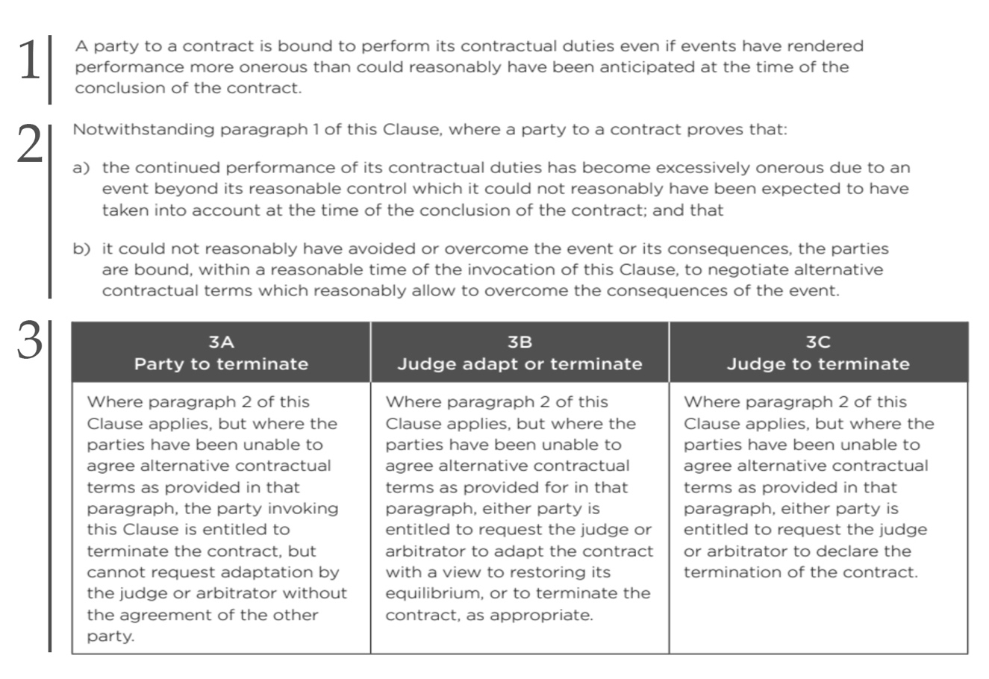

1- Hardship regulations might be embedded
into the Contracts / ICC Hardship Clause

Slide 10
2- Hardship provisions might be found under
the applicable law to the Contract
(mostly in Civil Law jurisdictions):
French Civil Code ( Article 1195 )
German Civil Code ( Section 313 )
Polish Civil Code ( Article 357 )
Dutch Civil Code ( Netherlands ) ( Article 6:258 )
Italian Civil Code ( Article 1467 )
Romanian Civil Code ( Article 1351 )
Georgian Civil Code ( Article 398 )
Turkish Code of Obligations ( Article 480 & 138 )

Slide 11

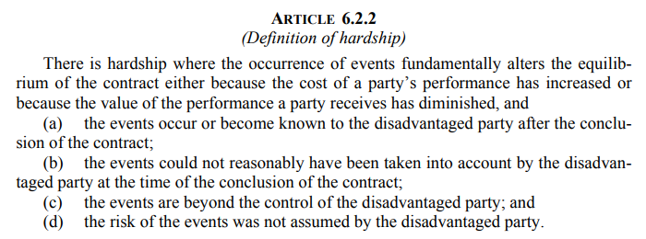
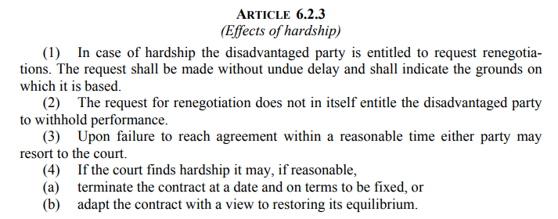
3- International Commercial Principles
(lex mercatoria) may enable hardship:
UNIDROIT Principles 2016 – Article 6 Section 2

Slide 12
PRICE ESCALATIONS and
CORRELATION WITH HARDSHIP
In some FIDIC Contracts, provisions for “Adjustments for Changes in Cost”
(Sub-Clause 13.7 & 13.8) are already agreed to apply by the contracting parties:
For increases not covered by Adjustments for Changes in Cost, the Accepted Contract Amount shall be deemed to have included amounts to cover the contingency of other rises and falls in costs.
Yet, “FIDIC Contracts guidance on the effects of inflation and unavailability of goods and labour following the global COVID-19 pandemic and the war in Ukraine” – March 2023 suggests the following:
---QOUTE--- “Where the Contract does not provide for compensation for full inflation Cost, (…)
remedies may exist at law. This is the case in some civil law countries, (…) where the so-called “hardship theory” may provide for specific remedies in such a situation.” ---UNQOUTE---
In ICC Award No. 16369, the Tribunal concluded that inclusion of a price formula does not necessarily lead to exclusion of hardship:
---QUOTE--- The price formula agreed in Clause 6 with certain fixed parameters and a number of variables, including increases and decreases of the treatment charge in function of above average and below-average settlement prices in the Tribunal's view reflects the Parties' understanding that market shocks were not to be assumed by either one of them but rather constituted a shared risk. ---UNQUOTE---

Slide 13
COMMON LAW v. CIVIL LAW APPROACH
Common Law jurisdictions mostly disregards hardship doctrine.
The Common Law requires a bargained-for exchange to be enforceable, regardless of whether the purpose of the contract disappears at a later time – “a man must stick to his bargain”.
Doctrine of Frustration (Frustration of Contract or Purpose) and Doctrine of Impracticability are mostly used, though with a higher bar – in Davis Contractors v. Fareham, a strict standard was established requiring that the circumstances must “involve a fundamental or radical change” from the original contractual obligation.
In US, the Doctrine of Impracticability is accepted, based on a shared tacit assumption:
UNIFORM COMMERCIAL CODE – Art. 2.615 includes the following:
---QUOTE--- Excuse by Failure of Presupposed Conditions
Except so far as a seller may have assumed a greater obligation (…); delay in delivery or non-delivery in whole or in part (…) is not a breach of his duty under a contract for sale if performance as agreed has been made impracticable by the occurrence of a contingency the non-occurrence of which was a basic assumption on which the contract was made (…).---UNQUOTE----

Slide 14
COMMON LAW v. CIVIL LAW APPROACH
Main difference in Common Law and Civil Law approach is
on the effects of financial difficulties to the Contract:
Civil Law mostly requires re-negotiation of the Contract terms and conditions – ultimate solution is
to terminate if the terms cannot be adapted.
Common Law mostly grants right to terminate the Contract.
In Civil Law, adaptation or termination might be sought through lawsuit / arbitration. In Common Law, right to terminate may be initiated by directly by the affected contracting party – court interference is not welcomed.

Slide 15
WHAT TO DO?
Any attempt for re-negotiation shall be made without undue delay and shall indicate the grounds on which it is based – wait and see strategy may not be well-suited for hardship cases.
Negotiations shall be made in good faith – increasing the claims for adaptation in an abnormal manner can be taken as a frivolous attempt to block negotiations.
Performance may be withheld in extraordinary circumstances – each case shall be studied diligently to find out if there are grounds for delaying the performance.

Slide 16
t h a n k y o u . . .

