Slide 1

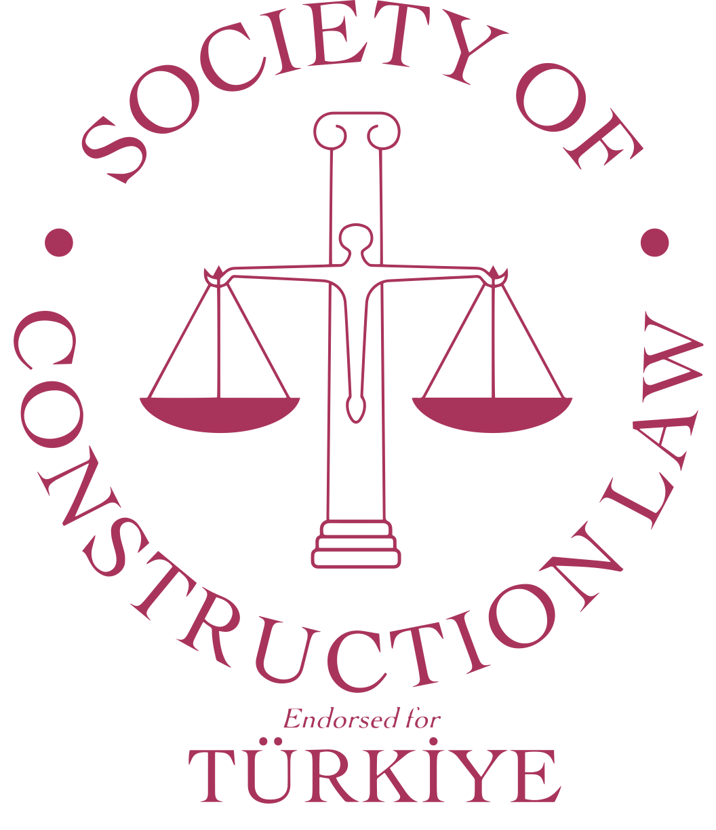
The Right People at the Wrong Time:
Why Timing Matters in Early Contractor Involvement
Oğuz Müftüoğlu
Deputy Contracts Manager
Makyol Construction Co.
June 11, 2026 - Istanbul
Notes:
When I was preparing this presentation, I found myself coming back to one simple question:
When should contractors actually become involved in a project?
Not as early as possible.
Not as late as necessary.
But at the point, where they can create the most value.
And that is what I'd like to explore today.

Slide 2
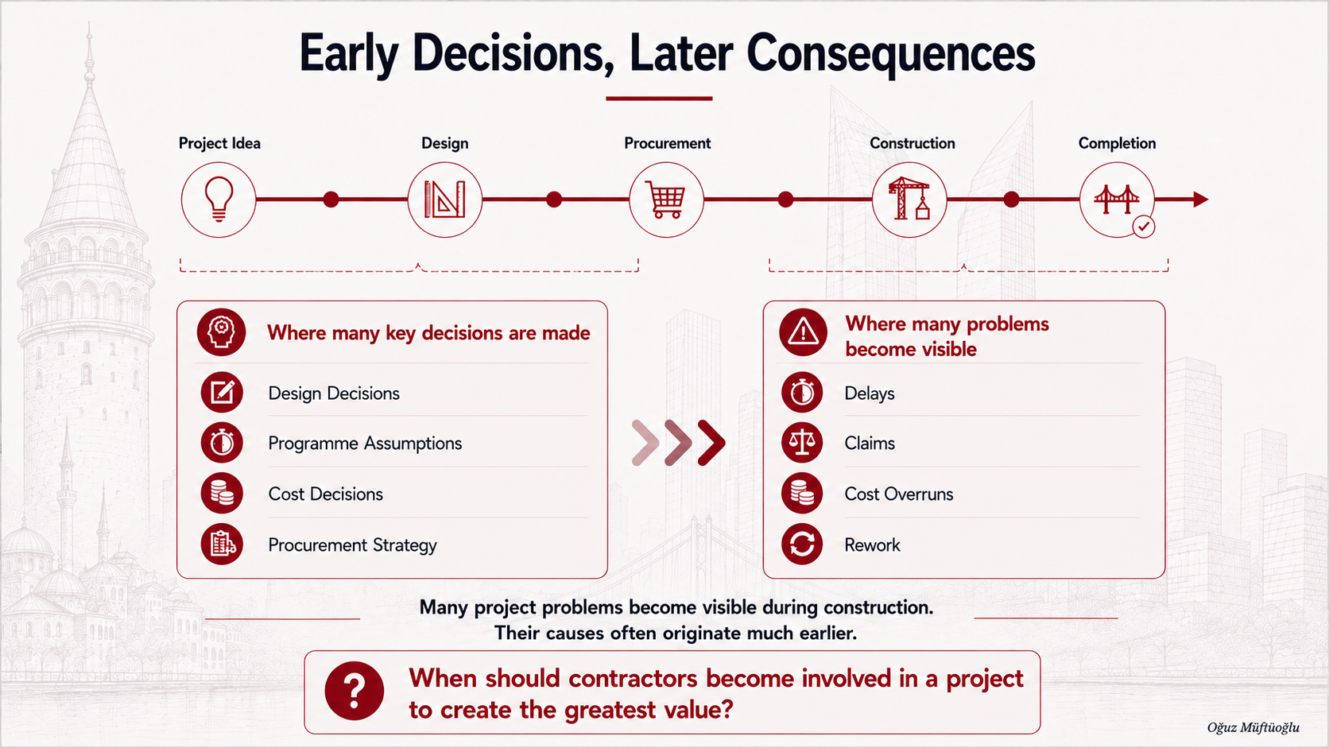
Notes:
1) For a moment, let’s think a construction project as people.>
2) Like people, important milestones and are shaped by the decisions made along the way.
3) the consequences of a decision only visible years later.
5) Many of the issues that become visible during construction, are often linked to decisions made much earlier
6) In otherwords, construction is often where problems become visible, but not necessarily where they originate.
7) And interestingly, project data seems to tell a very similar story.

Slide 3
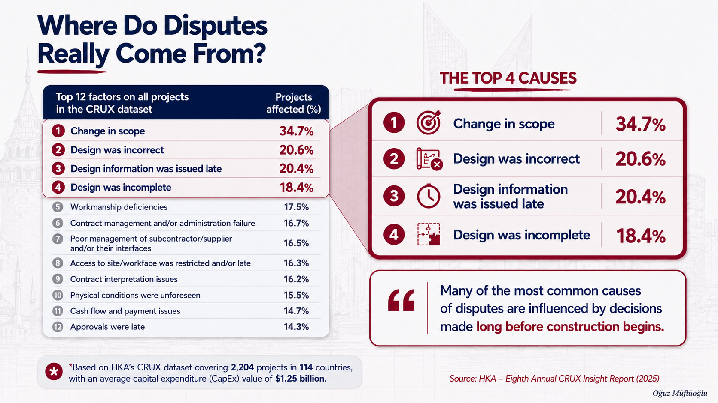
Notes:
SO what does project data tell us?
What I find particularly interesting is not any individual statistic.> It is the pattern behind the data.
The most common cause of dispute «change in scope»>
And then we see incorrect design, late design information and incomplete design.
At first glance, these may appear construction stage problem because they become visible mostly during conctruction period.
But, Many of the most common disputes are connected to choices made in the early stages of a project.
IF THAT IS THE CASE, PERHAPS WE SHOULD ASK WHETHER CONSTRUCTION KNOWLEDGE COULD ADD VALUE BEFORE CONSTRUCTION EVEN STARTS.

Slide 4
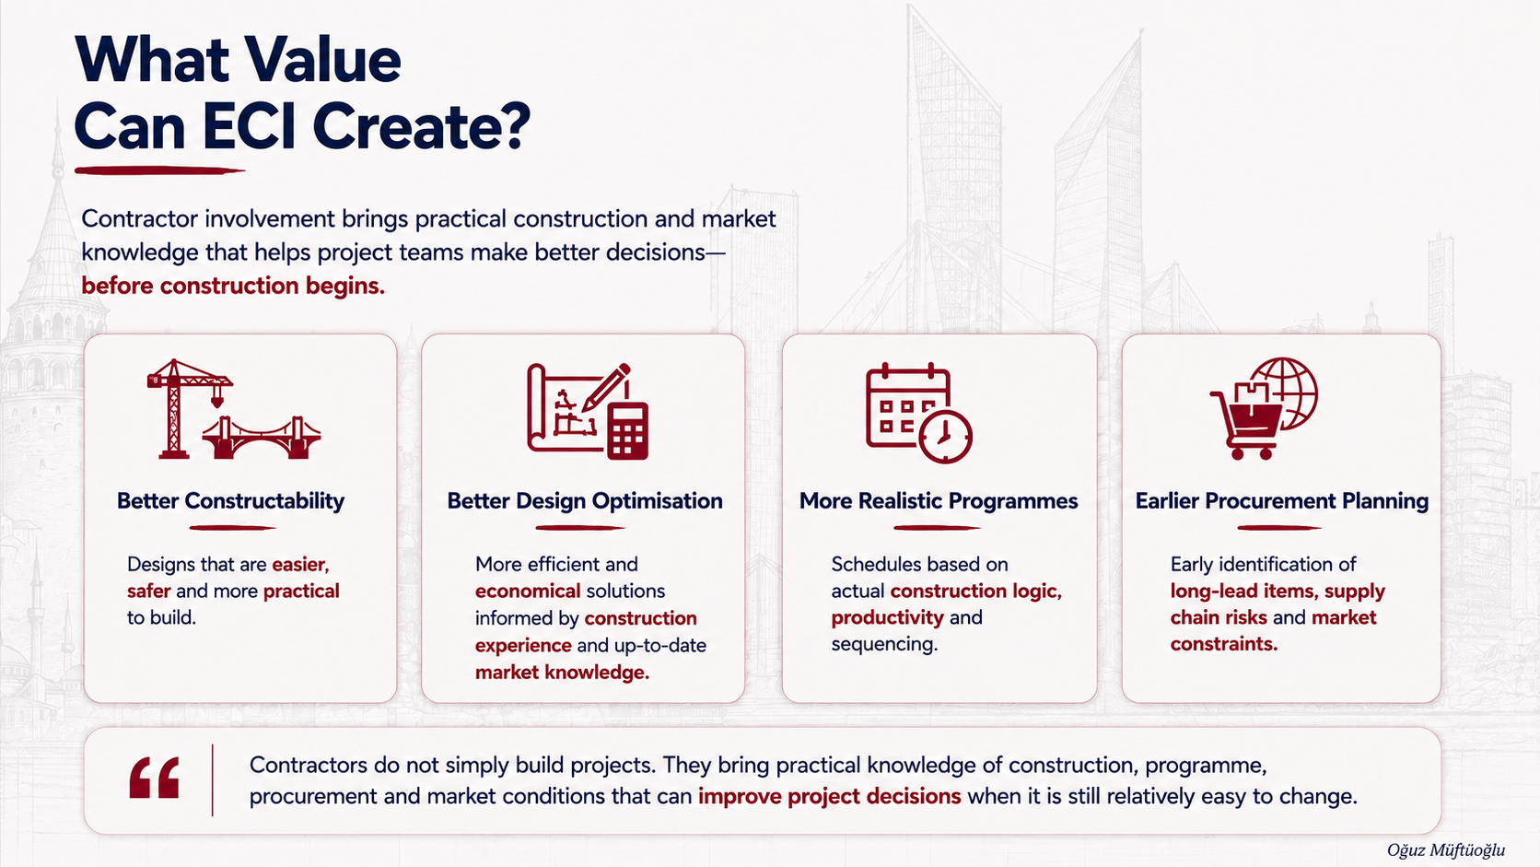
Notes:
In my view, the answer is YES.
Contractors bring something that is difficult to obtain elsewhere.
They know how projects are actually built.
How supply chain behave
How markets change
And where problems are likely to appear.
As a result, they often identify risks and opportunities that others may overlook.
they have current knowledge of material prices, labor availabililty, equipment constraints and production method. >
This allow them to propose solutions that are not only technically sound, but also more economical and efficient.
BUT, The real value is improving decisions before they become difficult and expensive to change

Slide 5
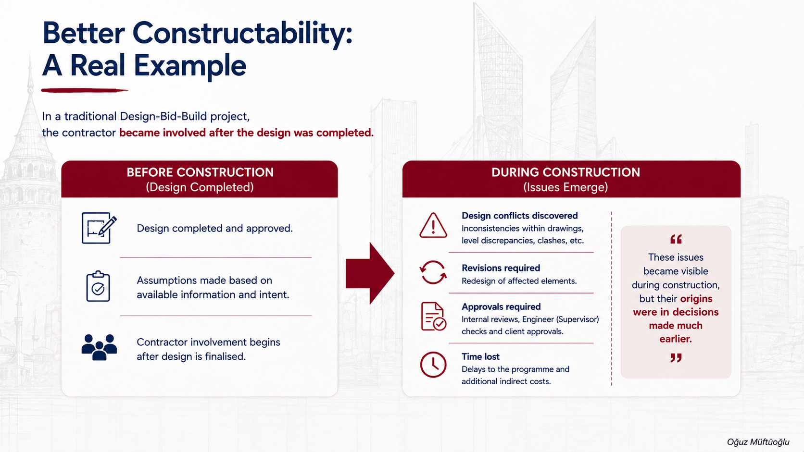
Notes:
I would like share an example from a traditional Design-Bid-Build project that I was persponally involved in.
We found issues in the drawings, level discrepancies and several constructability challenges that was not considered during the design.
Not difficult to resolve.
The challange was the time required to identify the issues, develop revised solutions and obtain the necessary approvals.
Project experience delay and additional costs.
Would ECI have prevented every one of these problems?? > PROBABLY NOT> However, earlier contractor involvement could have provided an opportunity to identify many of these issues before construction began.

Slide 6
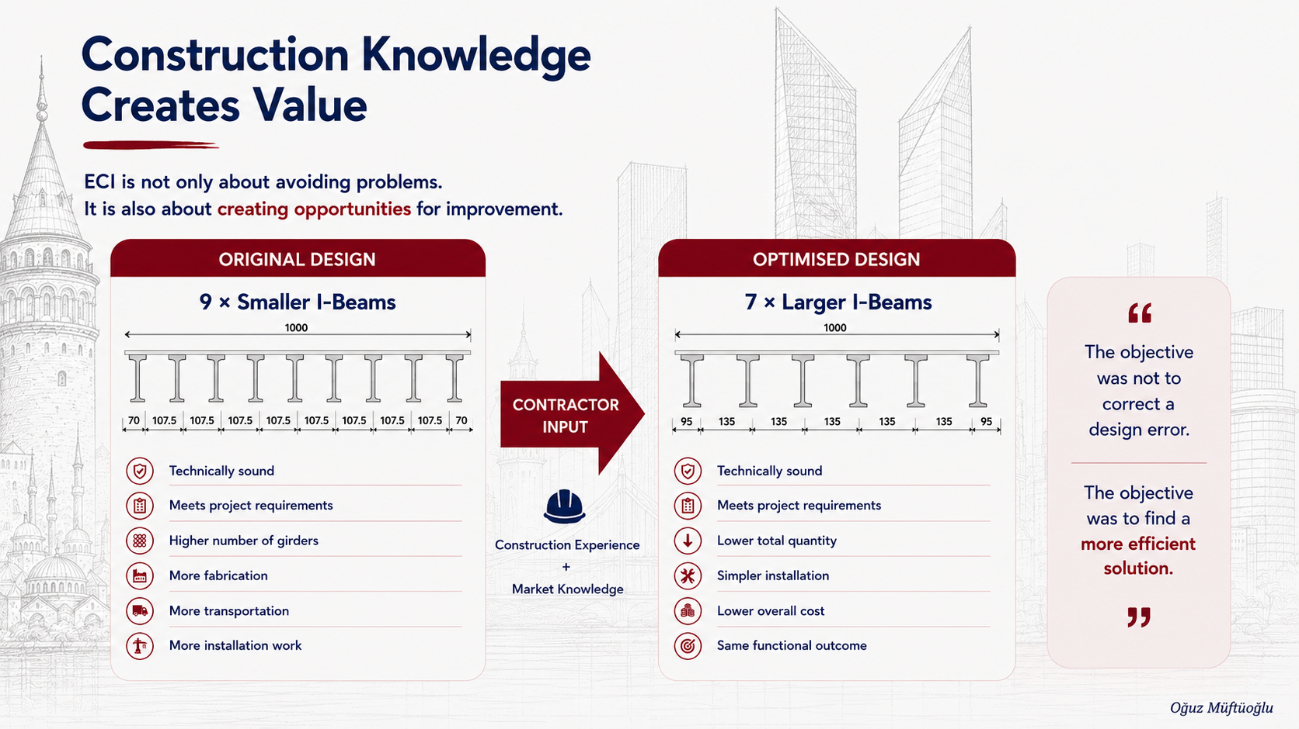
Notes:
The previos example focused on identifying problems earlier. However, ECI is not only about reducing risk
It can creat opportunities > Let me illustrate from one of my projects.
Design was technically sound and fully compliant with the project requirements. Compliance does not mean the optimal solution.
There was an opportunity. By increasing the size of the girders, the number of girder for each brider was reduced from 9 to 7
While maintaning same bridge width and structural performance.
At first glance, seems because of unit cost of each larger girder. >However, the overall quantity decreases > As a result, fewer girders need to be fabricated, transported, and installed.
It simply was not the only possible solution.
The value came from combining engineering requirements with construction experience and market knowledge.
This is another way contractor involment can improve project decisions before construction begins.

Slide 7
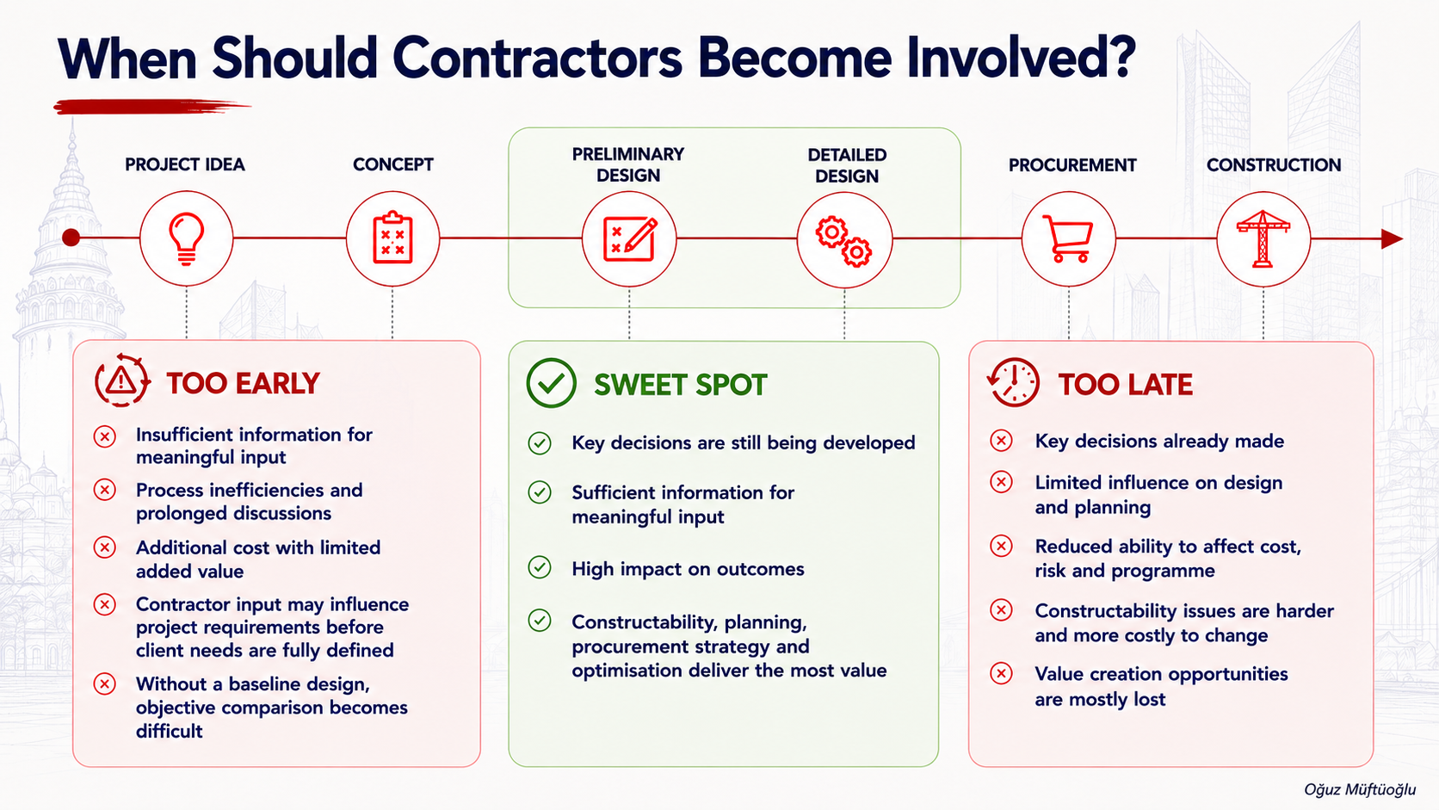
Notes:
This bring us what I believe is the most important question. When involve?
We have discussed so far, Tempting to conclude that Earlier is always better.
In my view, Contractor involvement can be considered in three broad zones. (Too early, sweet spot, too late)
TOO EARLY: If C involve too early, there may not yet be enough inf. to provide meaningful input.
The process can be longer and expensive w/o creating significant addt. Value
There is also risk that Contractos input influence project requirements befor the client’s need is defined.
Without base line design, difficult to objectively compare alternative solutions.
TOO LATE: at the other end of spectrum > many key decision made> the ability to influence limited> opportunities for optimisation exist, but more difficult and more expensive
Which brings us to the sweet spot> key decisions are still open> const review, programme dev., procument planning, design opt. Can have greatest impact.
SO PERHAPS, THE OBJECTIVE IS NOT TO INVOLVE CONTRACTORS AS EARLY AS POSSIBLE
THE OBJECTIVE IS TO INVOLVE THEM AT THE POINT WHERE THEY CAN CREATE THE GREATEST VALUE.

Slide 8
Thank you…
Oğuz Müftüoğlu

