Slide 1

Power of AI-Driven Data Discovery to Enhance Construction Project Controls
Vladimir Milovanovic
CEO
www.lupa.technology

Slide 2

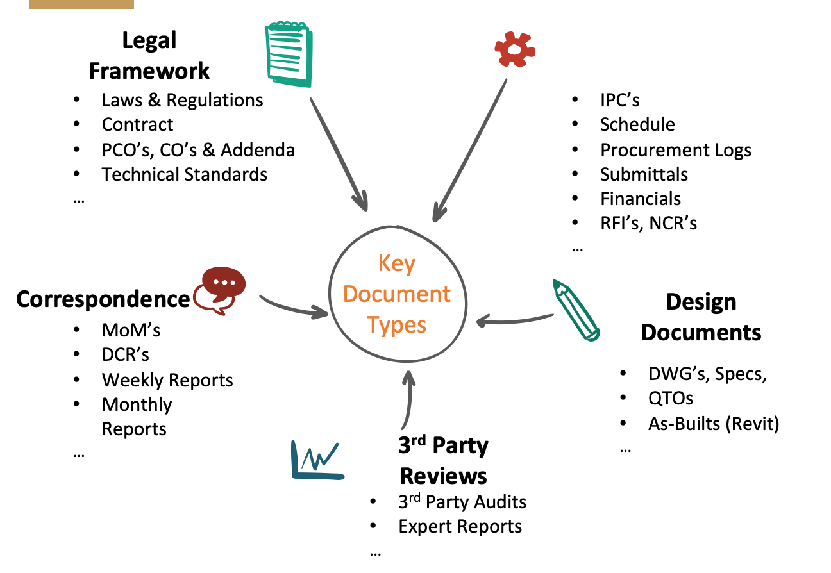
Information overload
- Hundreds of emails every day
- contracts, schedule updates, budgets, payments
- meetings, phone calls, messages
- reports, change management, risk management
Basically, you do your work, when everyone else goes home.

Slide 3


Project unpredictability
- No idea how the project will end
- Control and being prepared
- Contracts
- what’s missing? HR, InMan, Characters
“69% of construction projects have experienced claims related to changes.”

Slide 4
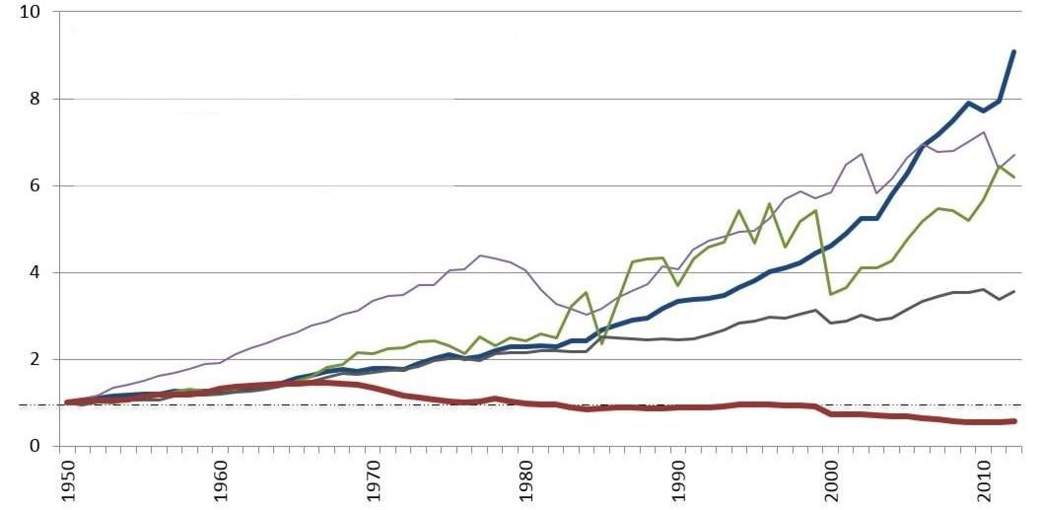
Innovation
Construction Productivity 1950-2012
Source: BEA, US
- Babyboomers
- Manual processes, DCS
- Millenials, Attracting Best Talent
- Knowledge transfer from BB to M

Slide 5
Innovation
Reduction in Manual workflows
Streamlined solutions vs. Patchwork
Enhanced data-driven decisions

Slide 6

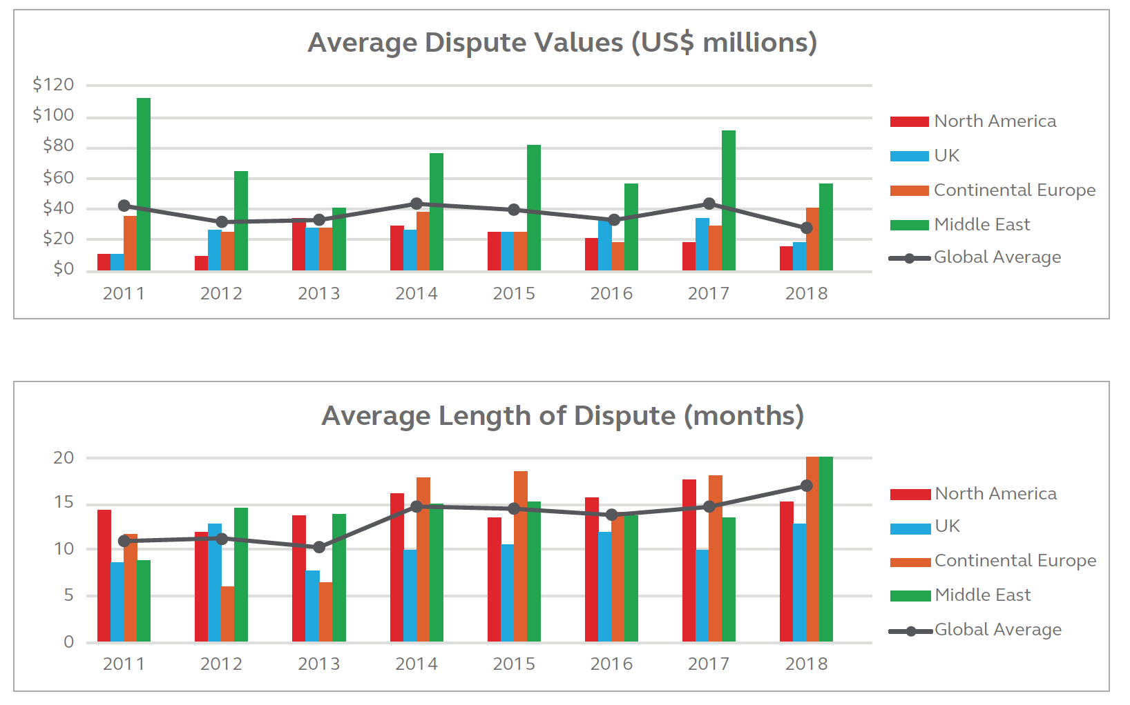

Slide 7

Negotiating time and money in construction is decided by facts…
…buried in emails, documents, drawings and schedules!

Slide 8







Talented staff lost…
Months in delays…
“69% of construction projects have experienced claims related to changes.”
$$ Millions gone…
Immeasurable stress…
“Project related claims cost more than *10% of the entire project value.”
Reputational damage…
“Effective substantiation of claims is the difference between profitability and loss.”
too many decisions…
“Companies that successfully leverage project information can save millions of $$ and avoid costly claims.”

Slide 9
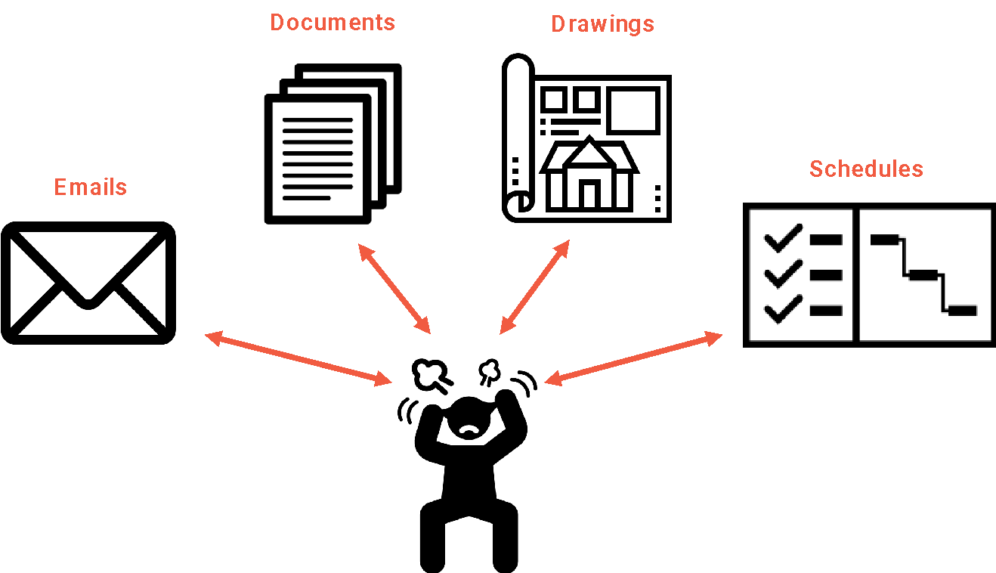

“Construction teams waste 35% of their time looking for information.”

Slide 10
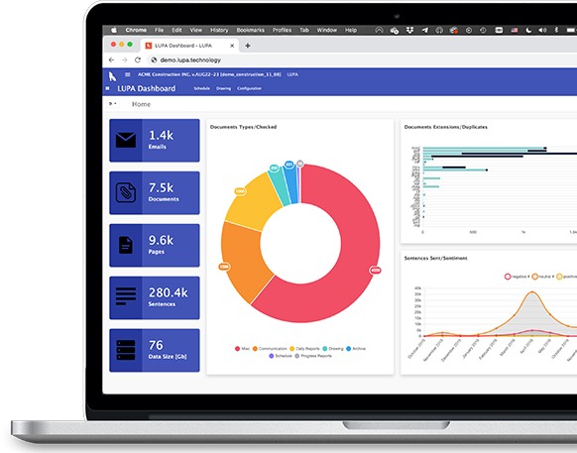
Solution
Cloud-based Data Discovery solution that empowers people to successfully manage changes, delays and claims.
It incorporates real-time processing of all construction project data and provides built-in analytics at the click of a button.

Slide 11
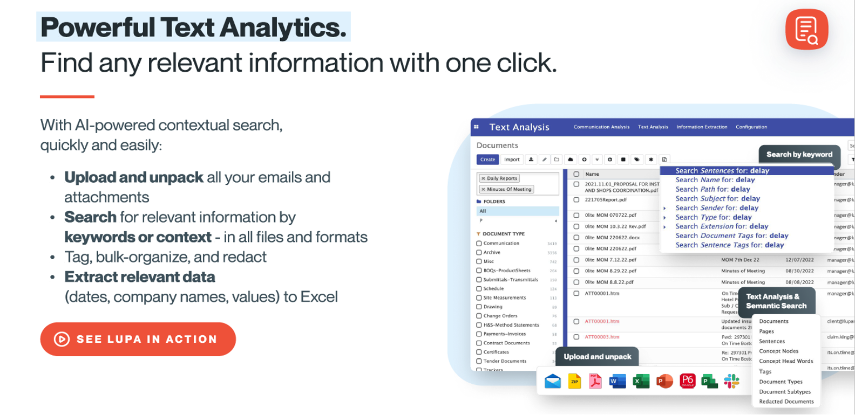

Slide 12
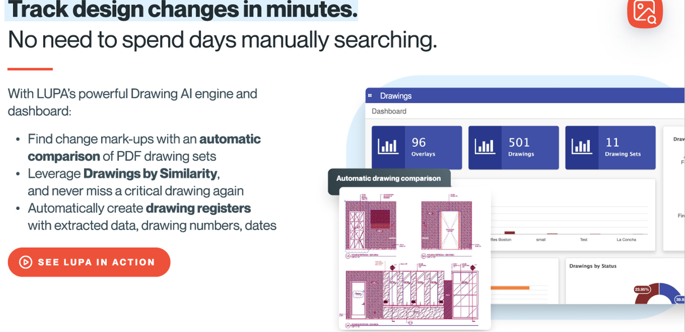

Slide 13
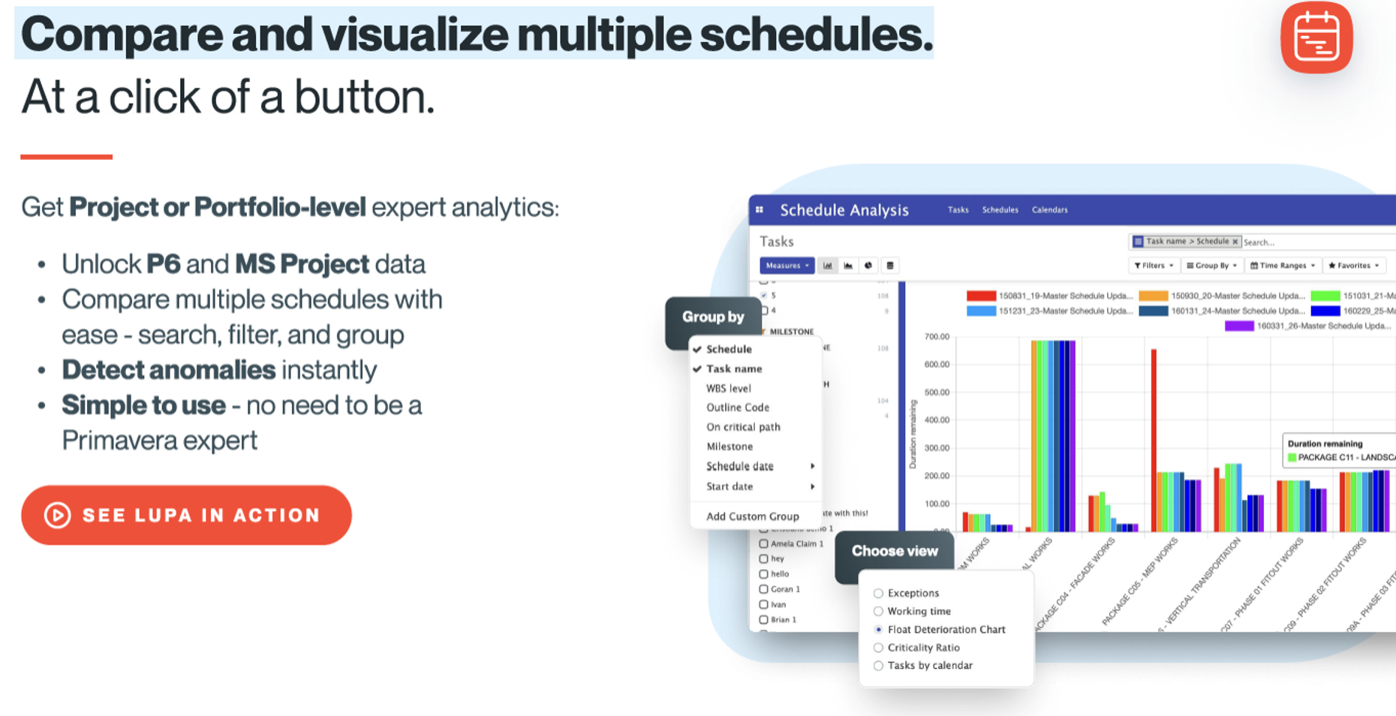

Slide 14
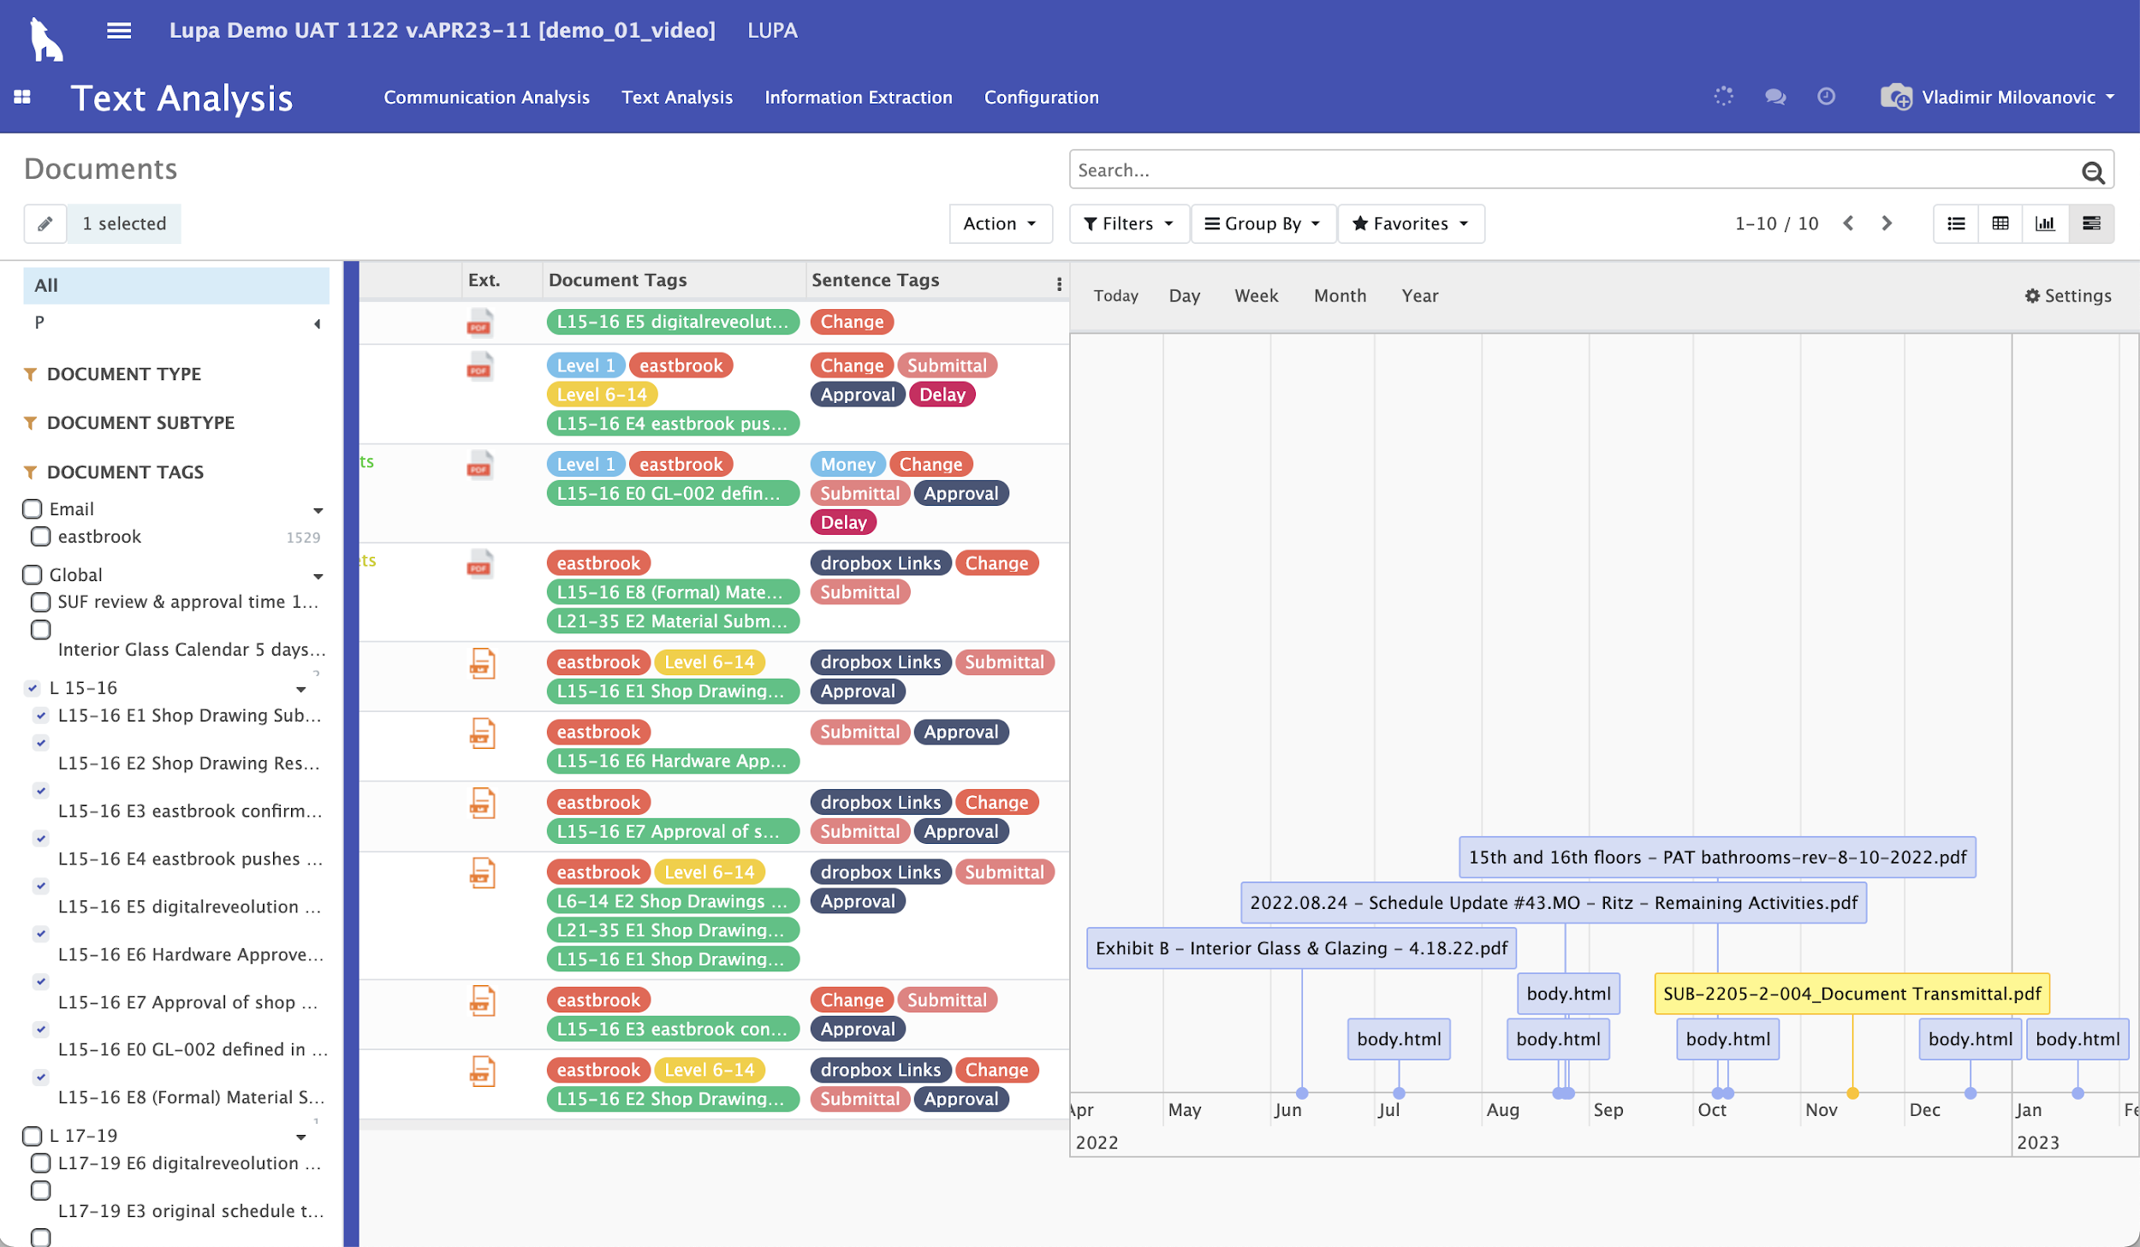
Case Study
Key parameters
Client: Confidential (leading law firm in UK)
Claim size: USD 750,000 International dispute
Data size: 3,500 emails &10,000 documents
Deadline: 3 weeks.
Problem
Leading expert companies from the UK who already worked on the case failed to produce the assessment. The Client waited for two weeks, paid GBP 150,000 in fees and was ultimately told that the fees would outweigh the value of the claim.
LUPA
Just before time ran out, LUPA was introduced to the case and all analytics, assessments and reports were produced in 3 days.
Customer Value
$750k
Review time
3 days

Slide 15

Thank
You!
Vladimir Milovanovic
CEO
www.lupa.technology

