Slide 1

Termination and Withdrawal: Now WHAT to DO?! Lessons Learned
Fadi Nashed
Ankura Consulting Group

Slide 2
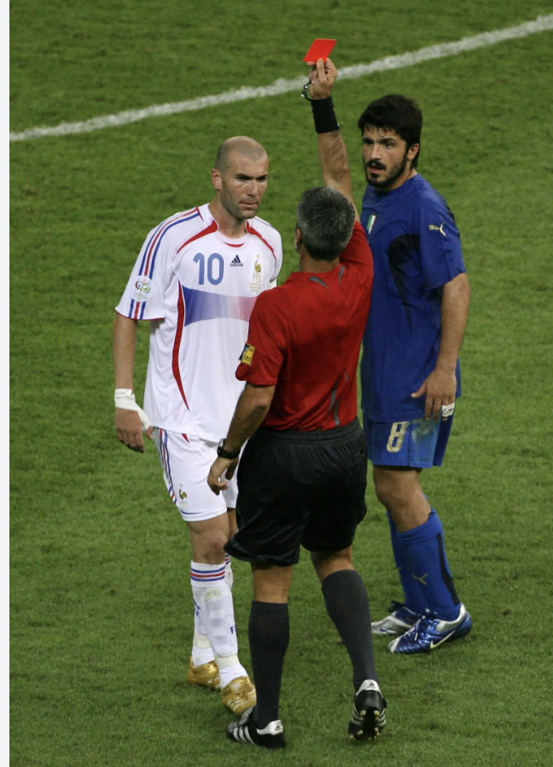

Termination
Credit: thesun.co.uk

Slide 3
Crossfire
Claims
Counterclaims
The contractor claimed costs of disruption from the owner
  A question – did the contractor experience disruption? Or in fact, maybe the real question is ‘what is disruption?’!
Unapproved/Disputed Change Orders
Prolongation Costs
  Another question – was it a ‘pacing delay’ a ‘concurrent’ delay?
Cost of termination (primarily cost to complete the works)
Delay claims
Costs of rectifying legacy defects and punch-lists

Slide 4
Claim#1: Disruption Claim
Disruption is treated by the construction industry as if it were the same thing as delay.
Delay is lateness in completion of certain activities, of certain milestones or of the overall project.
Disruption is disturbance or interruption of progress.
Disruption tends to cause loss of productivity, in other words when a project’s resources do not produce efficiently delays may occur if such resources are not supplemented
This is not the same as lacking resources and encountering production delays.
The contractor would need to understand the difference in order to keep the right records and pursue the adequate claim!

Slide 5
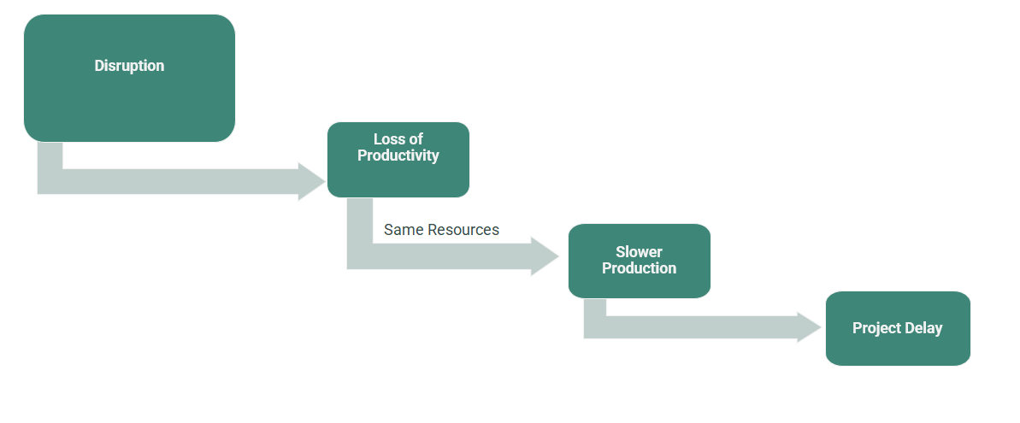
Claim#1: Disruption to Delay

Slide 6
Claim#2: Pacing vs Concurrent Delay
Pace is defined as a “rate of performance or delivery.”
Technically pacing of an activity is a reduction in an activity’s rate of performance (i.e., delaying its delivery). It is considered a ‘pacing delay’ if:
  pacing of the activity is deliberate;
  the activity could have proceeded at the planned pace; and
  a parent delay precedes the pacing of the activity.
A pacing delay cannot exist on its own, it must arise as a consequence of and run concurrent with a parent delay.
If there have been [sic] no potential concurrent delays identified, then pacing is irrelevant.
It is also critical that the pacing is deliberate because, in order to be concurrent delay, the delays must be involuntary.

Slide 7
Lessons Learned: If You See it Coming
When you see it coming it is probably coming!
Record-keeping is Boring—keep the right ones!
AND I’m not saying don’t try to avoid termination. Work on the latter, without neglecting the former.
Last schedule/programme updates are accurate.

Slide 8
Lessons Learned: If You See it Coming
Your quality control platforms (Aconex, Zutec, Procore, Bluebeam, etc.). Defects or Non-conformance Reports (NCRs): Close them out or update your platform.
Contemporaneous Witness Statements.
Physical Documents!

Slide 9

Termination and Withdrawal: Now WHAT to DO?! Lessons Learned
Fadi Nashed
Ankura Consulting Group

