Slide 1
THIRD-PARTY FUNDING IN CONSTRUCTION DISPUTES:
STRATEGY FOR ASSESSING
FUNDING REQUIREMENTS
SHISHIR KANT
Senior Partner, Masin

Slide 2
OUTLINE
Cost vs Potential Return
Engagement of Technical Experts in Due Diligence
Assessment of Potential Returns
Assessment of Costs

Slide 3
THIRD PARTY FUNDING
Third-Party Funding (TPF) in arbitration refers to the practice of providing financial assistance by a third-party funder to one of the parties involved in the dispute,
Generally, it is in exchange
for a portion of the potential award or
the settlement amount received at the conclusion of the dispute.
It may be a smart strategy in many arbitrations to opt for TPF in order to manage the risks and costs associated with the arbitration proceedings.

Slide 4
THE BIG QUESTION
WHAT WILL BE FUNDING REQUIREMENTS?
Once it is decided to proceed with TPF, then the next big question would be ‘how to assess the funding requirements?’
‘Funding Requirement’ means what amount of money (and when) will be required in the arbitration process, in anticipation of successful outcome.
There are several factors which are ought to be considered such as
Complexity of the claim
Type of arbitration/ Jurisdiction,
Enforcement of award,
Paying capacity of opposite party etc.

Slide 5
COST Vs POTENTIAL RETURN
The unique feature of TPF is that it is a ‘non-recourse finance’,
Hence the funders would be naturally interested in the disputes with high chances of realizable monetary outcome.
TPF mechanism involves a cost associated with the outcome, therefore it is the ‘margin’ between the potential return and cost to be incurred , which would define the attractiveness of any dispute for TPF.
‘Time’ is most critical factor.

Slide 6
DISPUTES ARE INHERENT IN CONSTRUCTION PROJECTS
Disputes are unfortunately a common feature in construction projects worldwide.
The construction industry is characterized with having multiple stakeholders with overlapping responsibilities and competing interests.
The construction projects are operated on some of the lowest profit margins in any industry — as low as 2%-5% of the project value.
Further, the prevalent practice of delayed completion and late payments make the matter worse.
In such environment, most construction companies set ‘cashflow management’ as their first priority while executing the project.

Slide 7
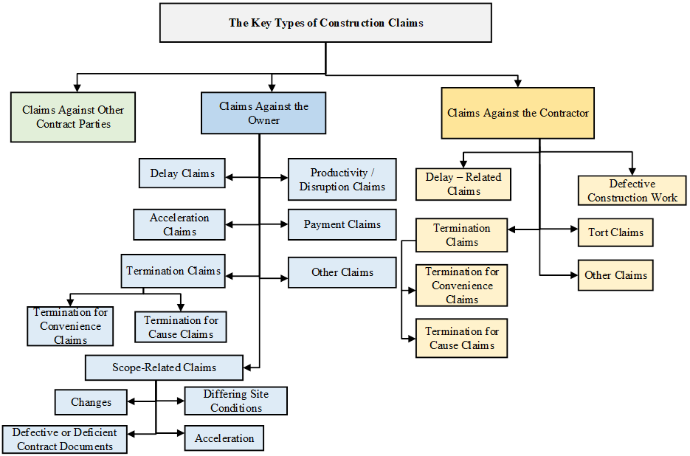
TYPES OF CLAIMS IN CONSTRUCTION

Slide 8
CLAIMS IN CONSTRUCTION INDUSTRY IN INDIA:
FROM CONTRACTOR’S PERSPECTIVE#
Claim Type | Relative Importance Index (%) | Rank
Delay claims | 75.38 | 2
Change claims | 75.21 | 3
Extra-work claims | 81.54 | 1
Different site conditions claims | 62.39 | 5
Acceleration claims | 56.07 | 8
Disruption claims | 59.15 | 7
Contract ambiguity claims | 60.17 | 6
Price escalation claims | 73.16 | 4
# Mohammed Taha Al-Qershi, and Ravande Kishore, “Claim Causes and Types in Indian Construction Industry - Contractor’s Perspective.” American Journal of Civil Engineering and Architecture, vol. 5, no. 5 (2017): 196-203. doi: 10.12691/ajcea-5-5-3.

Slide 9
DUE DILIGENCE IN TPF: A RIGOROUS PROCESS
Not all disputes are eligible for TPF.
Worldwide, the funding application rejection rate is around 90%. A funder expects that it must have at least a 60-65% chance of a successful outcome including recovery from the opposite party.
Arbitration proceedings can be costly and time-consuming, so funders are very rigorous in assessing the eligibility of any case.
Funders have their internal benchmark (i.e. minimum claim value) to assess the eligibility of any funding application.

Slide 10
ENGAGEMENT OF TECHNICAL EXPERTS IN DUE DILIGENCE
Not only the Funder, but the Applicant Party would also be keen to have a realistic assessment of cost and potential return.
The success fee for funder to be decided on two parameters: In terms of ‘multiple of cost to be incurred’ or in terms of ‘% of potential return’.
A Funding Proposal would be seen as more reliable if claim assessment is done by the external domain expert(s). The recent trend of TRF has come up with new business offerings to the claim consultants.
Engagement of domain experts: jointly or separately.

Slide 11
TECHNICAL ASSESSMENT
Due diligence by technical experts may happen in two stages:
Stage 1: To assess the acceptability of the funding proposal
Stage 2: Once the proposal is in-principal accepted, then thorough assessment of costs and returns is done
The assessment of potential threat i.e. claims expected to be presented by the opposite side is equally important. The net realizable amount (parties own claim minus opposite party’s claim value) is to be considered as potential return.
A SWOT (Strength- Weakness- Opportunity-Threat) of each claim is performed.
The claim assessment is done with three options: Minimum, Maximum and Most Likely Amount.

Slide 12
PARAMETERS OF ASSESSMENT OF POTENTIAL RETURN
The ‘quantity’ as well as ‘quality’ matters in the assessment of viability of claim.
Three assessment parameters are:
Substantive Requirements: Justification by citing the provisions of Applicable Law and/or contract documents.
Procedural Requirements: The set procedure in the contract/ law i.e. written notice, time bar, recommended methodology of analysis
Proof Requirements: The relevant contemporaneous documentation which support the claims under consideration.

Slide 13
REVIEW OF CLAIM COMPUTATION

Slide 14
QUALIFICATION OF CLAIMS:
Claims with relatively stronger tenability such as ‘payment certified as per the contract but not paid’ is more qualified than ‘uncertified /disputed sums’.
A variation claim involving certified quantities/ rates is more qualified in comparison to the prolongation costs based on the theoretical calculations.
Interest cost on the awarded amount may be a significant portion but is generally not considered in the overall assessment by the funders.
Any ‘Global Claim’ is difficult to establish as it does not provide adequate explanation of the causal nexus between relevant events/matters and alleged loss/ damage claimed for.
There is a distinct difference between ‘delay’ and ‘disruption’ events; hence inter-mixing to be removed to make a valid claim.

Slide 15
ASSESSMENT OF COSTS TO BE INCURRED
a. Due diligence/ Pre-arbitration stage
Cost associated with engaging legal and technical experts (in-house/ external) and using online platforms/ automated tools/ algorithms
b. Arbitration stage
It typically includes tribunal/ arbitration administrative fees, legal fees/ senior counsel fee, claim consultant fee, expert witness fees, document production costs, hearing venue/ travel/ accommodation expenses etc.
c. Post arbitration stage
Even after obtaining a favorable award, the understanding the potential enforcement challenges and the related costs is to be considered in the estimation.
d. Contingency buffer
it is prudent to include a contingency buffer (typically a percentage of the estimated costs) to mitigate any unexpected cost or circumstance.

Slide 16
CONCLUSION
TRF is a non-recourse finance mechanism, which is governed by the ‘margin’ between the cost to be incurred and the potential return in the construction arbitration.
The nuisances of the construction arbitration process demand that the strategic steps be adopted by the stakeholders to have a realistic assessment of this cost and potential returns in order to define the funding requirements.
The realistic assessment is the common platform to decide upon the success fee/ T&C between the funder and the party.
Hence, it is a good strategy to engage technical experts by the applicant parties and the funders in the due diligence process, and this evaluation may be performed jointly or separately.

Slide 17
THANK YOU

