Slide 1


Liquidated Damages for Delay in Construction Projects
A Comparative Approach
Ertuğrul AKINCI, LLM
Tahan | Cem Attorney Partnership
June 11, 2026 - Istanbul

Slide 2
What Are Liquidated Damages?
LD clauses allow parties to predetermine the damages payable by the Contractor to the Employer in the event of delay.
Avoid Disclosure
Skip Mitigation Debates
Contractor Certainty
Releases the Employer from proving losses — no need to disclose confidential records.
Avoids lengthy debates on whether the Employer mitigated its losses.
The Contractor can foresee its liability for delay in advance.

Slide 3
LDs vs. Penalties: Why the Distinction Matters
The legal consequences of an LD clause depend on how it is classified under the governing law. Jurisdictions take markedly different approaches.
England & Wales / US
Netherlands
Switzerland & Turkey
Penalty clauses are unenforceable. LDs are valid. If deemed a penalty, the aggrieved party is left to general law damages.
[Cavendish v. Makdessi & ParkingEye v. Beavis]
No distinction between penalty and LD — both subject to the same regime. [Dutch Civil Code, Art. 6:91]
LDs and penalties are distinct legal concepts, each governed by different rules.

Slide 4

How to Determine the Nature of the Clause
Requires determining the intent of the parties at the time of contracting.
English Law
Swiss & Turkish Law
On wording: The label used by the parties ("liquidated damages" or "penalty") is relevant but not decisive. Courts and tribunals look to the true and common intention of the parties.
LD should
not be punitive and
be proportionate to the legitimate interests of the aggrieved party.
Somewhat accurate estimation of the potential loss
LD = pre-estimation of damage
Penalty = pressure to perform
Amount is also important for making the determination.
Turkish Code of Obligations – Art. 19
Swiss Code of Obligations – Art. 18
Cavendish v. Makdessi & ParkingEye v. Beavis
Dunlop Pneumatic Tyre v. New Garage

Slide 5
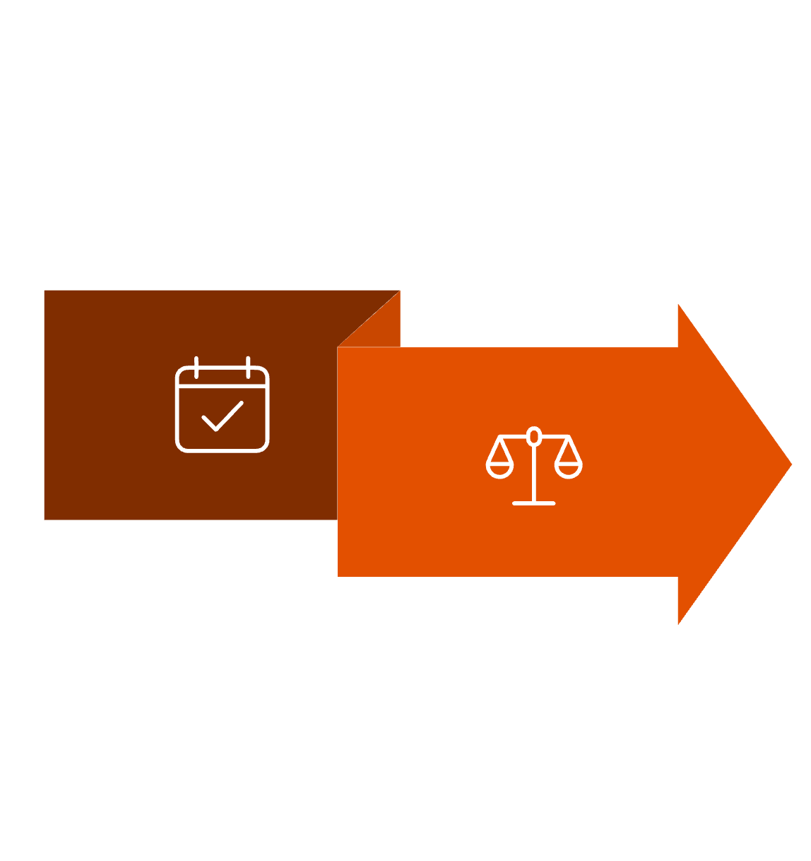
The Correct Point in Time for Assessment
Assess at Conclusion of the Contract
The rule applies consistently under English, Swiss, and Turkish laws
"The [determination] depends on the character of the provision, not on the circumstances in which it falls to be enforced." — Cavendish v. Makdessi & ParkingEye v. Beavis
Need not Match Actual Damages After the Fact

Slide 6
Practical Considerations

Slide 7
Must the Employer Actually Suffer a Loss?
Swiss & Turkish Law
English Law
LD is a type of damage — the Employer must incur some loss, but is not required to prove its extent.
No inquiry into the actual loss suffered.

Slide 8
Is the LD Amount a Cap or a Floor?
Can the Employer claim more than the LD? Can the Contractor pay less?
Depends on how the clause is constructed.
English Law
Swiss & Turkish Law
Where a valid LD clause exists, it is the sole remedy for that breach. Unliquidated damages are not recoverable — the parties' agreement replaces the general remedy.
[Gilbert Ash (Northern) Ltd v. Modem Engineering (Bristol) Ltd]
Unless otherwise stipulated, the Employer cannot claim more by proving higher losses, and the Contractor cannot pay less by proving lower losses.

Slide 9
Adaptation Due to Hardship
Can an Employer seek adaptation of the LD amount where unforeseen circumstances render it inadequate?
The doctrine of adaptation due to hardship exists under both Swiss and Turkish law. Turkey's Code of Obligations includes a specific provision – Art. 138
The Turkish Court of Cassation confirms that LD amounts may require adjustment [15. HD, E: 2011/515, K: 2011/7200, T: 16.12.2011].
Article 138, Turkish Code of Obligations allows the parties to seek adaptation when an unforeseeable change in circumstances renders performance excessively burdensome.

Slide 10
Thank you!
Ertuğrul AKINCI, LLM
Tahan | Cem Attorney Partnership

