Slide 1

Julian Bailey
Partner, Jones Day, London.
20 October 2023

Slide 2

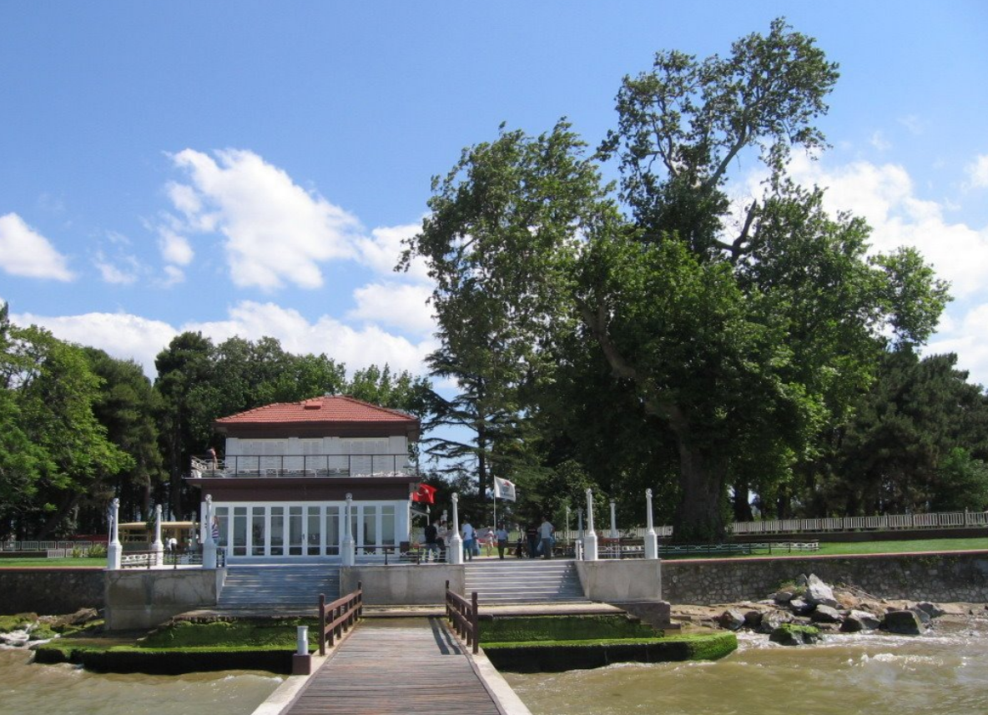
The “E” in ESG – something old, something new?

Slide 3
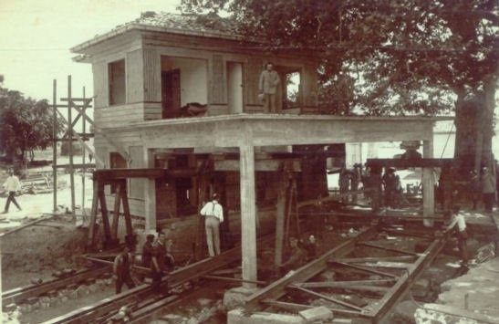
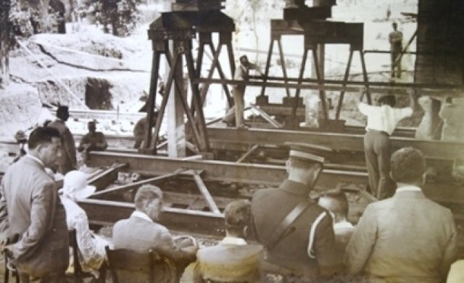
Yalova Walking Mansion

Slide 4
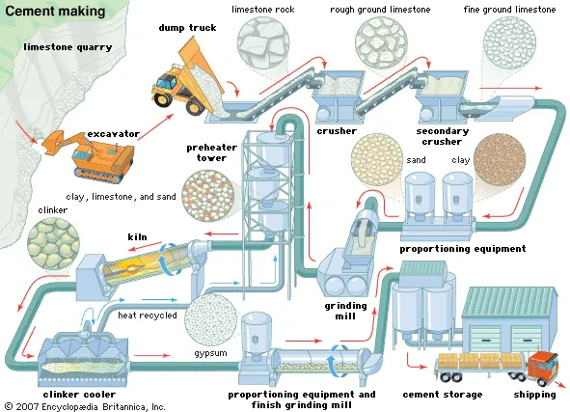
We need to talk about concrete…
“According to multiple sources, roughly 40 percent of the world's cumulative annual carbon emissions are caused by the built environment”: Turner & Townsend (2023).
“Concrete is a major source of CO₂ in construction, accounting for 1.5% of all emissions in the UK and 8% globally”: British Institution of Civil Engineers (2022).

Slide 5
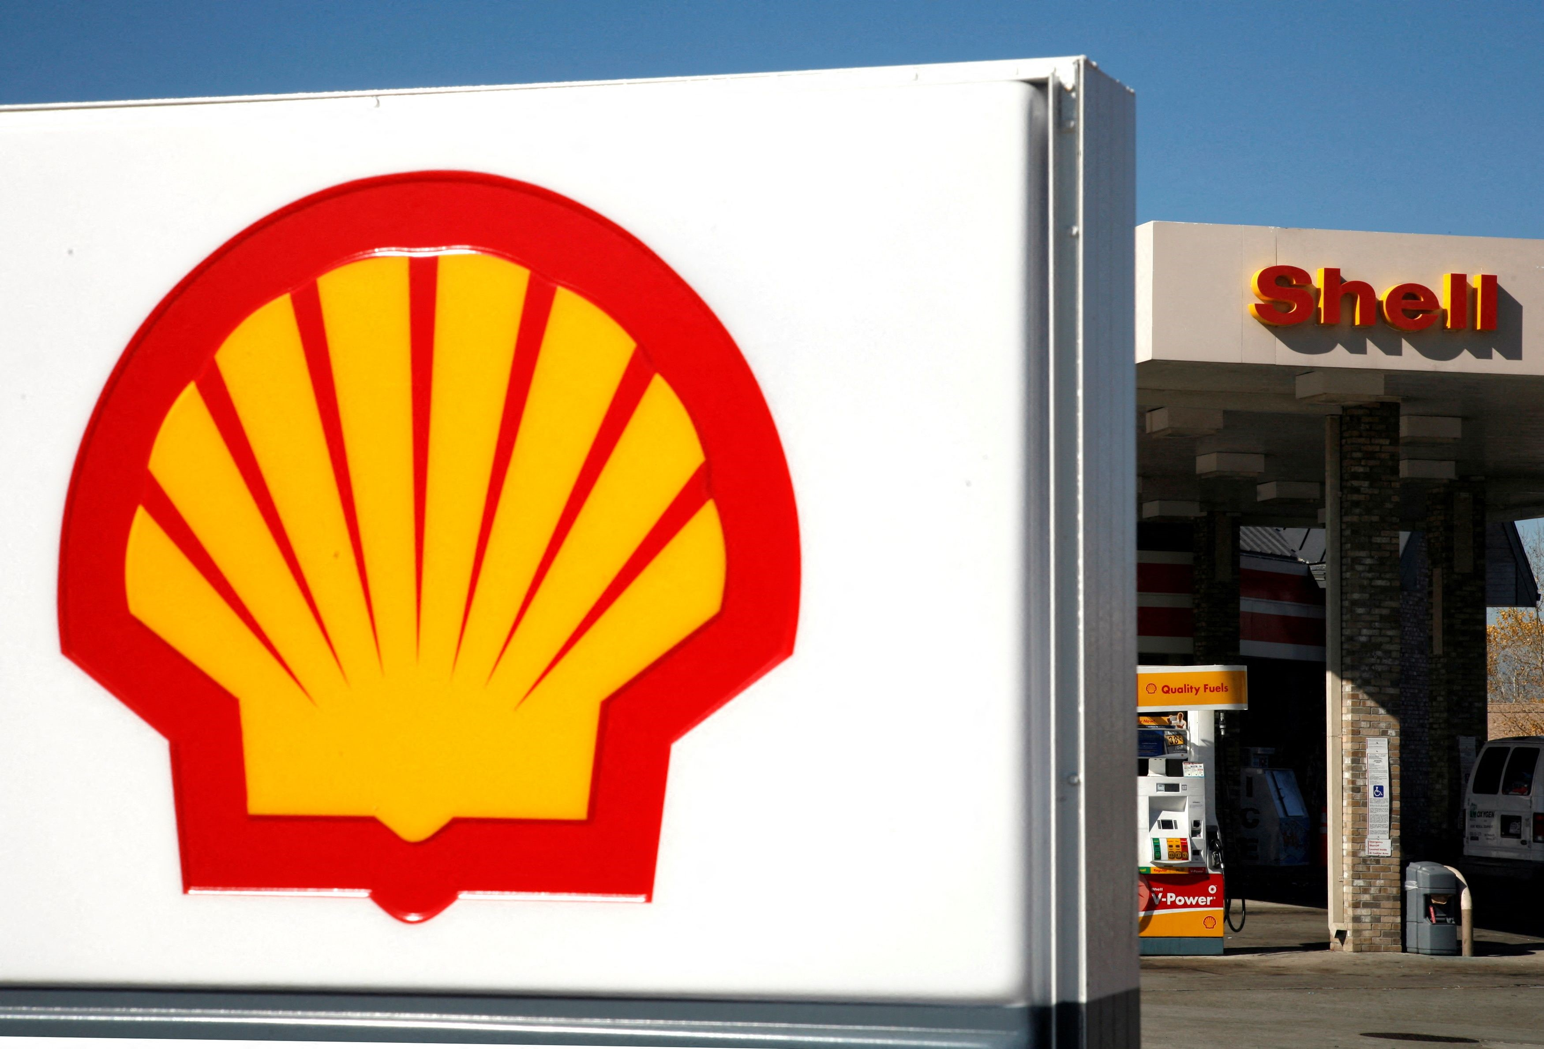
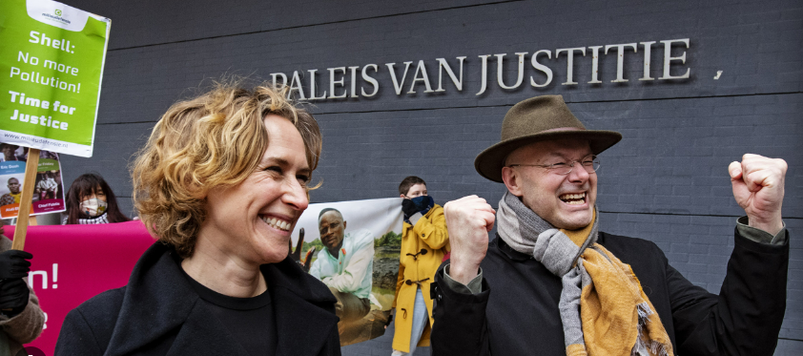
Greenhouse emissions & the law
NGOs / interested persons can seek court orders (injunctions) where there is an environmental statute or treaty, e.g.
Milieudefensie v Royal Dutch Shell (Hague District Court, 26 May 2021).
  NGO claimed that Shell group violated Dutch Civil Code.
  Shell group ordered to reduce its greenhouse gas emissions by 2030 to 45% of the group’s 2019 greenhouse emissions.

Slide 6
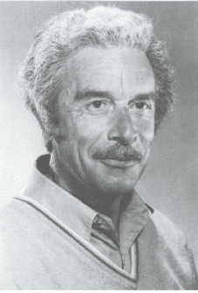

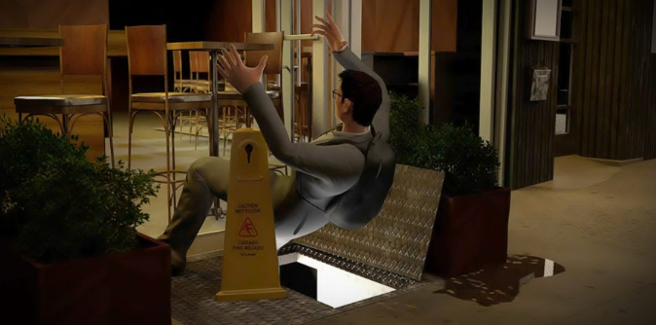
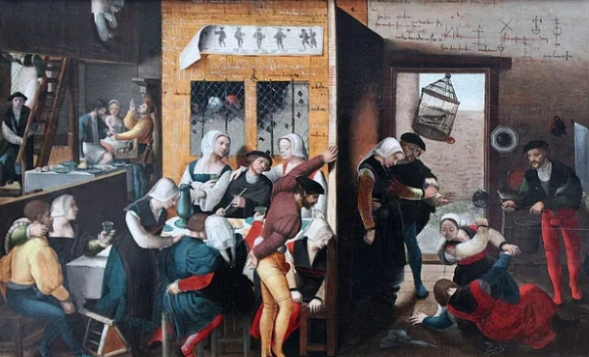
What role for the common law?
Tort claims – tort of “public nuisance” – a potential role?
“Public nuisance” targeted at anti-social activities of innumerable types.
Professor John Fleming:
“Fewer words in the legal vocabulary are bedevilled with so much obscurity and confusion as ‘nuisance’…”
“[Nuisance] has become a catch-all for a multitude of ill-assorted sins, linking offensive smells, crowing roosters, obstructions of rights of way, defective cellar flaps, street queues, lotteries, houses of ill-fame and a host of other rag-ends of the law”.
A vague, ill-defined tort – but potentially a powerful weapon for NGOs?

Slide 7
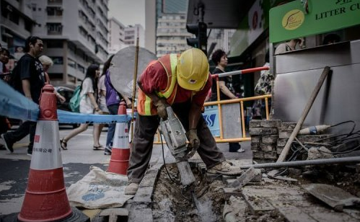
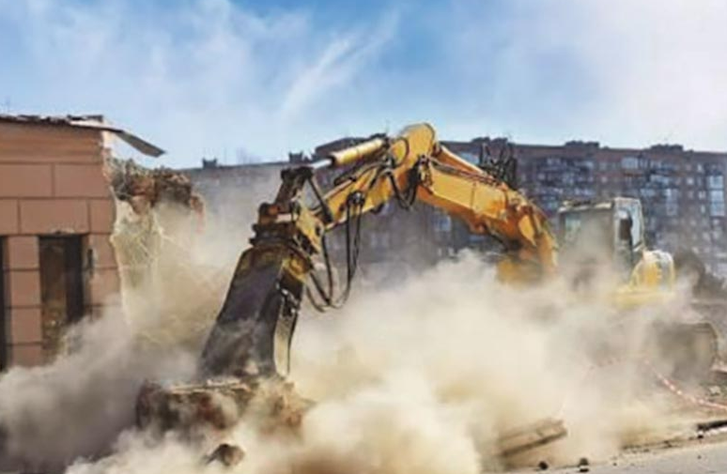

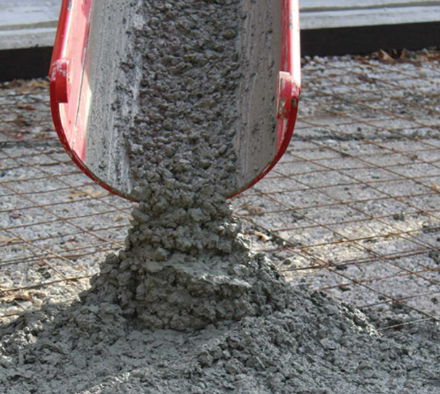

Public nuisance & construction projects

Slide 8

Public nuisance: three elements
Substantial and unreasonable conduct of a legal person causing material harm to or interference with person or property; as a consequence of which
The complainant has suffered a special injury or loss to himself, beyond any injury or loss suffered by other members of the public; where
The injury was the direct, necessary, natural and immediate consequence of the defendant’s wrongful conduct.
May be relatively straightforward for claims by people affected by large amounts of dust or noise from a construction project, but what about CO₂ emissions? Let’s consider (as a thought – or tort – experiment)…

Slide 9
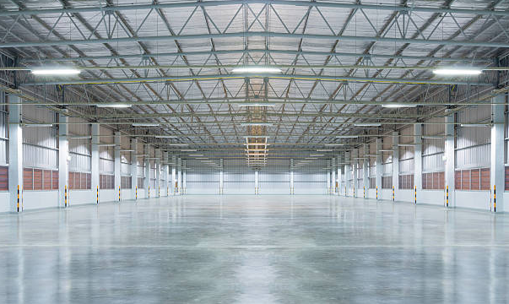
Hypothetical scenario
Project in Norwich, England, to demolish an old industrial site and build a new car factory. It has received all required planning approvals.
Concrete for the new factory floor = 5,000m², 1 metre thick = 5,000m³.
Carbon emissions = 410 kg/m³ x 5,000m³ = approx. 2,000,000kg of CO₂.

Slide 10
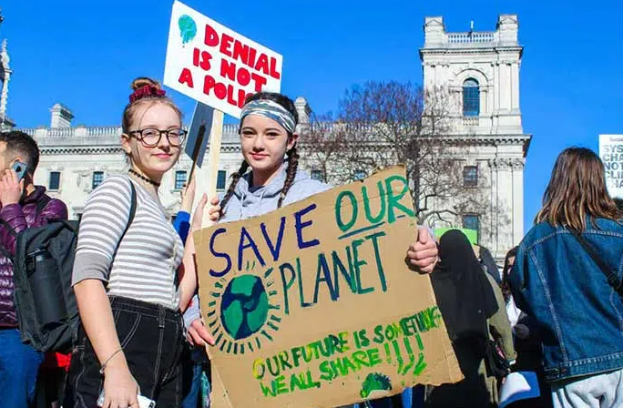
Hypothetical scenario
Local resistance from “Norwich Youth for the Environment” (NYE).
NYE consists of around 50 people, ages 14-23.
They object to the development on environmental grounds -> seek a court injunction to stop it on the basis of it being a public nuisance due to the CO₂ emissions from the concrete.
Can NYE get their injunction?

Slide 11
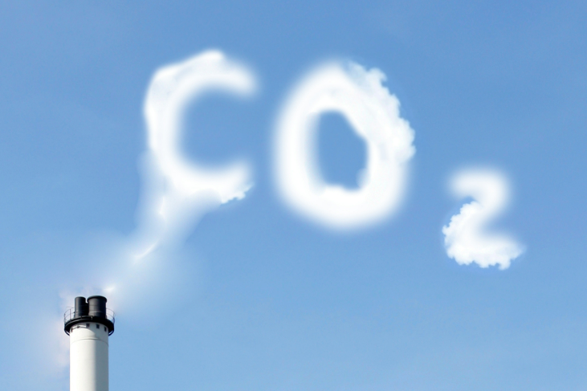
Element 1: Substantial and Unreasonable Conduct
What is “substantial and unreasonable” conduct?
No legal scale or yardstick.
We all produce CO₂ when we breathe, or when we drive a petrol car…is that “substantial and unreasonable” conduct?
Is 2,000,000kg of CO₂ a substantial amount?
Planning approval was given, is that relevant?
Has the developer tried to mitigate the project’s emissions?
Is it arguable that the CO₂ emissions will be substantial and unreasonable?

Slide 12
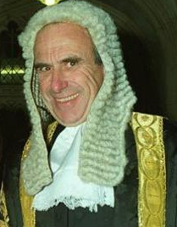
Element 2: Special Injury
“The plaintiff has to prove that he suffered particular damage greater than that suffered by members of the public in general. This rule offers considerable scope for dispute on the facts and some of the decisions on injurious affection reflect different judicial views on what amounts to particular damage”: Wildtree Hotels Ltd v Harrow LBC [2001] 2 AC 1 at 7 [2], per Lord Hoffmann.
Greenhouse gases -> global warming -> affects everyone -> how can NYE claim they will suffer “special damage”?
A possibility: their ages (14-23) -> average life expectancy = c. 80 years.
Young people more greatly affected than older folks by global warming.
Is it therefore arguable that special damage is made out here?

Slide 13

Element 3: Special Damage
Will the emissions from this project cause NYE members to suffer some kind of personal injury or damage?
Emissions from project = 2,000,000kg of CO_{2.}
Global CO₂ emissions in 2022 = 36.8 Gt.
A drop in the CO₂ ocean?
Test of causation: the alleged nuisance (from the factory development) need not be the sole or main cause of injury – could be one of many causes.
Is it arguable that special damage is made out here?

Slide 14

The upshot…
Tort of public nuisance is broad, ill-defined.
Frequently used in environmental litigation (esp. the US).
A real possibility of it being used in relation to construction & engineering projects that have a large CO₂ count.
Even if an injunction is refused, litigation may cause enormous disruption to a project (even an approved project).
Developers need to manage environmental issues including CO₂ emissions -> “being green” (in all its shades) is the best way to go…

Slide 15
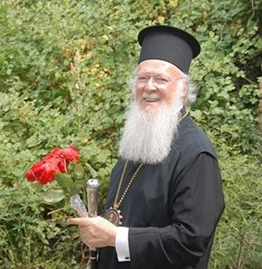
And finally…
His All Holiness the Ecumenical Patriarch of Constantinople – Bartholomew I – the “Green Patriarch”:
“We cannot expect to leave no trace on the environment. However, we must choose either to make it reflect greed and ugliness, or to use it in such a way that its beauty shows God’s handiwork through ours.”

Slide 16

Dinlediğiniz için teşekkürler!

