Slide 1
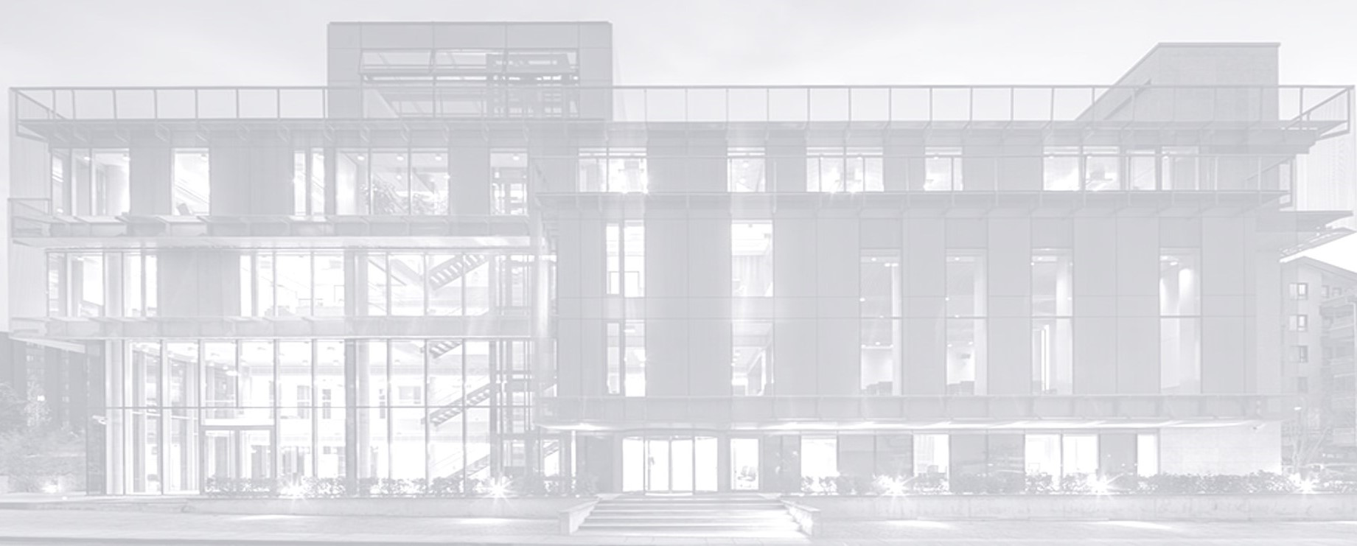

TURKISH
CONTRACTORS
ASSOCIATION
TURKISH INTERNATIONAL
CONTRACTING SERVICES
We build not only structures, but bridges
between time, people and spaces...
Ms. Çiğdem Çınar
Deputy Secretary General

Slide 2
‘‘TCA is a non-governmental, non-profit, independent professional organization
established in Ankara in 1952
which represents 130 leading construction and contracting companies of Türkiye.’’
About
TCA

Slide 3






INTERNATIONAL
MEMBERSHIPS !
CONFEDERATION of INTERNATIONAL CONTRACTORS' ASSOCIATIONS
(CICA)
GLOBAL ALLIANCE for BUILDINGS and CONSTRUCTION
(GLOBALABC)
EUROPEAN INTERNATIONAL CONTRACTORS
(EIC)
FEDERATION of CONTRACTORS from ISLAMIC COUNTRIES
(FOCIC)
WORLD WATER
COUNCIL
(WWC)

Slide 4
STRENGTHS OF THE TURKISH CONTRACTORS
Credibility in partnerships
Rich experience in diverse markets and project types
Cost effective service at
international standards
Risk-taker, competitive and dynamic
businessmen experienced to work
in international partnerships
Logistic advantages due to the
strategic geographic location
of Türkiye

Slide 5
International Activities of the Turkish Contractors (1972-2026/Jan.-May)
EUROPE 10.5%
138
countries
12.901 projects
562.6 billion USD
EURASIA 42.7%
MIDDLE EAST 25.4%
AMERICAS 0.8%
SOUTH ASIA & FAR EAST 2.6%
AFRICA; 18.0%
Source: Ministry of Trade of Türkiye

Slide 6
ACTIVITIES BY COUNTRY
Source: Ministry of Trade of Türkiye

Slide 7
ACTIVITIES BY NATURE OF WORK
Source: Ministry of Trade of Türkiye

Slide 8
ANNUAL INTERNATIONAL CONTRACTING SERVICES (billion USD)
Source: Ministry of Trade of Türkiye

Slide 9

TOP MARKETS
2024
2025
2026 / (Jan.-May)
61 Countries
386 Projects
29.9 billion USD
55 Countries
309 Projects
22.5 billion USD
22 Countries
40 Projects
2.4 billion USD
UAE, 9 Projects, 6.5 billion USD
S. Arabia, 22 Projects, 4.1 billion USD
Uganda 2 Projects, 3.1 billion USD
Romania, 13 Projects, 4.8 billion USD
Iraq, 22 Projects, 3.4 billion USD
Turkmenistan, 4 Projects, 2.2 billion USD
Romania, 1 Projects, 0.7 million USD
Libya, 4 Projects, 0.6 million USD
Algeria, 8 Projects, 0.3 million USD

Slide 10

ACTIVITIES by REGIONS
1972-2026 (Jan. – May)

Slide 11
12 COUNTRIES
5627 PROJECTS
240.2 billion USD
Source: Ministry of Trade of Türkiye

Slide 12
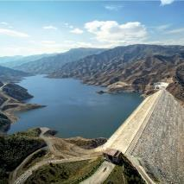
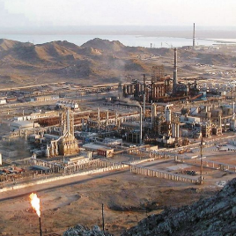
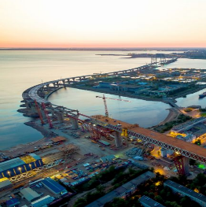
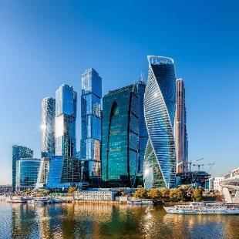
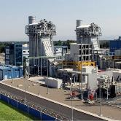
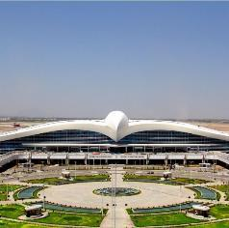
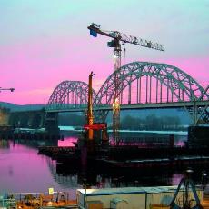
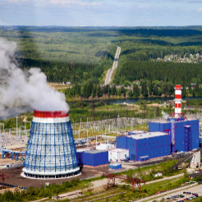
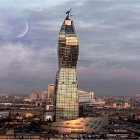
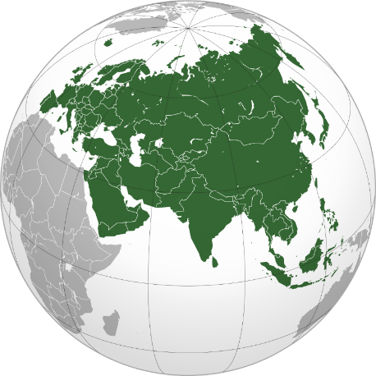
EURASIA
ŞEMKİRÇAY DAM, AZERBAIJAN
TÜRKMENBAŞI RAFINERY, TURKMENISTAN
ST. PETERSBURG MOTORWAY RUSSIAN FEDERATION
GARDABANİ POWER PLANT, GEORGIA
EVRİM TOWER, RUSSIAN FEDERATION
AŞKABAT INTERNATIONAL AIRPORT, TURKMENISTAN
SOCAR TOWER – AZERBAIJAN
KİEV DİNYEPER BRIDGE, UKRAINE
YAJVA POWER STATION, RUSSIAN FEDERATION

Slide 13
14 COUNTRIES
2425 PROJECTS
142.6 billion USD
MIDDLE EAST
Source: Ministry of Trade of Türkiye

Slide 14
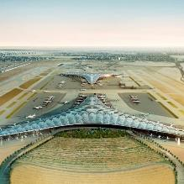
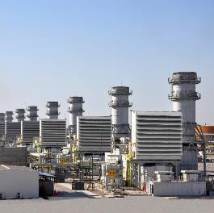
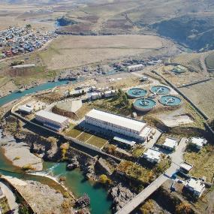
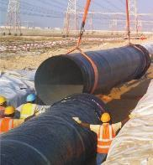
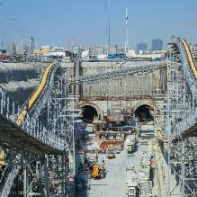
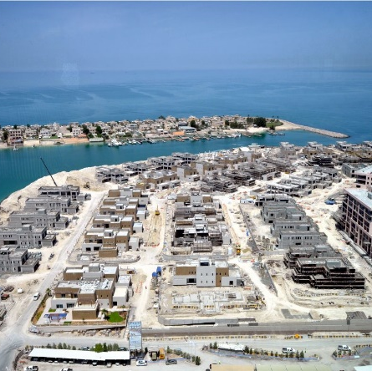
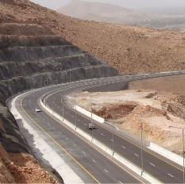
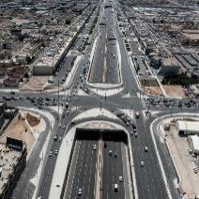
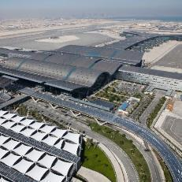
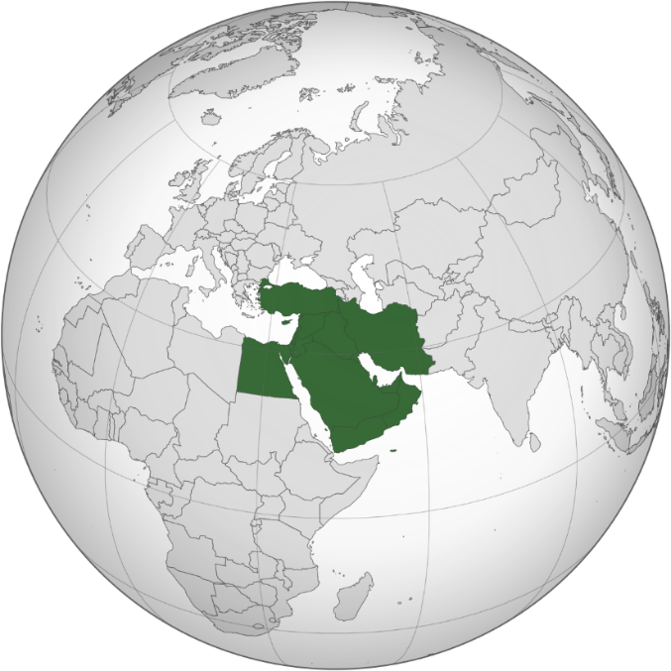
MIDDLE EAST
KUWAIT INTERNATIONAL AIRPORT, KUWAIT
AL-KHAIRAT POWER PLANT, IRAQ
ZAHO TREATMENT PLANT, IRAQ
MUSSAFAH WATER SUPPLY PROJECT, UAE
MARINA CITY PLOT, UAE
DOHA GOLD LINE METRO, QATAR
HAMAD INTERNATIONAL AIRPORT, QATAR
QURIYAT-SUR ROAD, OMAN
DOHA MOTORWAY SALWA ROAD, QATAR

Slide 15
34 COUNTRIES
1726 PROJECTS
59.2 billion USD
Source: Ministry of Trade of Türkiye

Slide 16
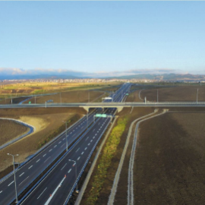
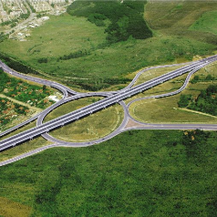
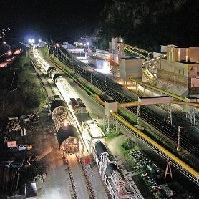
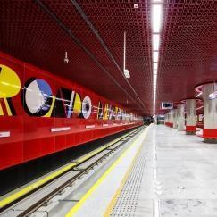
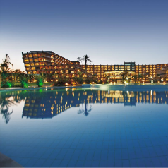
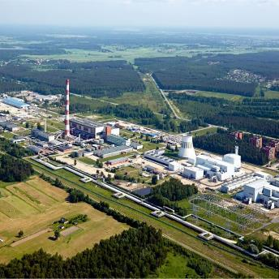
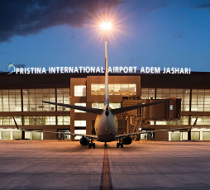
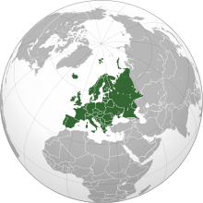
EUROPE
PRISTINA-ELEZ HAN MOTORWAY, KOSOVO
SOFIA RING ROAD, BULGARIA
GOTTHARD BASE TUNNEL, SWITZERLAND
WARSAW METRO LINE II, POLAND
NUHUN GEMİSİ HOTEL,
NORTH CYPRUS
POWER PLANT, LATVIA
PRISTINA INTERNATIONAL ADEM YASHARI AIRPORT, KOSOVO
SOFIA METRO EXPANSION PROJECT, BULGARIA

Slide 17
AFRICA
46 COUNTRIES
2106 PROJECTS
101.5 billion USD
Source: Ministry of Trade of Türkiye

Slide 18
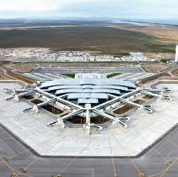
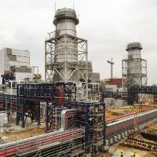
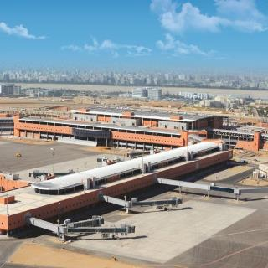
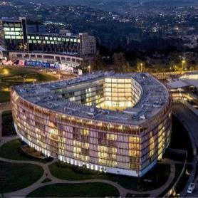
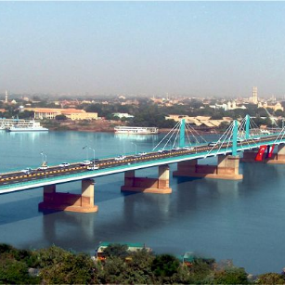
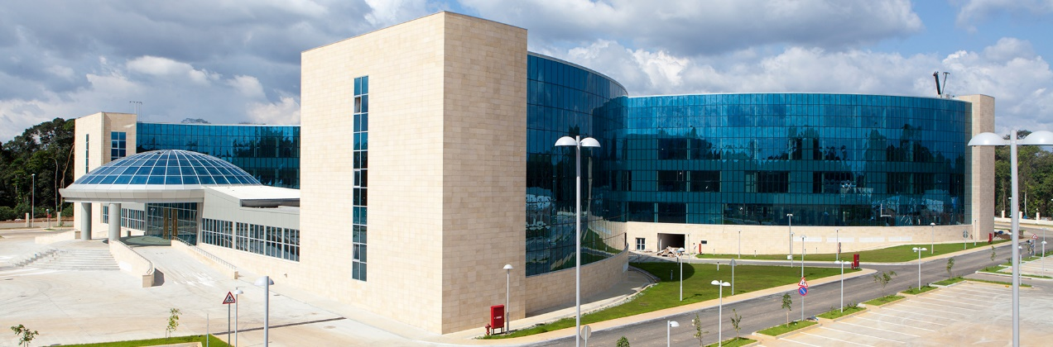
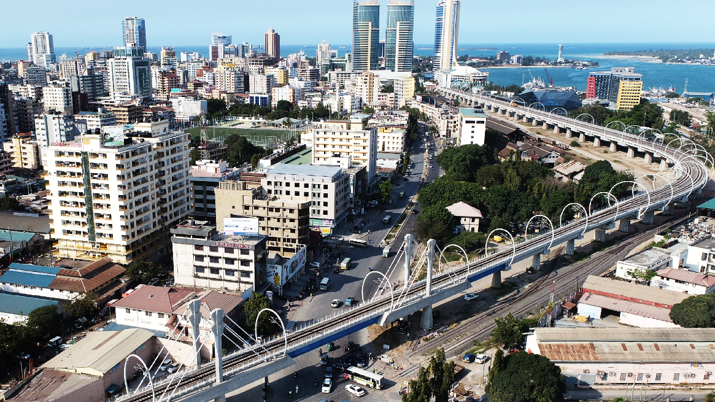
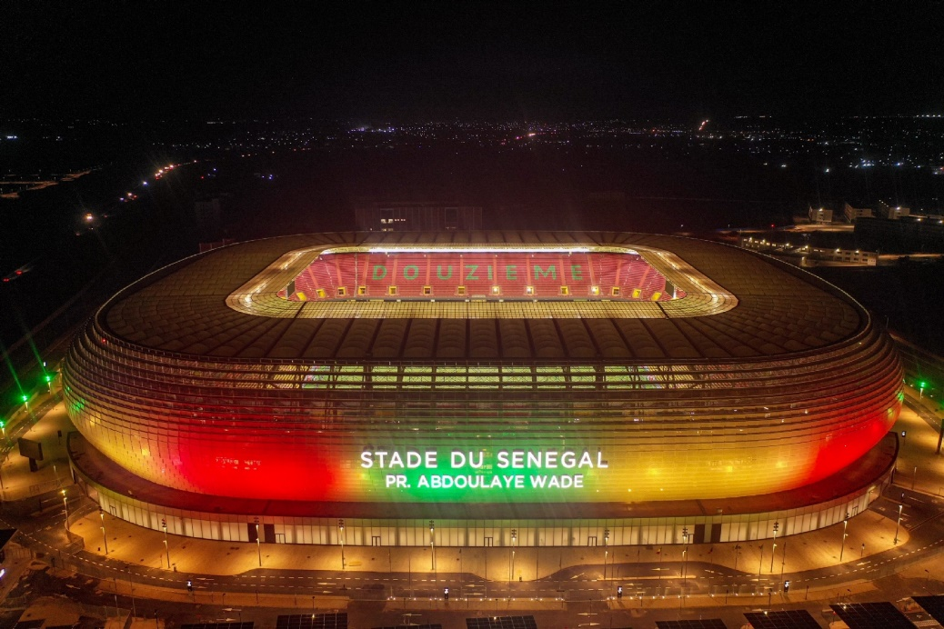
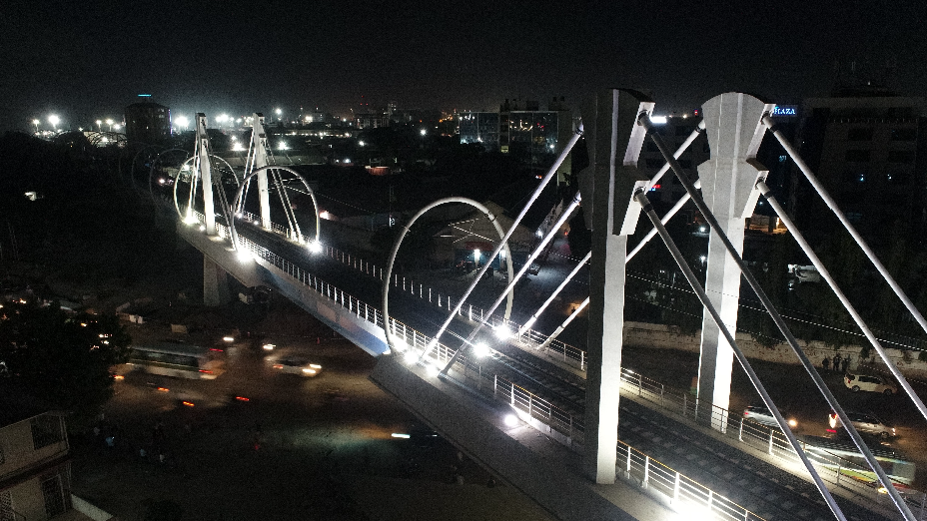
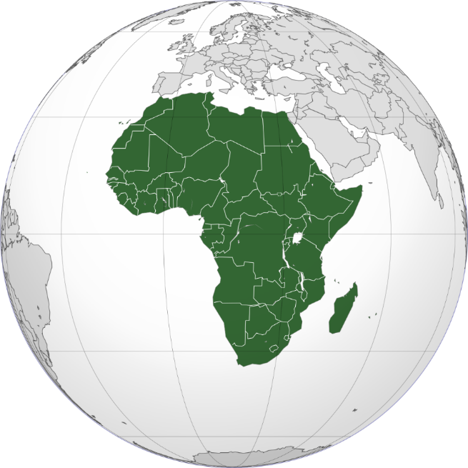
AFRICA
ENFIDHA HAMMAMET INTERNATIONAL AIRPORT, TUNUSIA
CAIRIO INTERNATIONAL AIRPORT TERMINAL BUILDING, EGYPT
BOUFARIK POWER PLANT, ALGERIA
KIGALI CONGRESS CENTER, RUANDA
OYALA GOVERNMENT BUILDING,
EQUATORIAL GUINEA
EL MEK NIMIR BRIDGE-SUDAN
DAR ES SALAAM VIADUCT, TANZANIA
NKRUMAH BRIDGE, TANZANIA
SENEGAL STADIUM, SENEGAL

Slide 19
SOUTH ASIA & FAR EAST
18 COUNTRIES
921 PROJECTS
14.5 billion USD
Source: Ministry of Trade of Türkiye

Slide 20
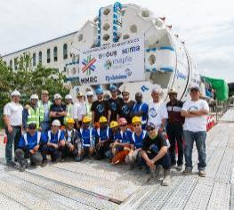
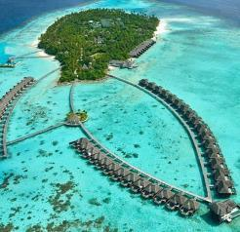
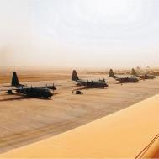
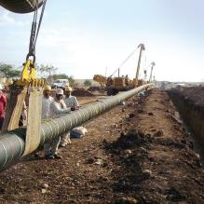
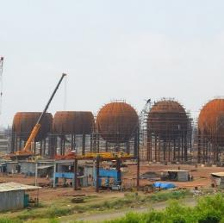
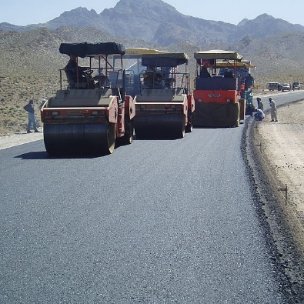
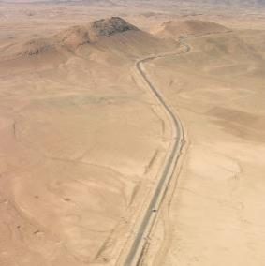
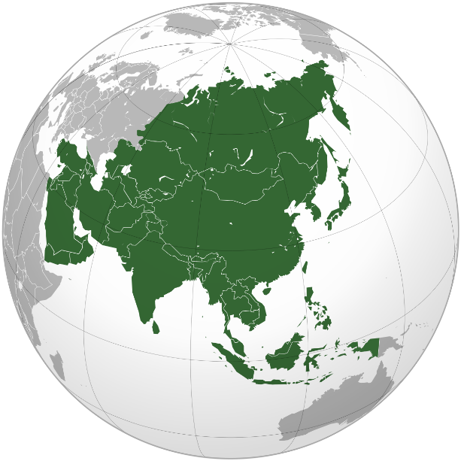
SOUTH ASIA & FAR EAST
AYADA RESORT, MAGUDHDUVAA ISLAND MALDIVES
MUMBAI METRO, INDIA
CAMP BASTION APRON AFGHANISTAN
KOYALI-RATLAM PIPE LINE ,INDIA
KANDAHAR-HERAT ROAD, AFGHANISTAN
DAHEJ
PETROCHEMICAL PLANT, INDIA
KABIL-KANDAHAR ROAD- AFGHANISTAN

Slide 21
AMERICAS
14 COUNTRIES
96 PROJECTS
4.6 billion USD
Source: Ministry of Trade of Türkiye

Slide 22
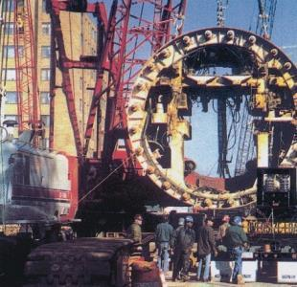
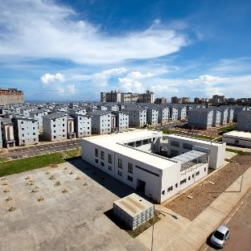
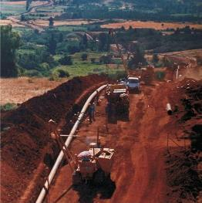



AMERICAS
GREENBELT METRO TUNNELS, USA
VARGAS PLAYA GRANDE SOCIAL HOUSING COMPLEX, VENEZUELA
GASODUCTO PIPE LINE,
CHILE
THE MARMARA MANHATTAN HOTEL, USA
NASSAU CRUISE PORT, BAHAMAS

Slide 23


Slide 24



Thank You!
TURKISH CONTRACTORS ASSOCIATION
Birlik Mahallesi, Doğukent Bulvarı, 447. Sokak No:4, Çankaya, 06610 Ankara, TÜRKİYE
Tel : 90 (312) 440 81 22 • Fax: 90 (312) 440 02 53 • e-mail : tmb@tmb.org.tr • web : www.tmb.org.tr
x / TMB_TCA
linkedin / tmborgtr
instagram / TMB_TCA

