Slide 1
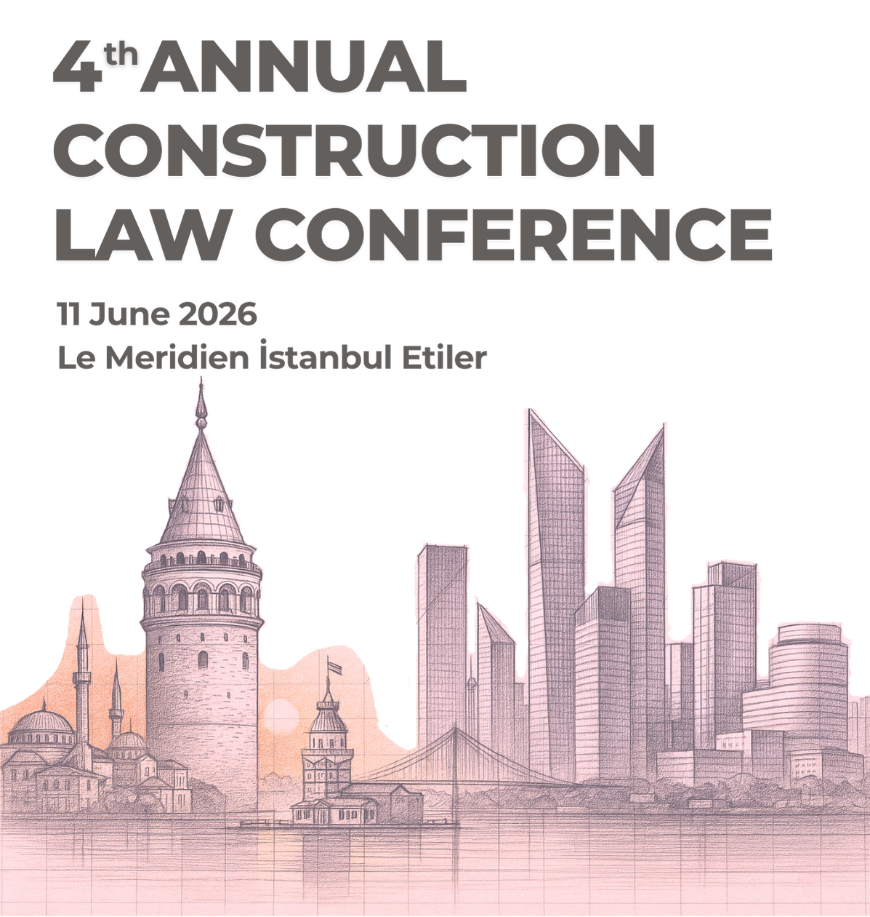

Multidisciplinary Literacy
A Critical Skill for Construction Dispute Resolution
Ekrem Kaya
Partner, HKA & Vice President SCL Türkiye
June 11, 2026 - Istanbul

Slide 2
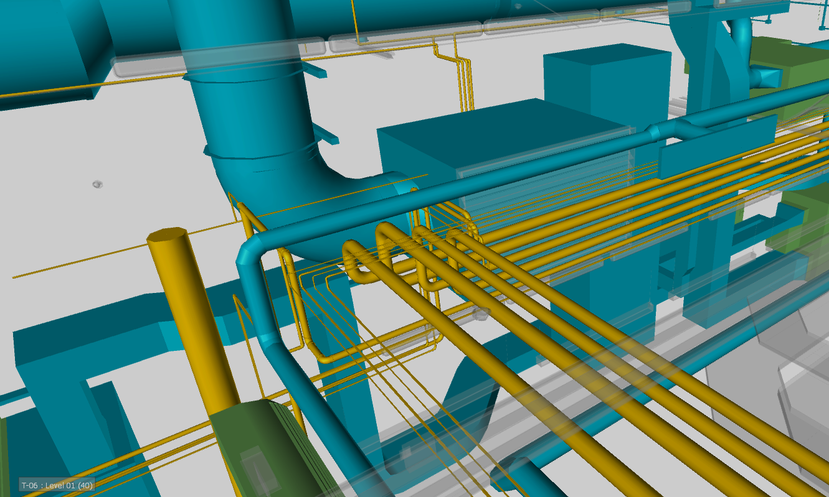
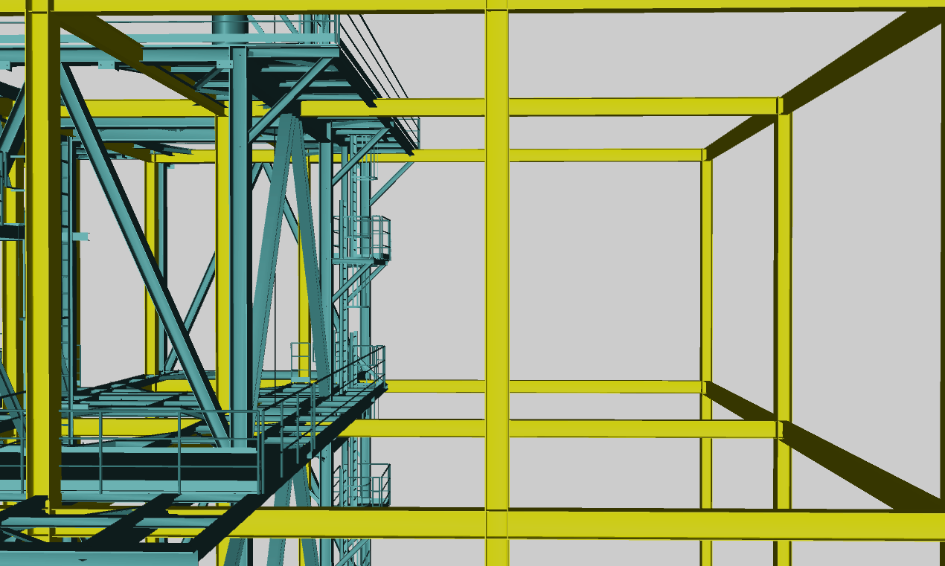
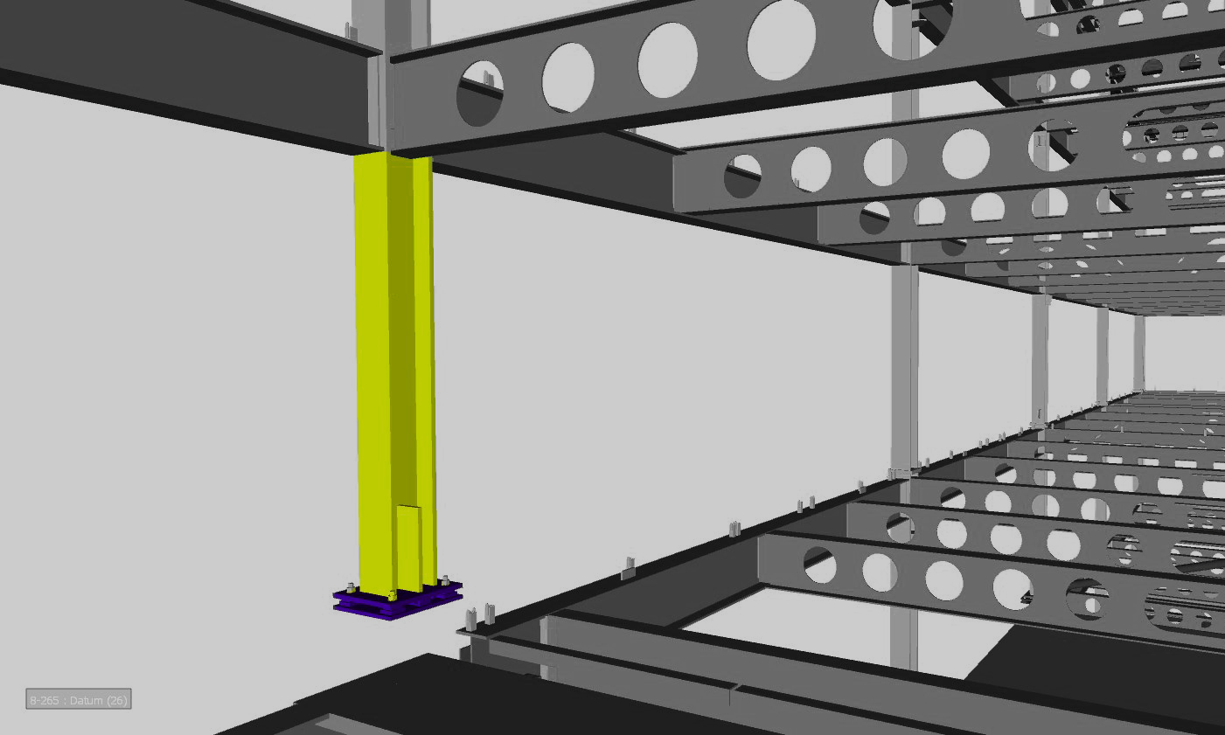
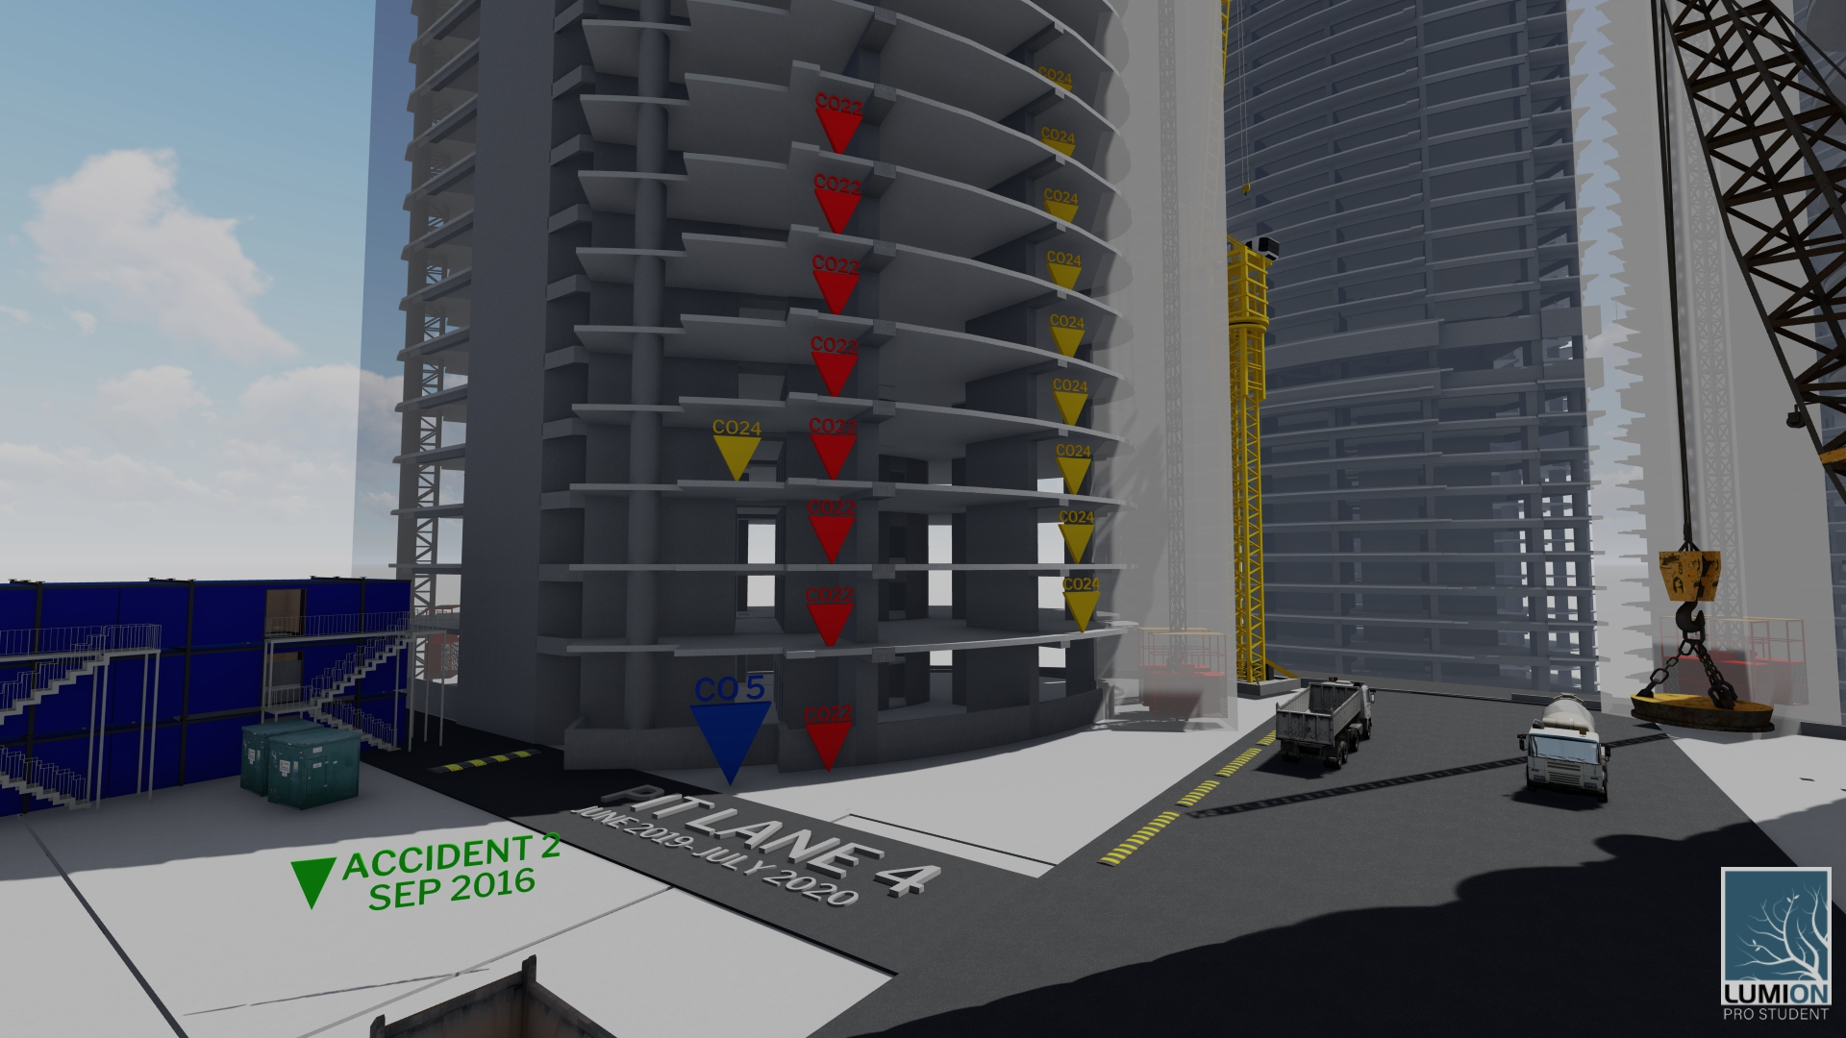
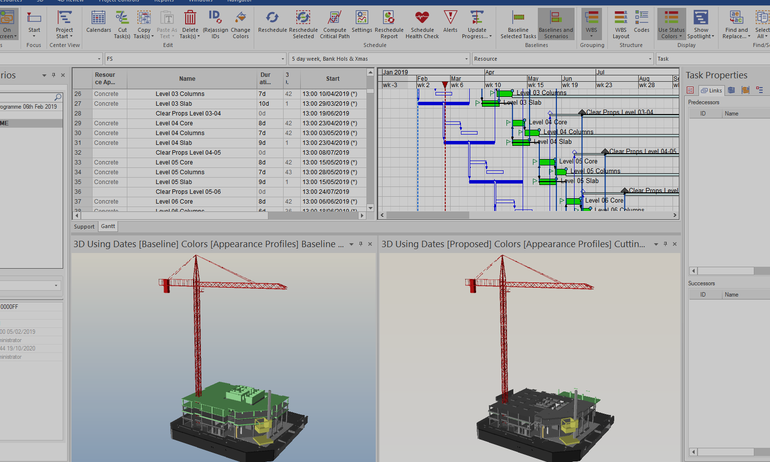
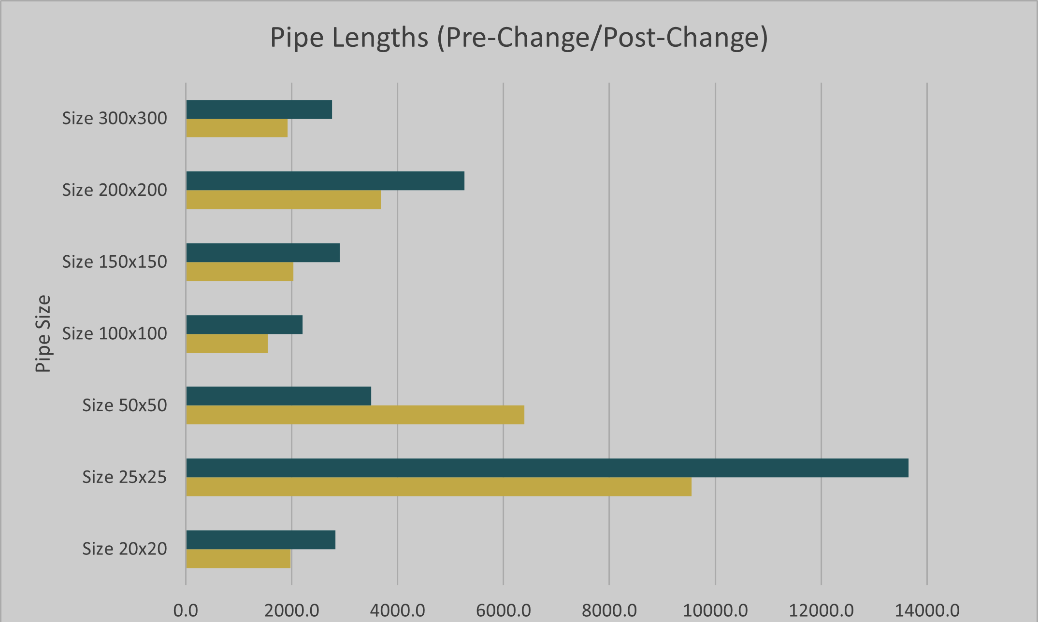
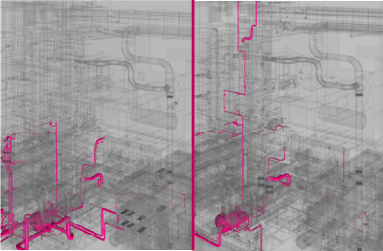
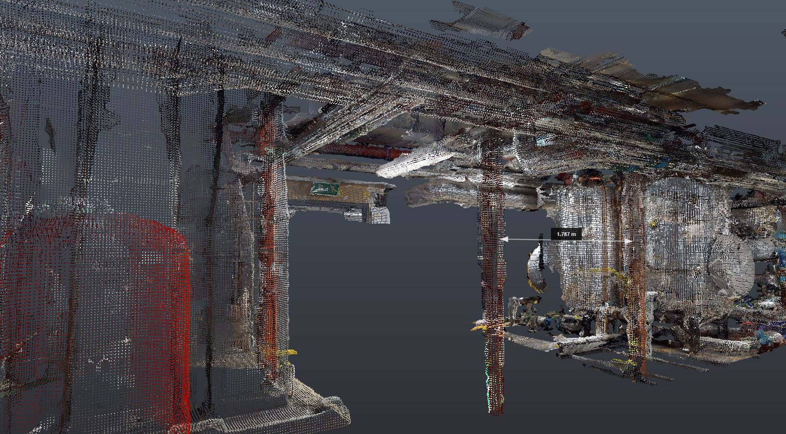


Why This Topic Matters
Construction disputes rarely arise within a single discipline.
They usually emerge at the interfaces between disciplines.

Slide 3
Central Proposition
The challenge is not a lack of expertise.
The challenge is connecting expertise across disciplines.

Slide 4
What is Multidisciplinary Literacy?
Understanding interactions between disciplines
Identifying failures at interfaces
Explaining complex issues clearly
Connecting technical, contractual and commercial perspectives

Slide 5
Project Reality
Design ↔ Procurement ↔ Construction ↔ Testing & Commissioning ↔ Operations
Problems often emerge at the handovers and interfaces.

Slide 6
Where Disputes Actually Arise
• Structural vs MEP coordination
• Design vs programme constraints
• Procurement vs construction sequence
• Testing vs contractual completion

Slide 7
Where Disputes Are Decided
Dispute Boards
Adjudication
Arbitration
Litigation
Decision-makers need integrated explanations, not isolated expertise.

Slide 8
How Multidisciplinary Literacy is Developed
• Project exposure
• Cross-disciplinary collaboration
• Curiosity beyond your specialism
• Learning from other experts
• Continuous professional development

Slide 9
The Role of AI
AI can:
• Accelerate learning
• Explain unfamiliar concepts
• Connect knowledge domains
• Support analysis

Slide 10
The Limits of AI
AI cannot:
• Replace judgment
• Understand project realities fully
• Determine significance on its own
• Replace experience

Slide 11
Practical Examples
Delay and system integration
2. Testing and commissioning
3. Scope reallocation and provisional sums

Slide 12
A Framework
Knowledge within disciplines
↓
Understanding across disciplines
↓
Integrated analysis
↓
Clear communication
↓
Better dispute resolution

Slide 13
Key Takeaways
• Disputes arise at interfaces
• Understanding matters more than information
• AI supports multidisciplinary learning
• Human judgment remains essential

Slide 14
Thank You
Questions & Discussion

