Slide 1
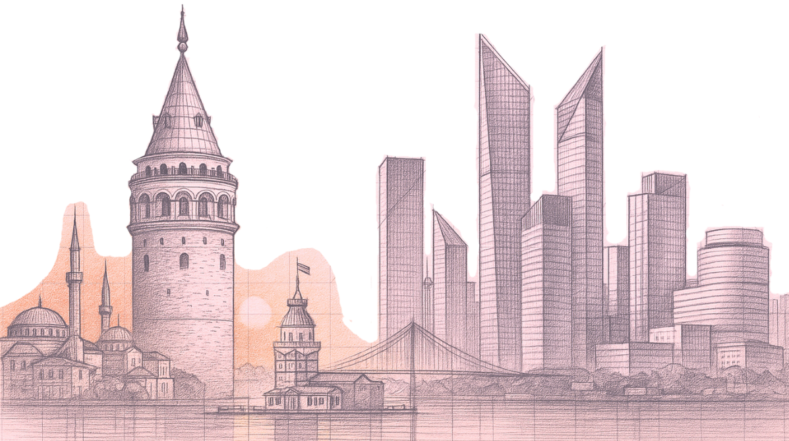
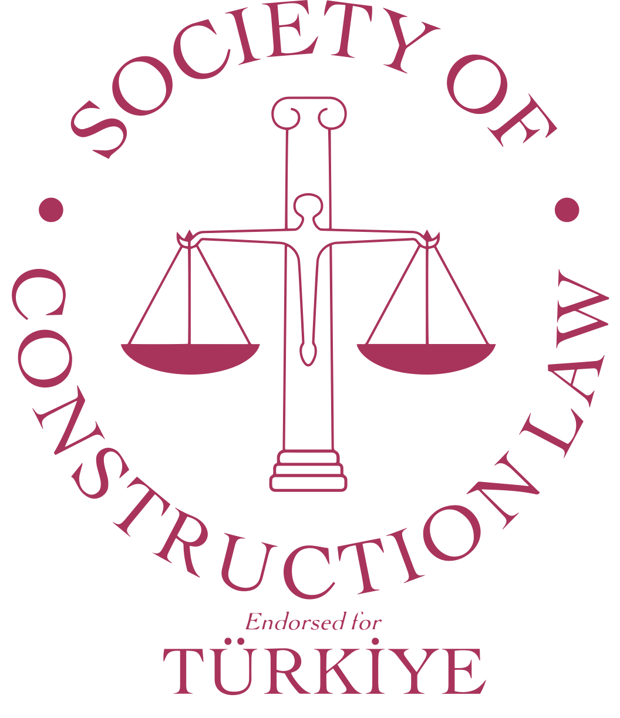
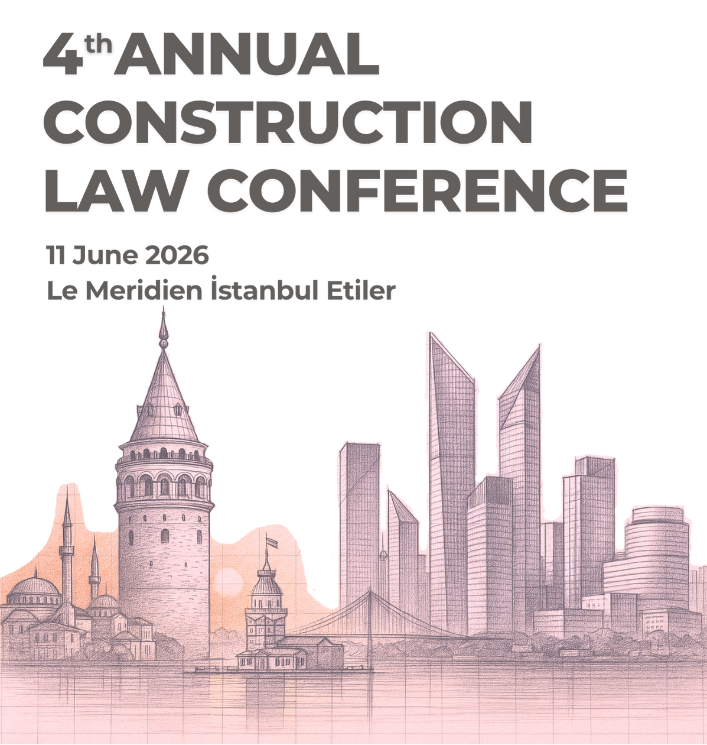
Istanbul Arbitration Centre
Yasin EKMEN
Secretary General
June 11, 2026 - Istanbul

Slide 2
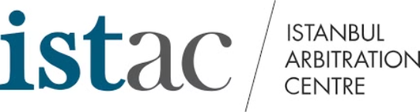
Arbitration in Türkiye
Turkish law based on UNCITRAL Model Law
High Amount, Mid Size and Small Disputes
Sanctions, Travel and Payment restriction
Neutrality
New York Convention
Turkish Courts

Slide 3

International
Freedom to choose
  Arbitrators
  Foreign Attorneys
  Language
  Applicable Law
  Seat of Arbitration
  Strong Board
  Competitive Costs
  E-Visa
  Easy to fly
  Istanbul

Slide 4
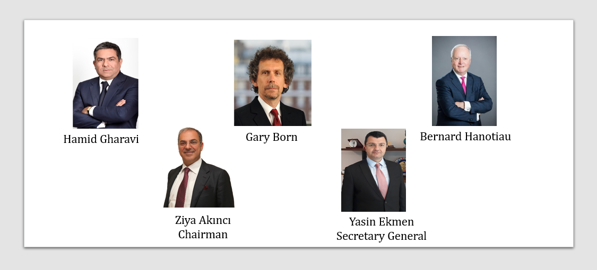
ISTAC International Board Members

Slide 5
ISTAC Rules
Familiar Rules
Emergency Arbitration
Fast Track Arbitration
Med-Arb Rules

Slide 6
Statistics: 263 cases in 2025

Slide 7
Disputed Areas

Slide 8
Nature of Construction Disputes
Complex Structure: Multi-party relationships (employers, contractors, subcontractors, consultants) spanning over long periods.
Dispute Types at ISTAC:
Extension of time (EOT) and liquidated damages
Progress payments and claims for variations/additional works
Material quality issues and allegations of defective performance
Adaptation
Consultation

Slide 9
ISTAC for Construction Disputes
Trustworthy
Strong Board
Cost effective
Easy Access
Enforcement
Expert Arbitrators
Speed

Slide 10
Nationalities of the Parties

Slide 11
Proportion of Female and Male Arbitrators

Slide 12
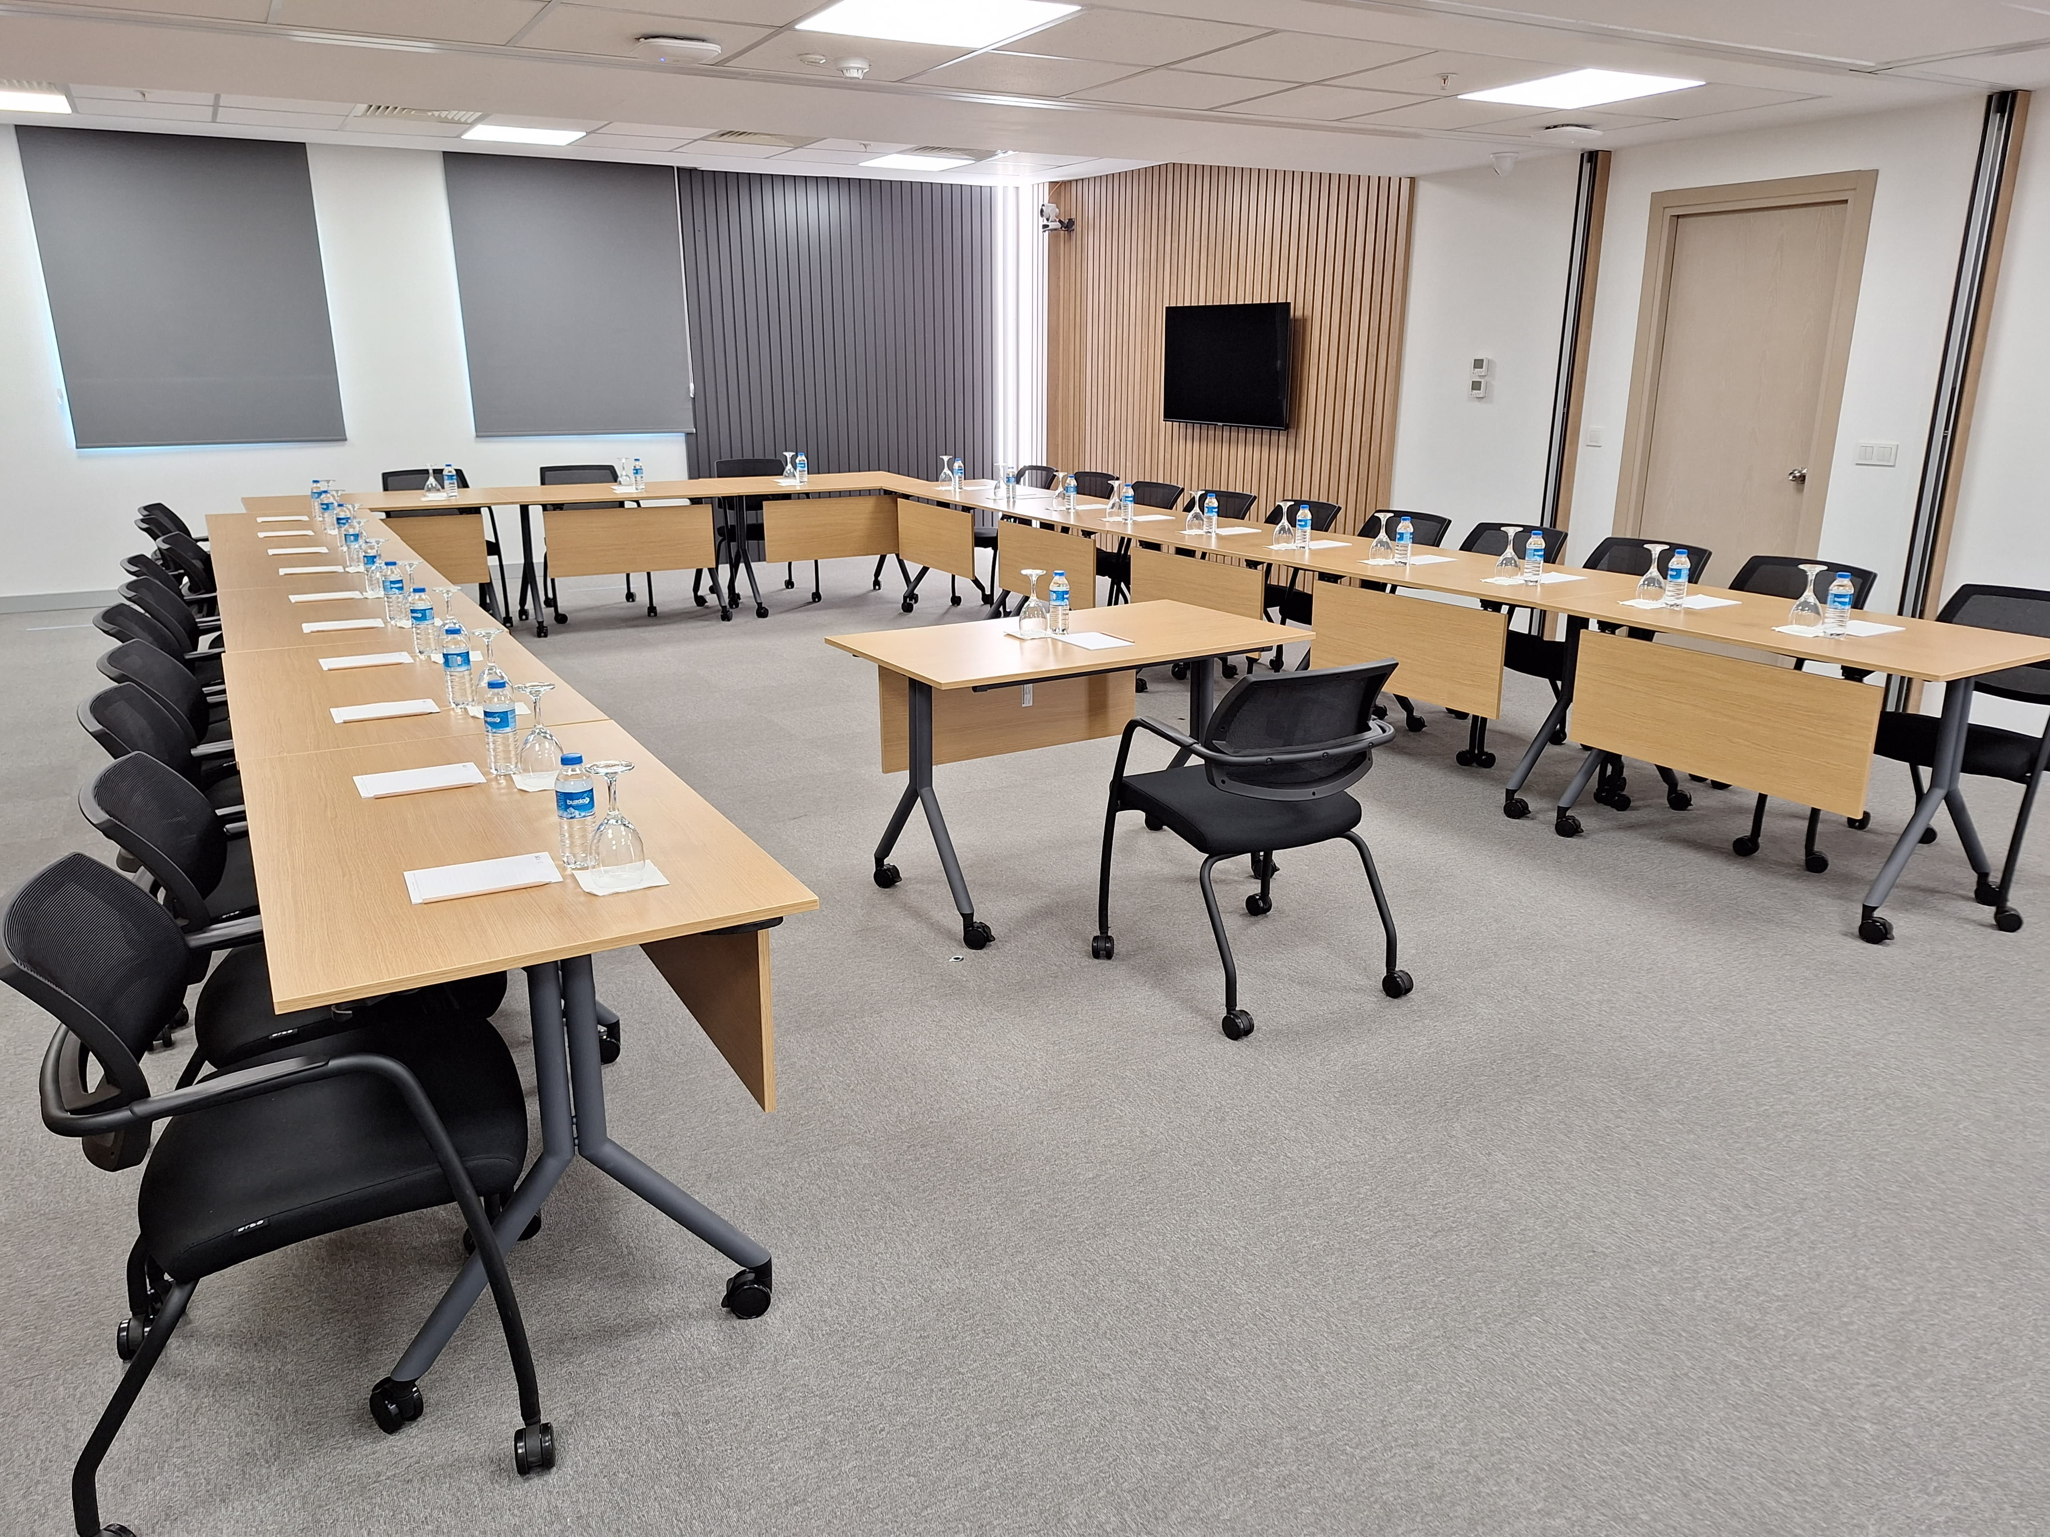
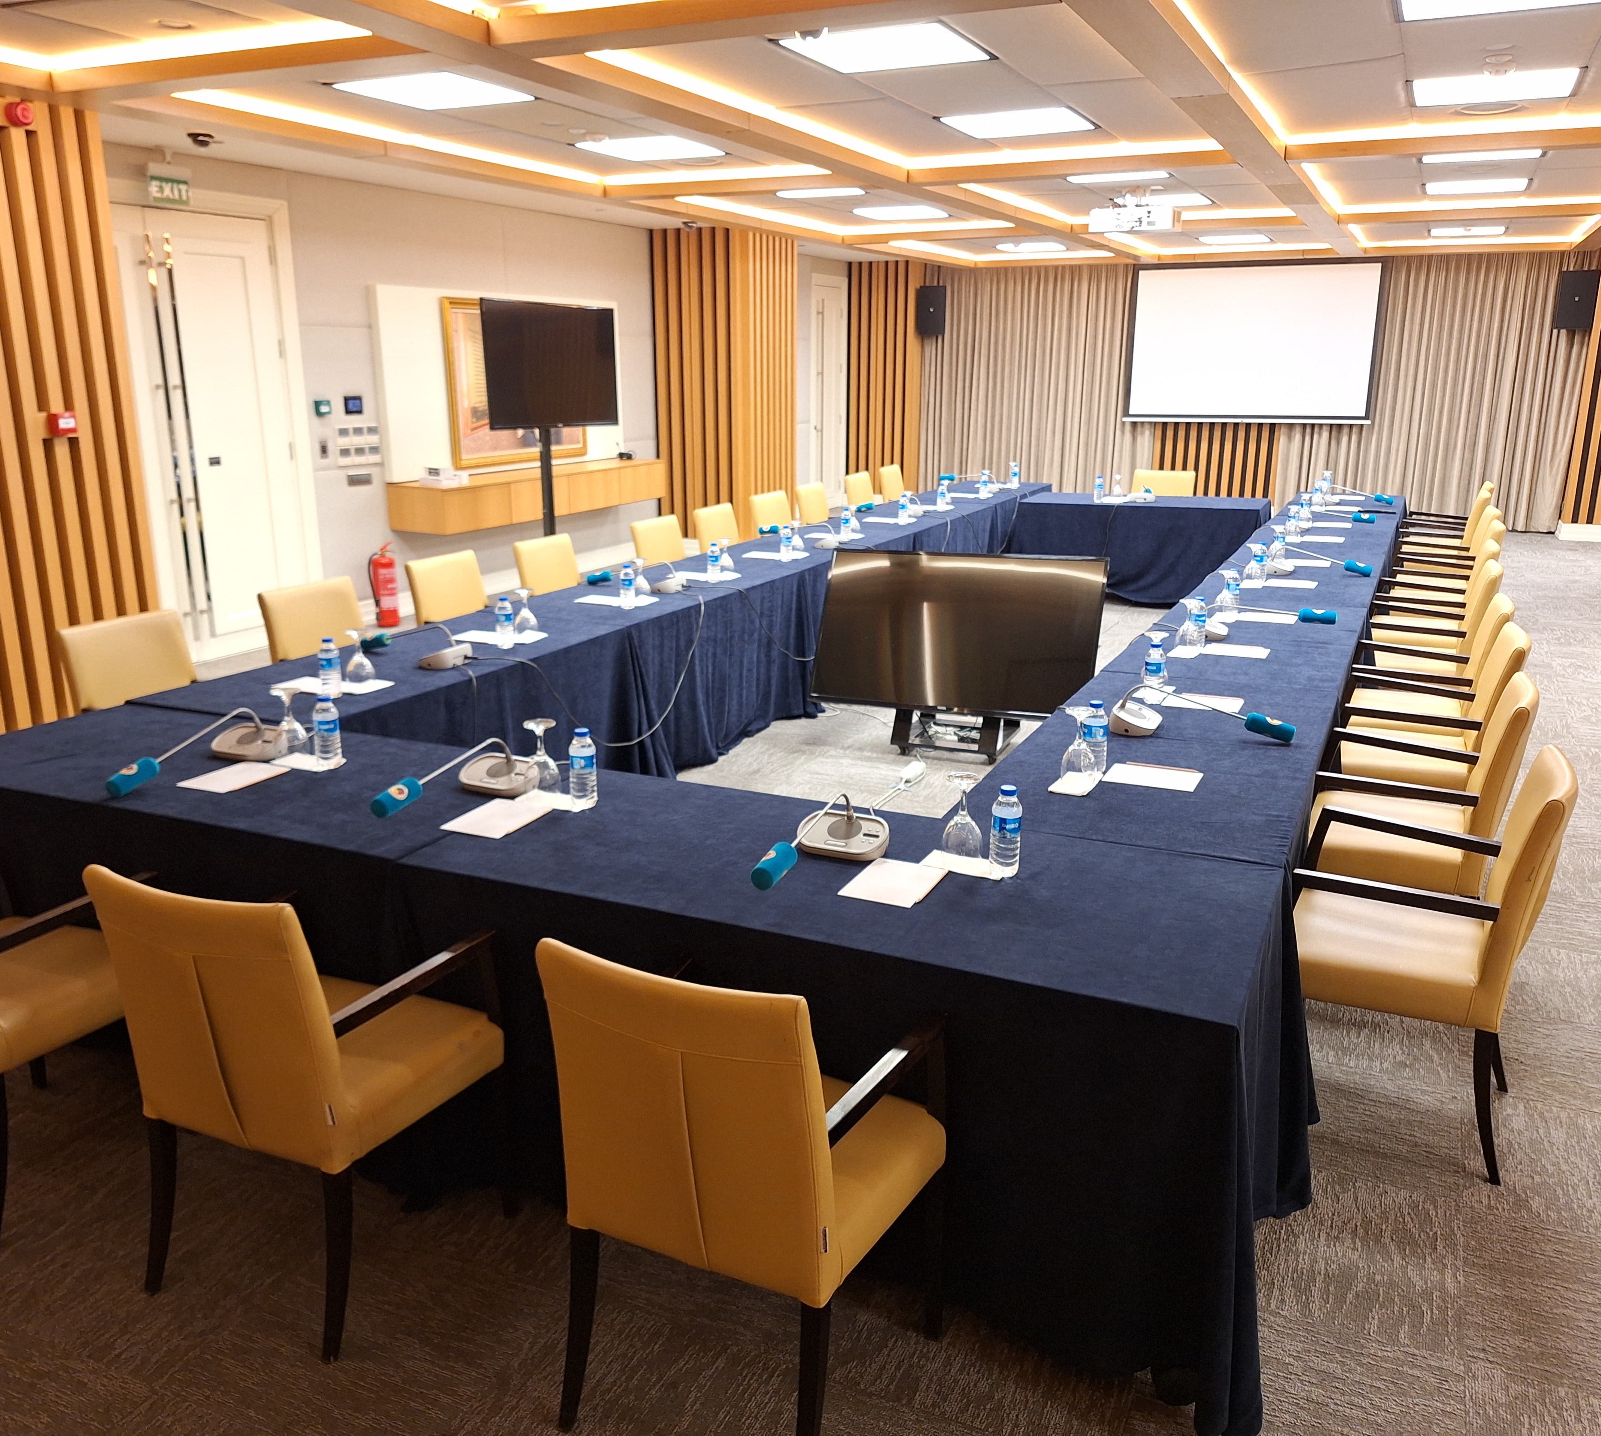
Hearings
Modern and Well-equiped facilities
Hybrid or online hearing
Assitance by the Secretariat

Slide 13
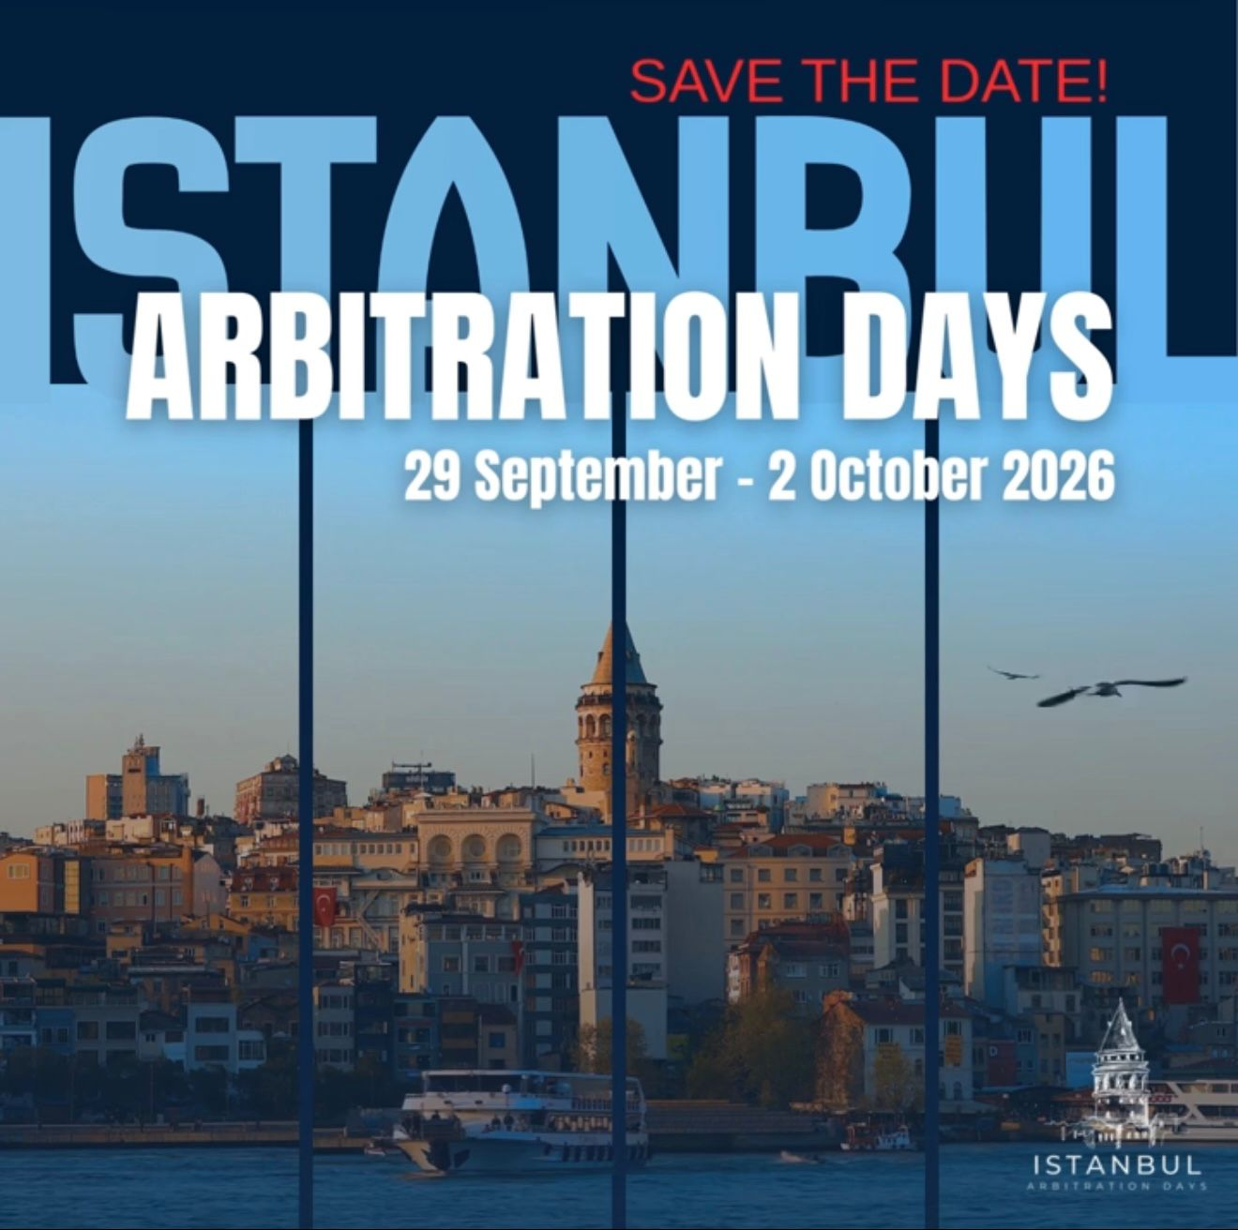

Slide 14
Thank you!

