Slide 1


Dispute Boards: The Good, The Bad, and The Ugly
Levent Irmak
Managing Director, MC2 MODERN
June 11, 2026 - Istanbul

Slide 2

The Dispute Board
Present from day one.
Three human neutrals.
Real expertise.
Real observations.

Slide 3
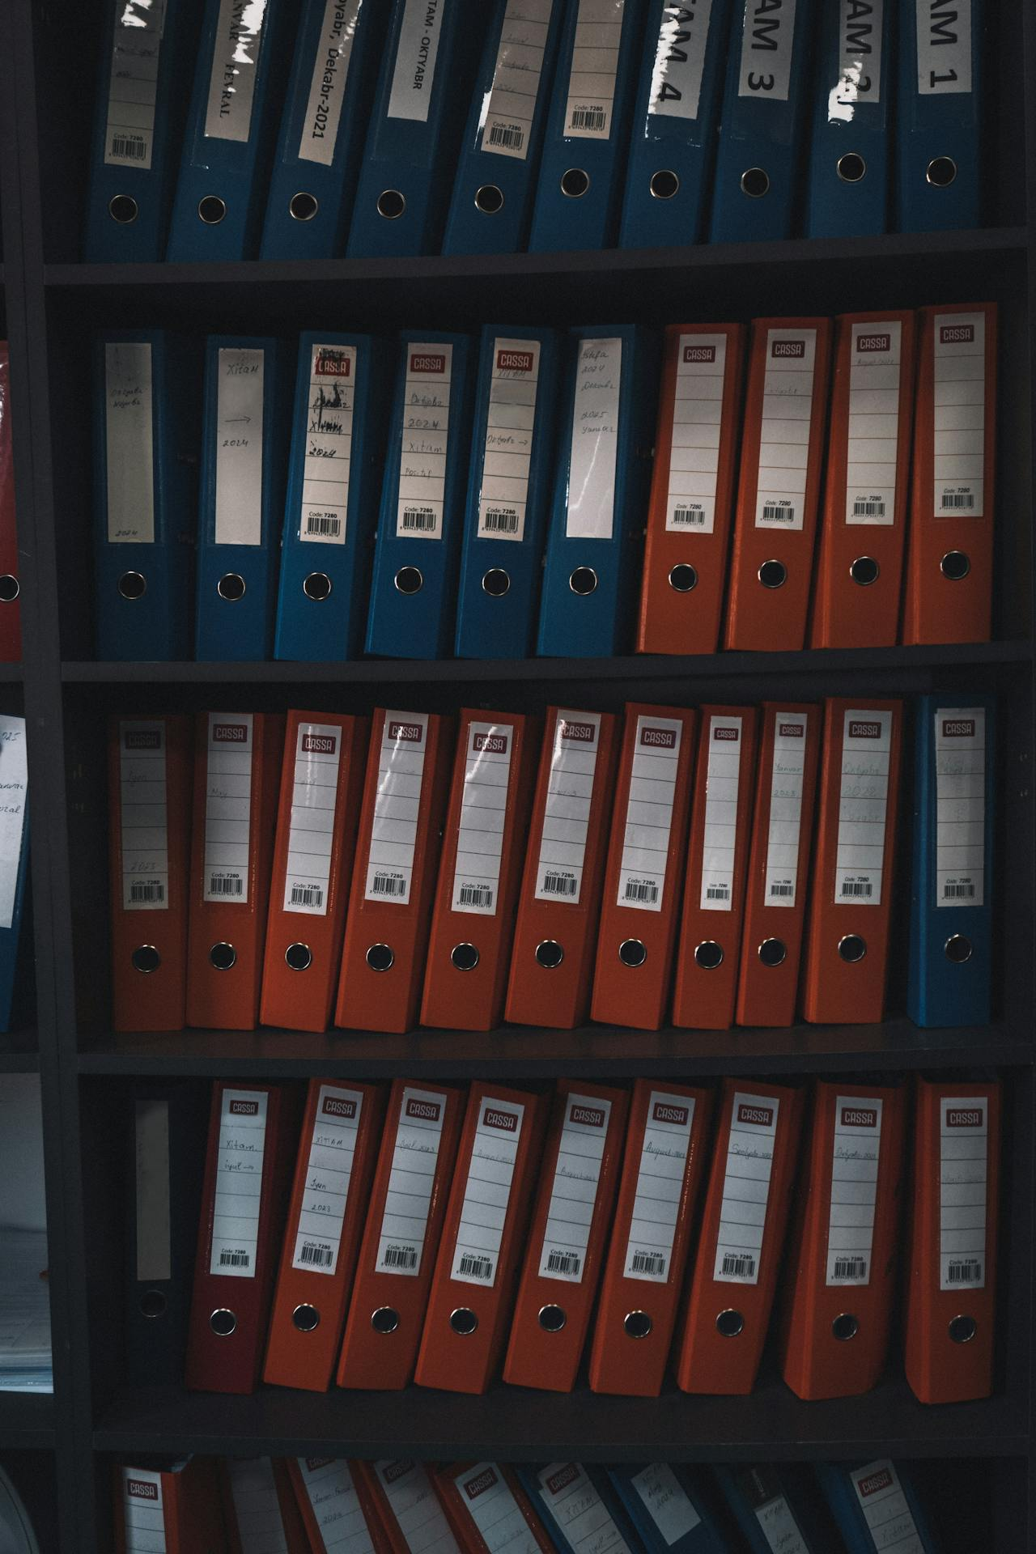

The Dispute Referral
Thousands of pages of Project records
- Claim documents
- Correspondence files
- Schedules
- Site Records
- Cost records, etc.

Slide 4

The Unappointed Member

Slide 5

Silent assistant
Sifts, summarizes and maps out critical project data and timelines across vast databases
Saves weeks/months of administrative labor

Slide 6
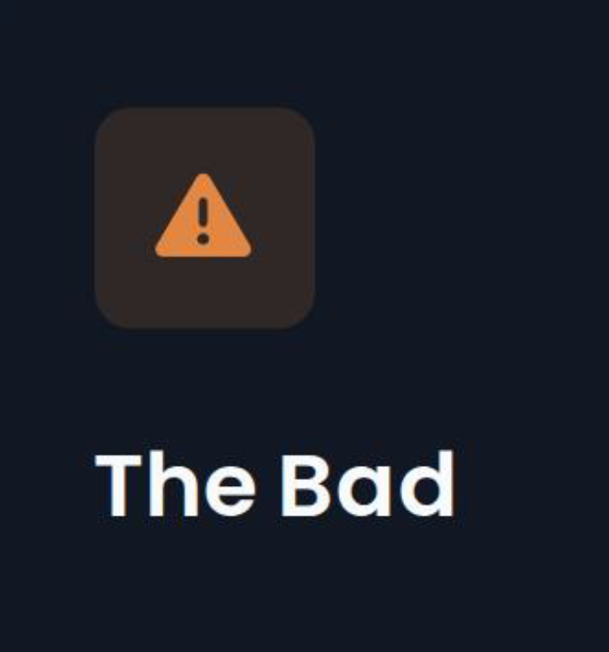


An unchecked agent
Operating without strict validation
Threatening absolute confidentiality
Hallucinatory facts

Slide 7
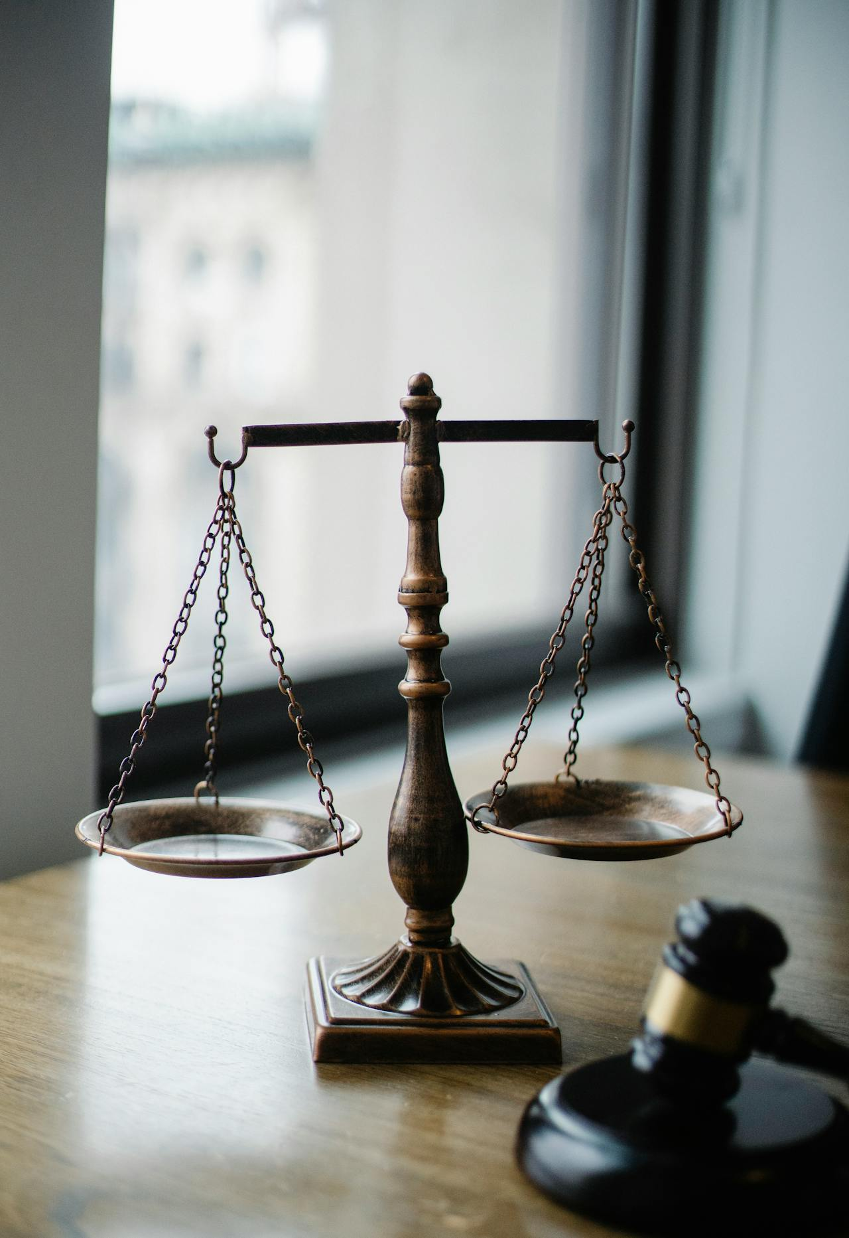
The abdication of human judgment
Blindly delegating critical evaluations to AI models
Replacing human wisdom with silent code

Slide 8
Final Notes & Takeaways
AI is an indispensable silent assistant (the scanner and the doctor).
The duty to reason, keep confidence and judge independently is of the Dispute Board.
The Dispute Board must always verify/double-check what the AI asserts.
Let the AI read, and let the DB keep its own hand on the pen!

Slide 9
Thank you for your attention!
Levent Irmak
Managing Director, MC2 MODERN

