Slide 1
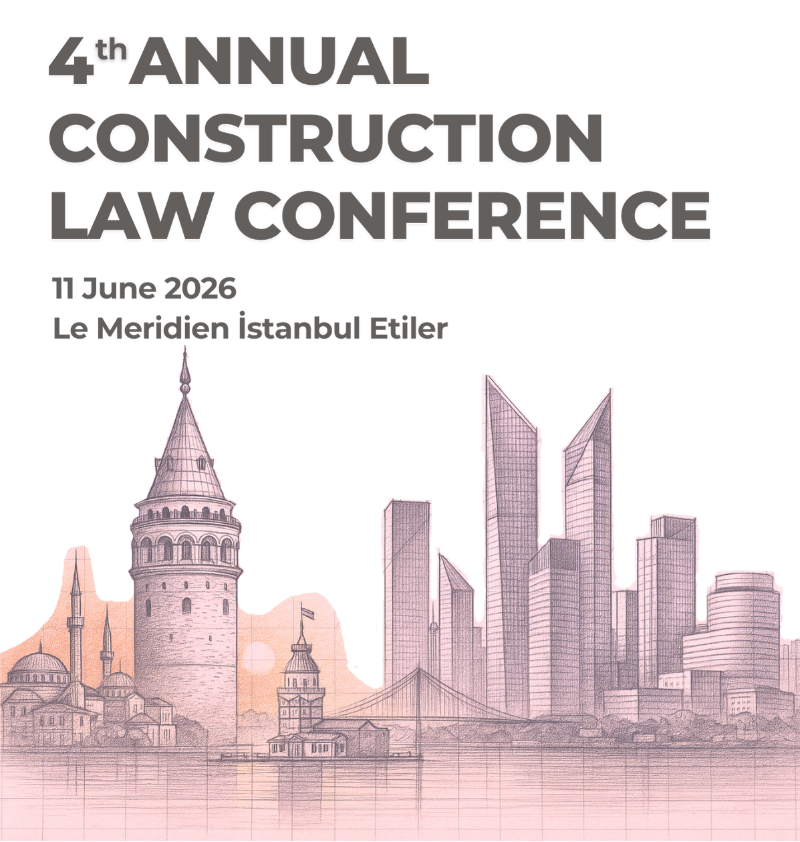
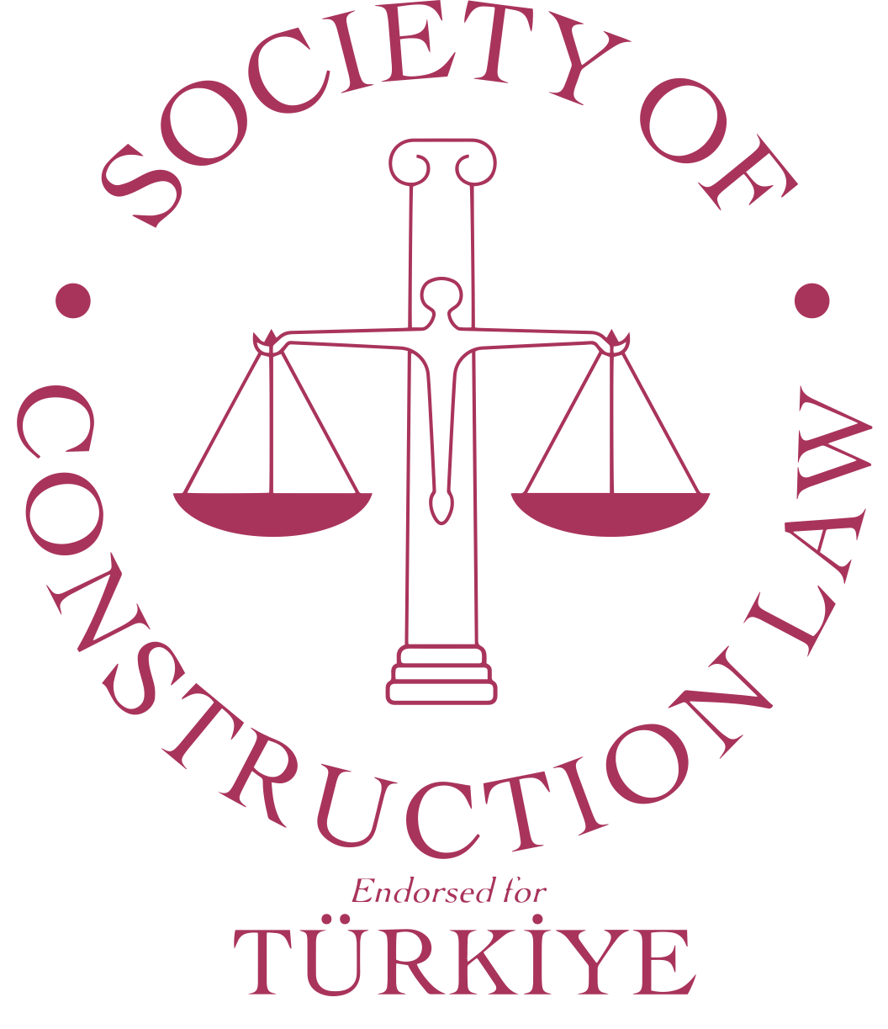
Beyond the hype:
AI as a tool for efficiency in construction arbitration
Matei Purice
Counsel, Freshfields
June 11, 2026 - Istanbul

Slide 2
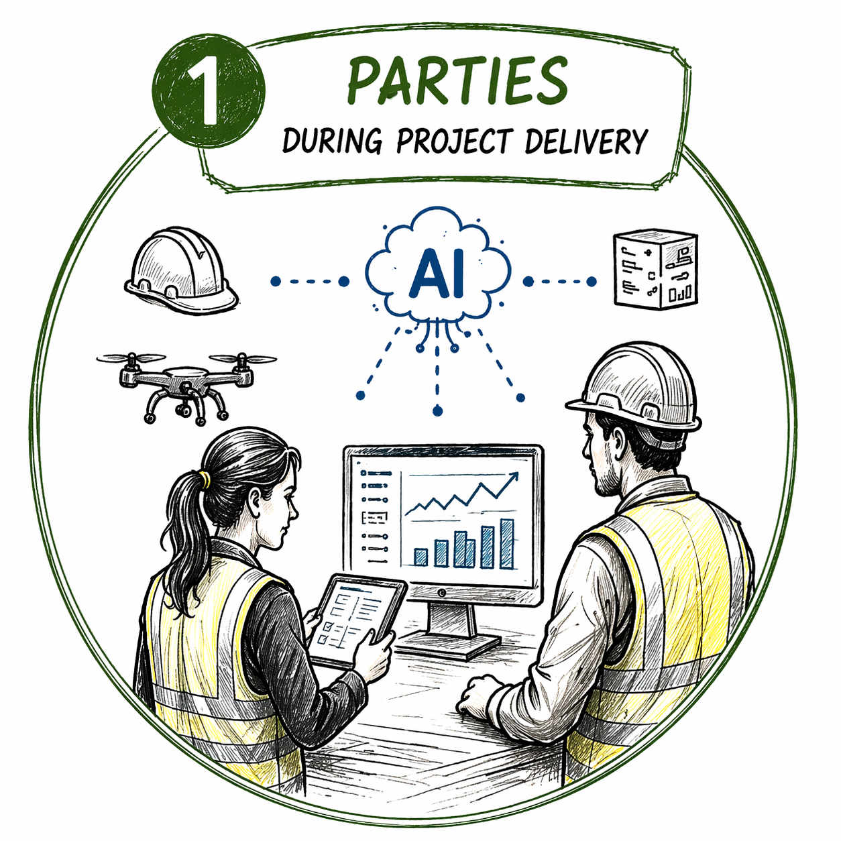

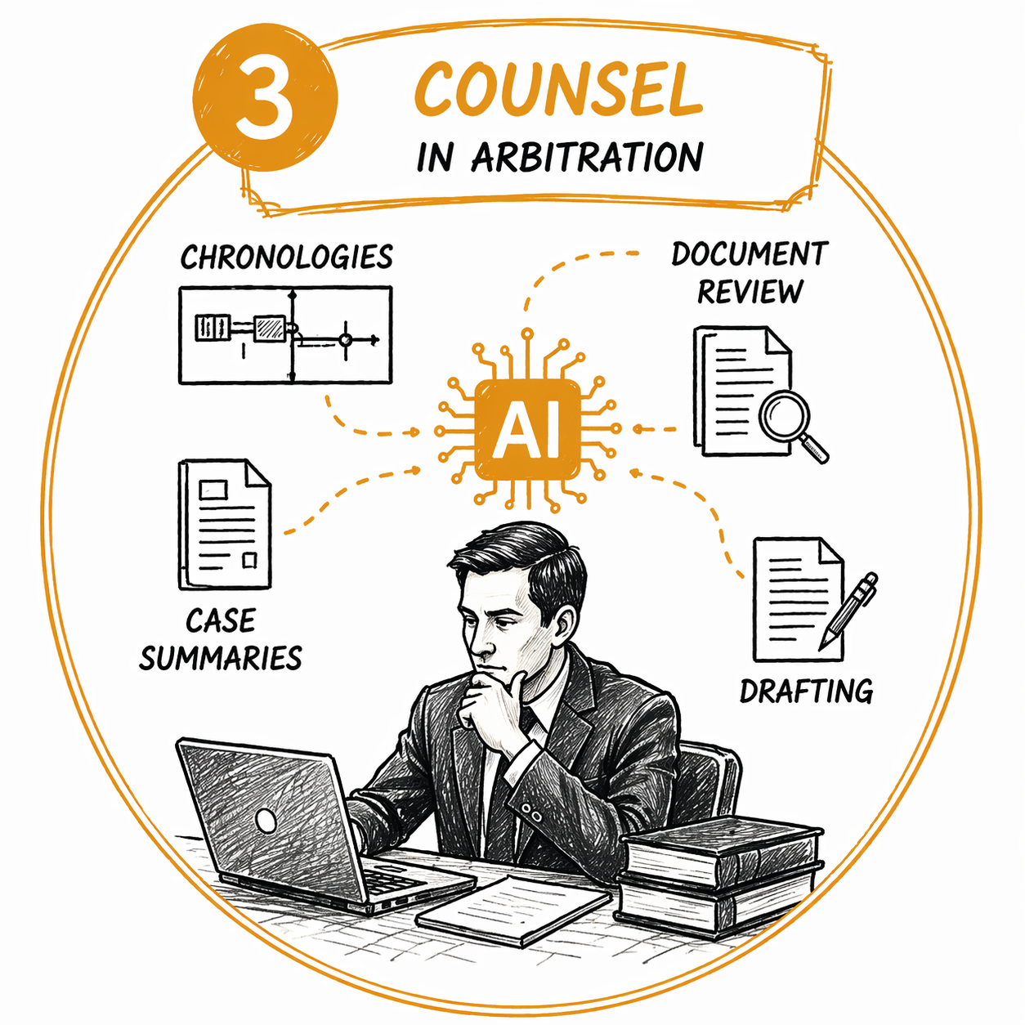
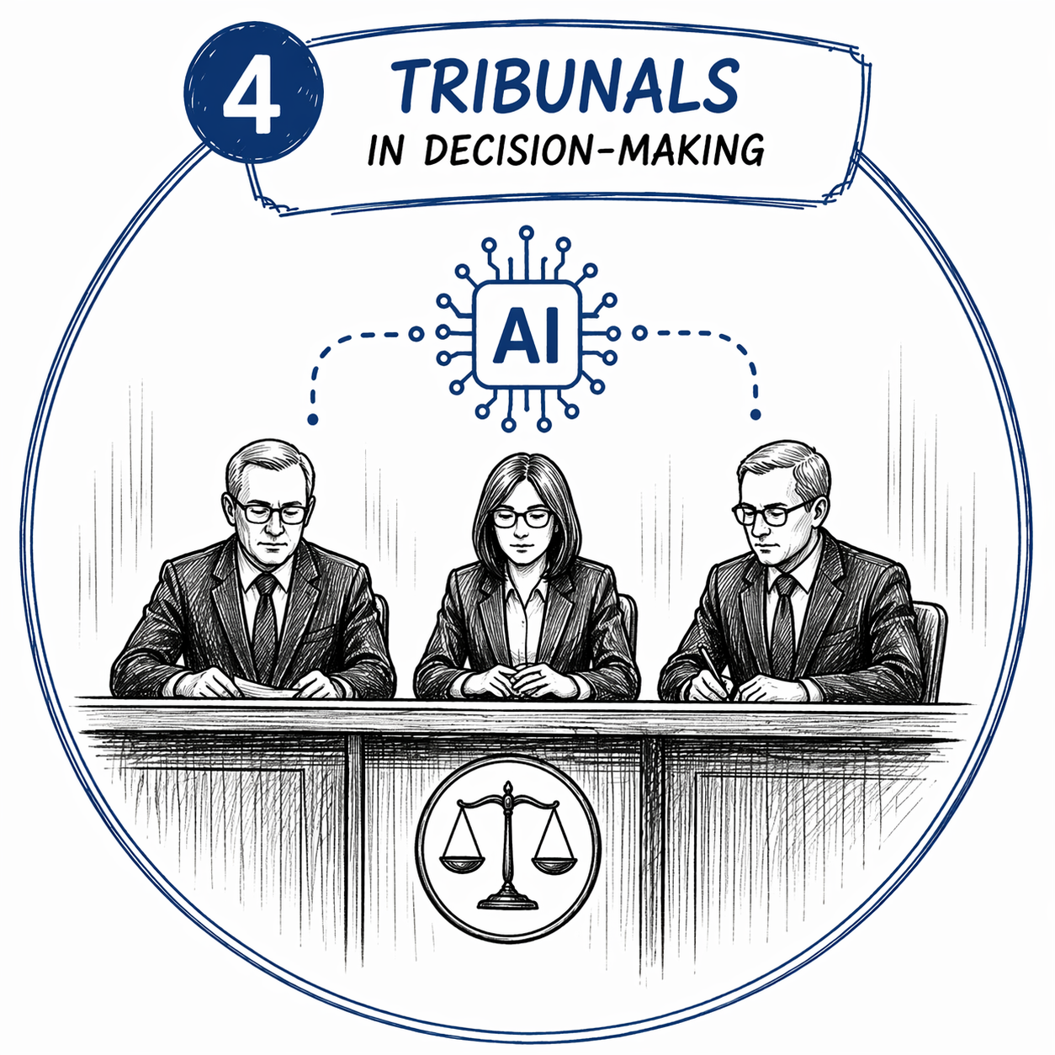
AI as a tool for efficiency in construction arbitration
Four perspectives

Slide 3
AI as a tool for efficiency in construction arbitration
Four perspectives
Identify risks, manage project and avoid disputes.

Slide 4
AI as a tool for efficiency in construction arbitration
Four perspectives
Identify risks, manage project and avoid disputes.
Process data and facilitate analysis.

Slide 5
AI as a tool for efficiency in construction arbitration
Four perspectives
Identify risks, manage project and avoid disputes.
Process data and facilitate analysis.
Summarise data and strengthen advocacy.

Slide 6
AI as a tool for efficiency in construction arbitration
Four perspectives
Identify risks, manage project and avoid disputes.
Process data and facilitate analysis.
Summarise data and strengthen advocacy.
Support the tribunal organise evidence and streamline process.

