Slide 1
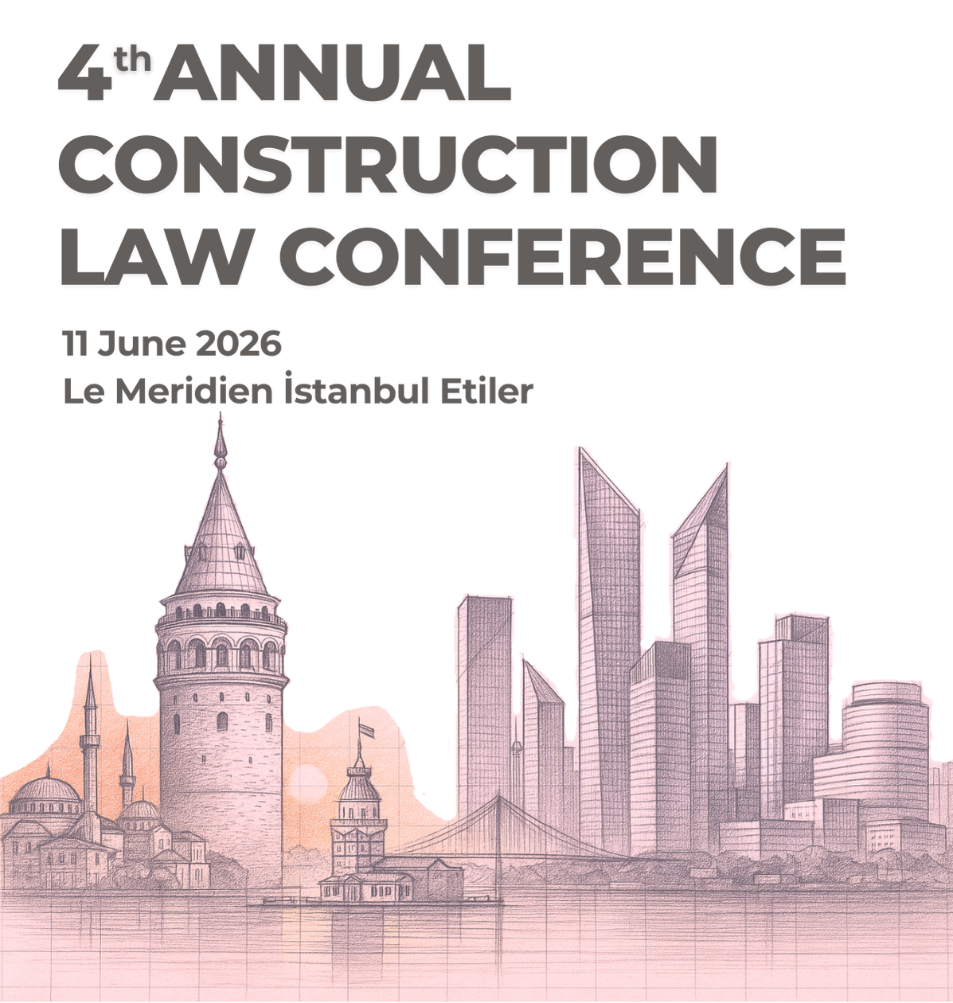

Role of Counsels/Representatives of
the Parties in Construction Arbitration
Ceren Iscioglu Uluturk
Partner of Uluturk Attorney Partnership
June 11, 2026 - Istanbul

Slide 2
Arbitration Stages in Construction Arbitration
Pre-Arbitration Stage
Arbitration Stage
Post-Arbitration Stage

Slide 3
Pre-Arbitration Stage
Collecting the documents and evidences of the disputes
Examining the documents
Building the strategy
Choosing the arbitrator
Choosing the outsource councels/experts
Having an expert examination/report before arbitration

Slide 4
Arbitration Stage
Appointment of arbitrators
Institutional Rules and Terms of Reference
Confidentiality
Story of the dispute, contractual obligations of the parties and the project

Slide 5
Arbitration Stage
Experts appointed by the tribunal
Principal of equality
Modifying/Correcting the award

Slide 6
Post-Arbitration Stage
Compliance of the Arbitral Award
Lawsuit for the Annulment of the Award
Application for set aside an arbitral award on a point of law
Enforcement of the Arbitral Award

Slide 7
Thank you for listening!
Ceren Iscioglu Uluturk
Partner of Uluturk Attorney Partnership
June 11, 2026 - Istanbul

