Slide 1
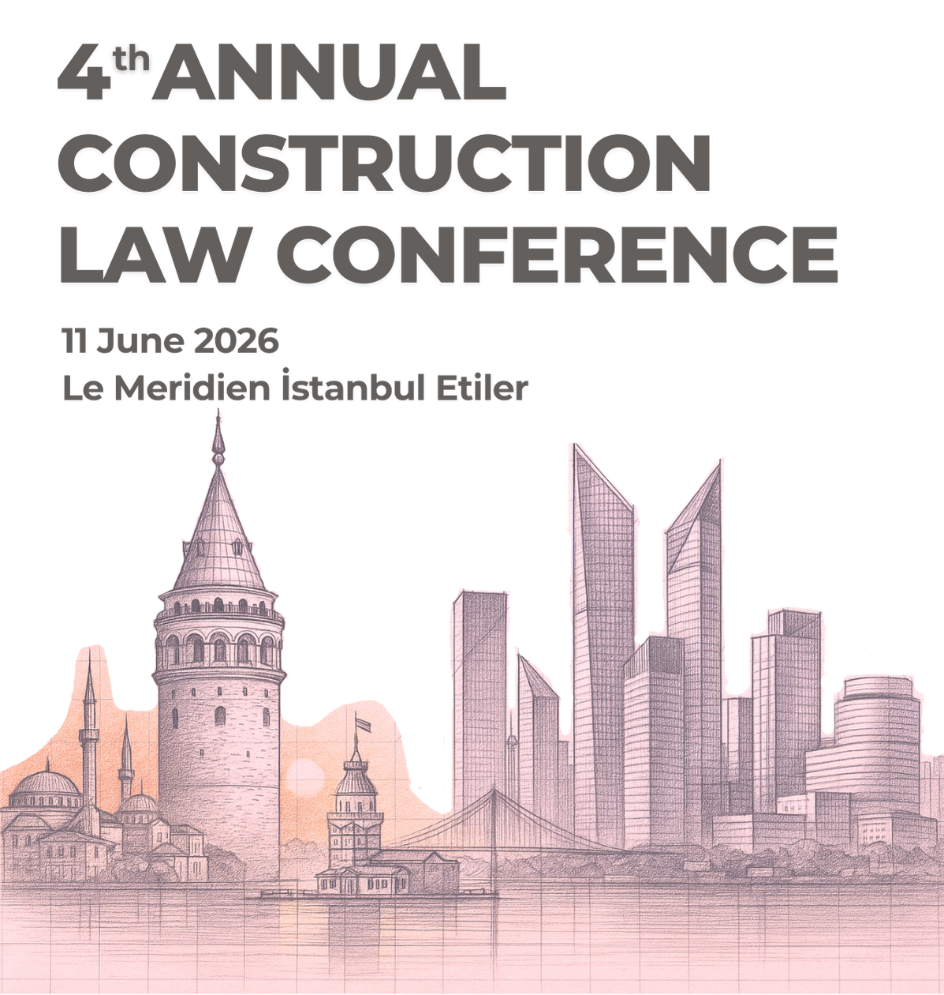

When Completion Is No Longer Enough
How Performance-Based Projects Are Reshaping Construction Risk in the Middle East
Saudi giga-projects | Data centres | Power | PPPs
Suzannah Fairbairn
Partner
June 11, 2026 - Istanbul

Slide 2
The Industry Is Changing
Traditional Project | Modern Project
Build the asset | Deliver the outcome
Completion | Performance
Handover | Operations
Defects | Availability
Construction risk | Performance risk
Completion is increasingly becoming the beginning of the conversation.

Slide 3
Why This Matters in the Middle East
The Next Generation of Projects
🏗
Saudi giga-projects
⚡
Renewable energy
💻
Data centres
💧
Water infrastructure
🏛
PPP projects
Employers are buying operational outcomes, not simply completed assets.

Slide 4
The Rise of Interface Risk
Waiting for information
Not in my scope
WHO OWNS THE GAP?
Design incomplete
Design on another contractor
Awaiting approval
Manage interfaces as actively as construction activities.

Slide 5
Joint Ventures: Alignment Under Pressure
Who funds acceleration?
Should claims be pursued?
How are decisions made?
What if partners disagree?
Scope
Governance
Four Key Pressure Points
Culture
Funding
Don't just stress-test the project. Stress-test the JV.

Slide 6
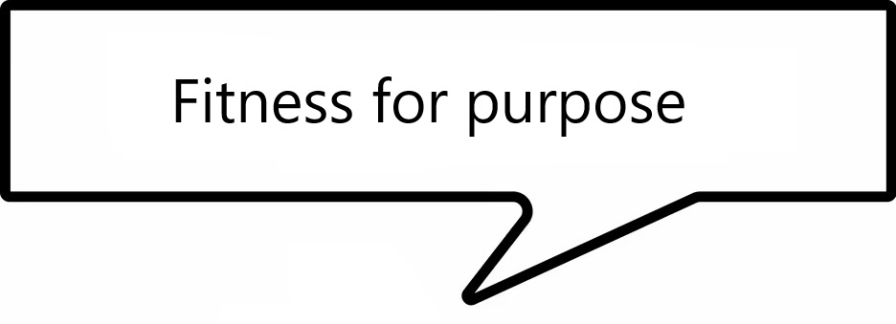
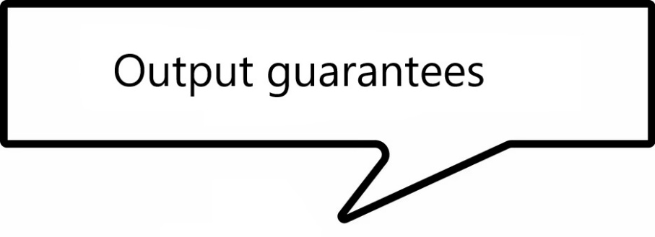


The Rise of Performance Obligations
Traditional Obligation
Build the works
↓
Modern Obligation
Deliver performance
Key Question
What exactly are we guaranteeing?

Slide 7

Data Centre Example: Where Is The Risk?
Employer Requirement
99.982% Uptime
Who is actually carrying the performance risk?
What exactly are we guaranteeing?
Contractor
Generator Supplier
UPS Supplier
Cooling Supplier
Controls Supplier

Slide 8

The Rise of Operational Disputes
Traditional Disputes
Delay
Variations
Defects
Emerging Disputes
Commissioning failures
Integration issues
Availability disputes
Performance shortfalls
What happens when the asset works… but not as expected?

Slide 9

The Evidence Changes
After Handover
Construction Evidence
📄 Programmes
📑 Notices
📝 Site instructions
📊 Progress reports
Operational Evidence
💻 SCADA logs
🖥 BMS records
🚨 Alarm histories
🛠 Maintenance records
📡 Sensor data
The evidence trail does not end at completion.

Slide 10
Disputes or Dispute Avoidance?
Traditional Route
Issue
Positions Harden
Experts
Lawyers
Arbitration
Years Later
Alternative Route
Issue
Early Intervention
Commercial Resolution
Project Continues
Resolve issues while the project can still benefit.

Slide 11

Five Questions The Most Successful Contractors Ask
Who owns the interfaces?
What happens if the JV comes under pressure?
What exactly are we guaranteeing?
How will performance be measured?
How do we solve problems before they become disputes?

Slide 12
When Completion Is No Longer Enough
The most successful contractors will not simply be those who build assets successfully.
They will be those who deliver performance successfully.
Thank you
Suzannah Fairbairn
Partner, Construction & Dispute Resolution

