Slide 1


Contributing to Design, Risk and Cost — Before the Commitments Are Made
Early Contractor Involvement
Ali Emre Ormancı
Chairperson · Construction Contracts & Multilateral Development Banks Working Group
CICA – World Construction Association
SCL Türkiye 4th Annual Conference · 11 June 2026 · Istanbul

Slide 2
THE STARTING POINT
The Industry's Structural Problem
98%
1–2%
↓
#1
of megaprojects are delivered late or over budget
net contractor margins — against 5–10% in manufacturing
construction productivity has fallen while the wider economy grew
contractors carry the highest insolvency rate of any major industry
These are not isolated failures. They are the predictable output of a procurement model that
transfers risk to the party least positioned to manage it — at the stage when it is too late to change anything.
The evidence is unambiguous: the industry needs new delivery models.
Note: productivity and margin data from UK sources (ONS 2024; Construction Productivity Taskforce 2022) — globally, McKinsey (2017) confirms large projects average 80% cost overrun across five continents.

Slide 3
THE STRUCTURAL PROBLEM
The Common Thread Across All Traditional Models
Traditional delivery models:
The shared flaw
Design by the Client
■ In every model that is used in complex and major projects, the contract price is committed before the design is mature enough to price it accurately.
■ The contractor's construction knowledge arrives too late to influence the decisions that determine cost, risk and buildability.
■ Contractor awareness of site conditions, sequencing, supply-chain constraints and constructability is absent from the design process.
■ When problems emerge during construction, the only tools available are variations, claims and disputes.
■ Adversarial dynamics are not a cultural failure — they are the structural output of this timing problem.
Client commissions design. Contractor prices completed design at tender.
Design–Build
Contractor designs and builds against Employer's Requirements. Price fixed at award.
EPC / Turnkey
Full design and delivery risk on contractor. Price fixed on outline specification.
Other lump-sum variants
Fixed price committed before the design reaches sufficient maturity to price accurately.

Slide 4
DEFINITION
What is Early Contractor Involvement?
TRADITIONAL MODELS
ECI engages the contractor during the design phase — before construction begins — to contribute buildability, cost planning, risk identification, sequencing and supply-chain input.
Design–Build · EPC / Turnkey
In these models, the contractor prices a fixed or largely fixed scope. The cost is committed before the design is commenced. The contractor's construction knowledge arrives too late to influence it.
■ A process, not a contract type. It can be applied within various contractual frameworks.
■ Input where it counts. The contractor shapes design and cost while changes are still inexpensive.
■ A two-stage structure. Stage 1 development and Stage 2 delivery, separated by a Notice to Proceed.
EARLY CONTRACTOR INVOLVEMENT
Contractor engaged during design — in time to shape cost, risk and buildability. Knowledge applied where it creates value.

Slide 5
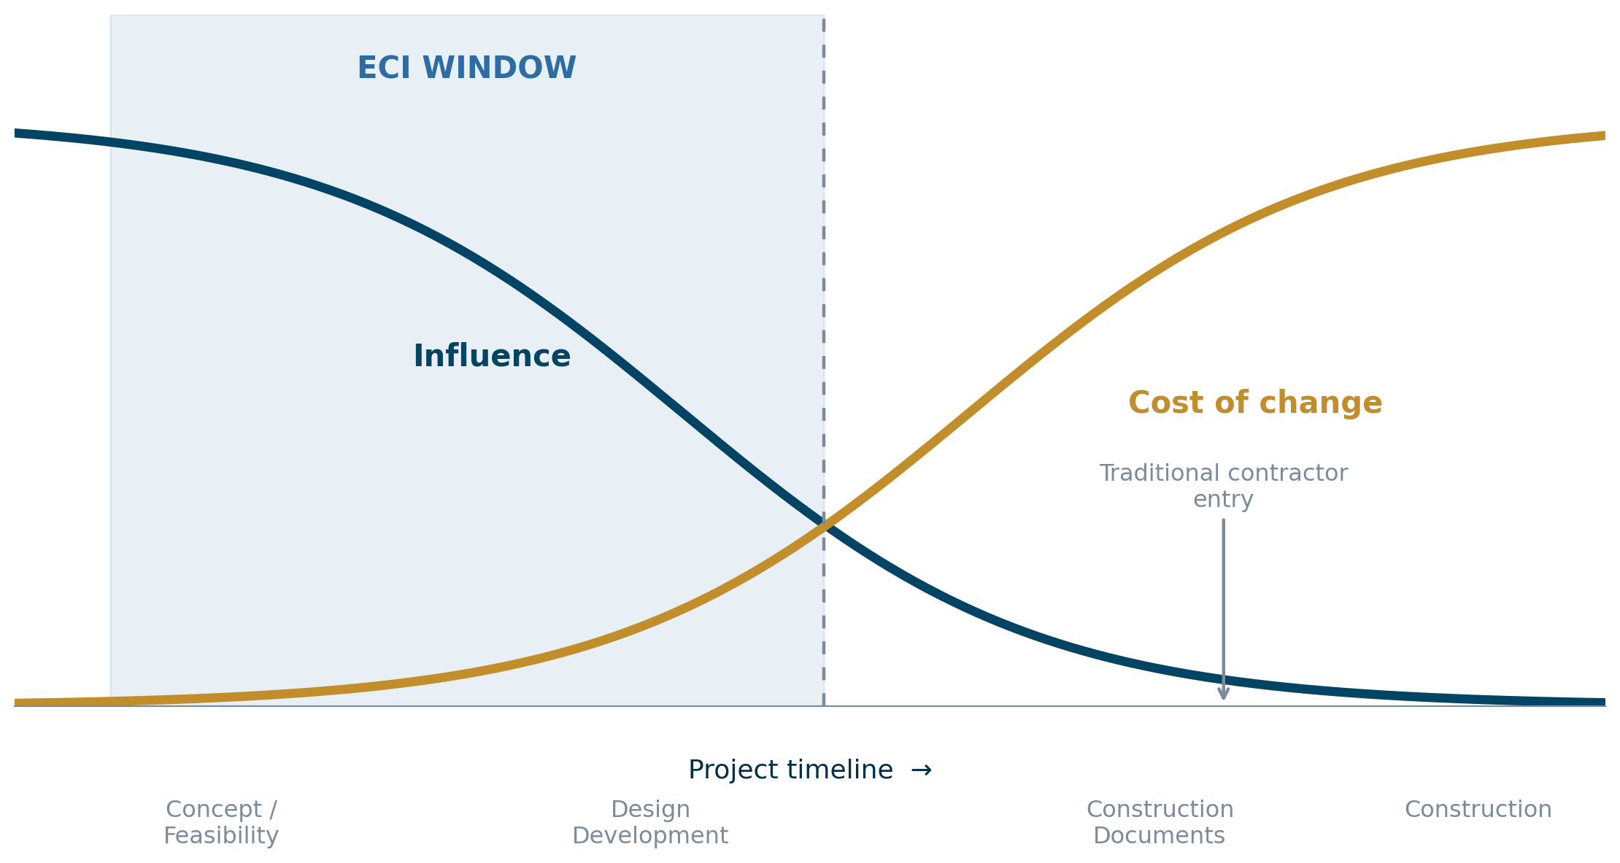
THE COST OF CHANGE
Why Timing Decides Value
The MacLeamy Curve
■ Influence over cost and function is highest at the start.
■ The cost of change rises steeply as the project advances.
■ The two curves cross during design development.
■ ECI positions the contractor before that crossover — where influence is high and change is cheap.
Diagram after P. MacLeamy (2004), widely used in construction and project management literature.

Slide 6
POSITIONING
ECI and the Wider Family of Collaborative Models
ECI sits within a growing family of Collaborative Delivery Models — differing in how far integration and risk-sharing are taken.
ECI
CMAR
PDB
Alliance
Contractor engaged early in design. Process applied within an existing client–contractor framework. The most broadly applicable model.
Construction Manager provides pre-construction advice and then delivers under a Guaranteed Maximum Price, assuming cost-overrun risk.
Progressive Design-Build: design developed collaboratively to % maturity before a Guaranteed Maximu50–75m Price is agreed with the same team.
All parties — client, designer, contractors — operate under one integrated contract with fully shared risk, reward and governance.
ECI vs Alliance — the key distinction
ECI is the entry point — a process applicable within many contract forms, bilateral in structure. An Alliance is the deepest integration — one agreement, fully shared risk and reward. CICA's view: ECI offers the widest applicability.

Slide 7
HOW IT WORKS (1 of 2)
The Two-Stage Process — Stage 1: Development
STAGE 1 Development
STAGE 2 Delivery
The Gateway
Notice to Proceed (NTP)
Stage 1 ends at a formal decision point. The client approves the Target Cost, programme and contract — or stops.
There is no obligation to proceed.
■ IDT formed. Client, contractor, designers and key subcontractors as one integrated team.
■ Collaborative design and a market-tested Target Cost developed against real physical conditions.
■ Joint risk identification — each risk allocated to the party best able to manage it.
■ Reimbursed on a cost-plus / open-book basis. The contractor's Stage 1 effort is compensated.
■ Duration: typically around 12 months; up to 24 months on larger or more complex schemes.

Slide 8
HOW IT WORKS (2 of 2)
The Two-Stage Process — Stage 2: Delivery
STAGE 1 Development
STAGE 2 Delivery
■ Triggered by the NTP. Works proceed against the agreed Target Cost.
■ Pain / gain mechanism. Overruns and savings shared between client and contractor on a pre-agreed ratio.
■ Open-book accounting and audit rights sustain financial transparency throughout delivery.
■ Proactive change control. Early warnings and compensation events replace the adversarial claims cycle.
■ Dispute-avoidance mechanisms embedded from Stage 1 — joint governance, escalation ladders, ADR. Not bolted on after conflict arises.

Slide 9
THE VALUE (1 of 2)
What ECI Delivers — Contractor and Client
For the Contractor
For the Client
■ Target Cost built on real conditions, not an imposed estimate
■ Stage 1 effort reimbursed
■ Upside captured through gain-share
■ Reduced claims exposure and adversarial cost
■ Innovation and IP protected contractually
■ Cost and programme certainty
■ Proactive, transparent risk management
■ Faster, better-informed decisions
■ Scope shaped by those who will build it
■ Fewer surprises carried into construction

Slide 10
THE VALUE (2 of 2)
What ECI Delivers — Financier and Project
For the Financier
For the Project
■ Open-book cost transparency
■ Fewer late-stage cost shocks
■ Bankability demonstrated without a lump-sum
■ Stronger governance and oversight
■ Fewer disputes and less contractual friction
■ Accelerated timelines through early works
■ Innovation embedded from the outset
■ More predictable, better-coordinated delivery

Slide 11
PROOF IN PRACTICE
The Evidence — Where ECI Has Delivered
Project
Country
Value
Outcome
A14 Cambridge–Huntingdon
UK
£1.5 Bn
On time & budget; opened 8 months early
Cork Airport Runway 16/34
Ireland
€21.7 M
~20% savings; delivered in a 10-week window
Edinburgh Tram – Newhaven
UK
£128 M
On budget despite COVID, Brexit & supply shocks
Beatrix Locks (DBFM)
Netherlands
€350 M
Bankable without a lump-sum price
A8 Belfast–Larne
UK
£112.5 M
£6.6 M value-engineering savings
Varbergstunneln
Sweden
€700 M
80/20 incentive; best-for-project culture
Sydney Metro West – ETP
Australia
A$320 M
Calibrated 50:50 pain/gain on complex tunnelling
Source: EIC Collaborative Delivery Models Position Paper, 2026 (case studies, Annex B).

Slide 12
A CRITICAL OBSERVATION
Where have these success stories mainly happened?
UK · Ireland · Netherlands · Sweden · Finland · Austria · Australia · Canada · USA
This is not about geography.
It is about the intentions and capabilities of the parties but particularly
the Employer.

Slide 13
AN HONEST VIEW
The Contractor's Risks — and the Safeguards
No guaranteed Stage 2
Intellectual-property exposure
Stage 1 costs are reimbursed — but intellectual contribution must be valued and IP protected contractually.
Innovations disclosed in Stage 1 must be protected. The client cannot take contractor ideas to a competitor.
Design-responsibility creep
Unequal commitment
Stage 1 input is advisory. The contract must explicitly state it does not constitute design liability.
Collaboration fails when only one party genuinely invests. Behavioural protocols and governance structures are the safeguard.
CICA's position: these are not reasons to avoid ECI — they are reasons to draft the agreements properly.

Slide 14
THE CICA VIEW
When Does ECI Work? — CICA's Position
The common view
The real preconditions — behavioural and structural, not scale
ECI is for large, complex projects only.
■ Client maturity and genuine capability
■ Genuine commitment from all parties
■ Stage 1 properly reimbursed and IP protected
■ Clear compensation terms if Stage 2 does not proceed
CICA's position
ECI is justified by uncertainty, not size.
Evidence from Latin America: ECI has delivered on smaller, simpler projects where uncertainty, not the size, was the driver.
ECI is more widely applicable than the headline cases suggest — including in developing markets.

Slide 15
Recommendations
Ten Recommendations for Successful ECI
1
Identify the right project
6
Set a realistic estimated budget
2
Mobilise an integrated team with collaborative behaviours
7
Ensure transparency — open book & Defined Cost
3
Adopt a two-stage process
8
Define tasks & responsibilities early for risk allocation
4
Allow sufficient time for Stage 1
9
Choose the right contract model
5
Reimburse Stage 1 activities
10
Provide agile, on-site dispute resolution
Aligned with the European International Contactors’ '10 Golden Rules'.

Slide 16

THANK YOU
Ali Emre Ormancı
CICA – World Construction Association
Chairperson · Construction Contracts & MDBs Working Group
www.cica.net | cica@cica.net

