Slide 1
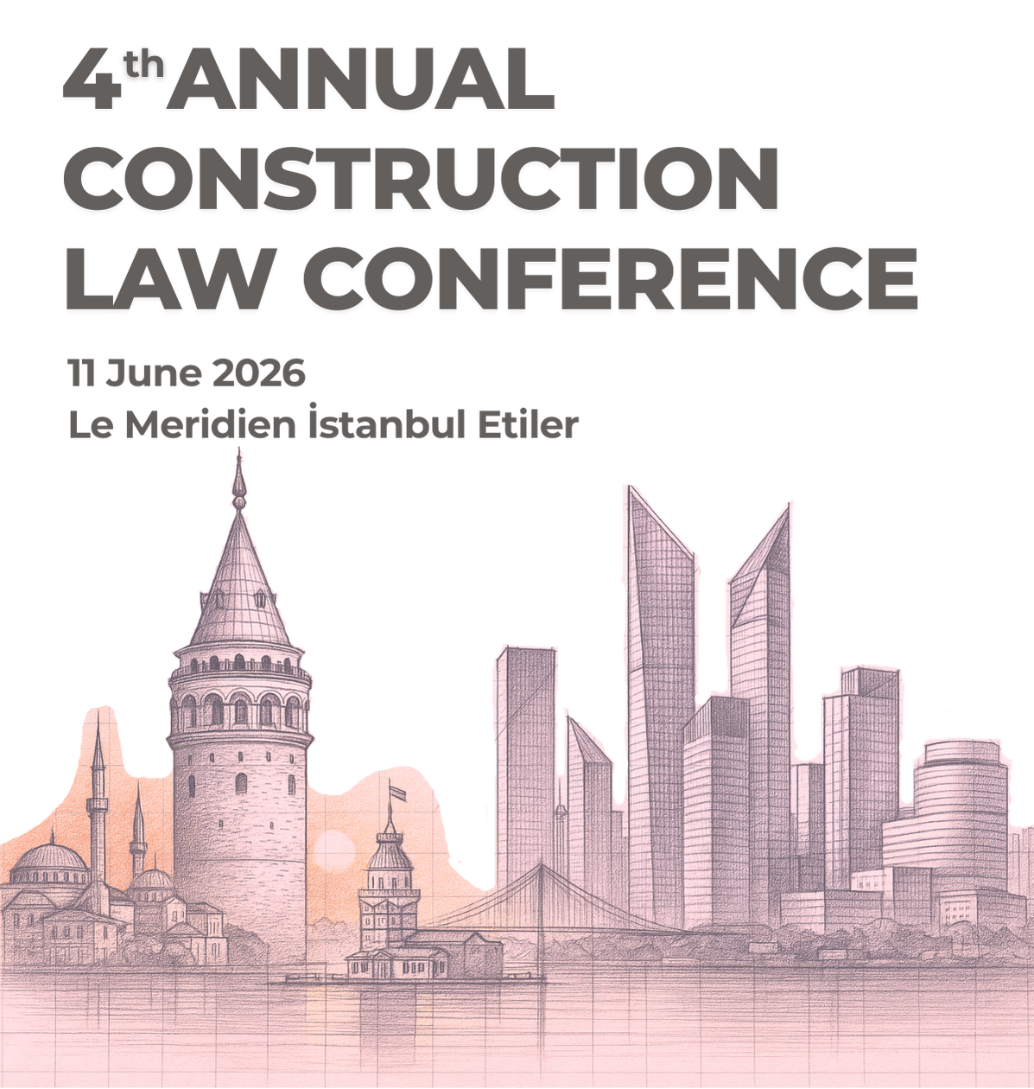
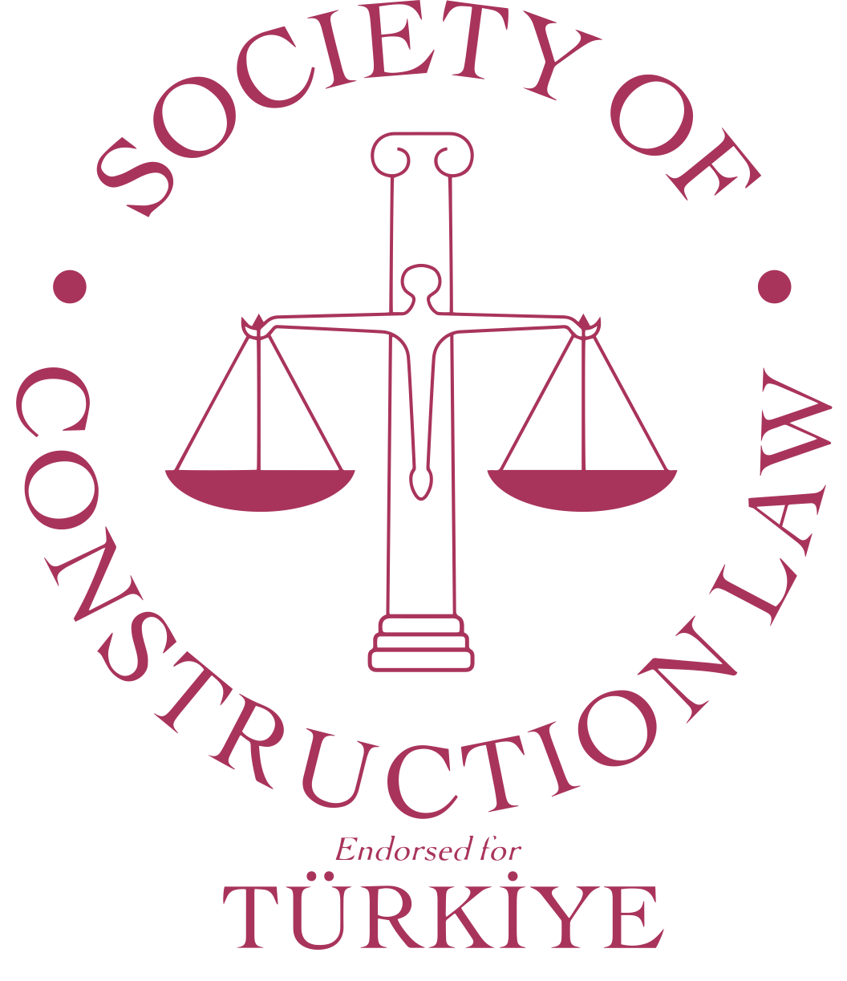
Guerrilla Tactics
in International Arbitration
James Bremen
Presiding Partner, Joseph Hage Aaronson & Bremen LLP
June 11, 2026 - Istanbul

Slide 2
Agenda
What are guerrilla tactics?
Why they matter in construction arbitration
Common examples
Tribunal responses
Practical guidance

Slide 3
What Are Guerrilla Tactics?
Conduct intended to obstruct, delay, increase costs, or gain unfair procedural advantage within arbitration proceedings.

Slide 4
Why Construction Arbitrations Are Vulnerable
Large volumes of documents
Multiple parties and experts
Complex delay and quantum issues
Significant commercial pressure

Slide 5
Document Production Tactics
Fishing expeditions
Late disclosure
Selective disclosure
E-disclosure manipulation

Slide 6
Witness and Expert Evidence
Tactical changes in expert opinion
Late expert reports
Witness interference
Surprise evidence

Slide 7
Procedural Delay Tactics
Repeated extension requests
Jurisdictional objections
Satellite court proceedings
Non-compliance with procedural orders

Slide 8
Challenges to Arbitrators
Legitimate versus tactical challenges
Impact on timetables
Institutional scrutiny of abusive challenges

Slide 9
Tribunal Tools
Robust case management
Procedural timetables
Adverse inferences
Costs sanctions
Early identification of misconduct

Slide 10
Institutional Responses
ICC, LCIA, SIAC and other rules
Greater emphasis on efficiency
Case-management powers
Proportionality principles

Slide 11
Practical Guidance for Counsel
Create a clear record
React proportionately
Preserve due process
Focus on enforceability

Slide 12
Key Takeaways
Guerrilla tactics remain common
Effective tribunals can neutralise them
Counsel should focus on efficiency, fairness and credibility

Slide 13

Contact
    James Bremen
          Presiding Partner
          Joseph Hage Aaronson & Bremen LLP
      james.bremen@jha.com
      +44 (0)7717 341 058

