Slide 1

Adjustment of the Price
Prof. Dr. Ziya Akıncı
ziya@akincilaw.com

Slide 2

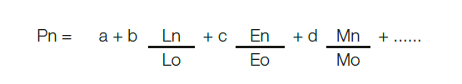
Adjustment of the Price
FIDIC 1999 Red Book Sub-Clause 13.8 [Adjustments for Changes in Cost]
  "In this Sub-Clause "table of adjustment data" means the completed table of adjustment data included in the Appendix to Tender.
Example Formula for Adjustment for Change in Cost (FIDIC Guidance)

Slide 3
No Table of Adjustment Data
FIDIC 1999 Red Book Sub-Clause 13.8 [Adjustments for Changes in Cost]
“... If there is no such table of adjustment data, this Sub-Clause shall not apply…”

Slide 4
Principles
Pacta Sunt Servanda (“agreements must be kept”: as agreed)
Rebus Sic Stantibus (“as things stand”: a fundamental change in circumstances may give rise to price adjustment or termination)

Slide 5
Applicable Law
UNIDROIT Principles of International Commercial Contracts 2016, Article 6.2.3
  In case of hardship the disadvantaged party is entitled to request renegotiations.
  If no settlement: Adaptation or termination
Civil law vs. Common law

Slide 6
Turkish Code of Obligations (TCO)
Articles 138 and 480/2
TCO Art. 138 → hardship clause for all kind of contracts
TCO Art. 480/2 → for lump sum construction contracts

Slide 7
Reasons Giving Rise to Price Adjustment Requests
Russia-Ukraine conflict
Pandemic
Problems with supply chain
Increase in construction costs and Euro zone inflations

Slide 8
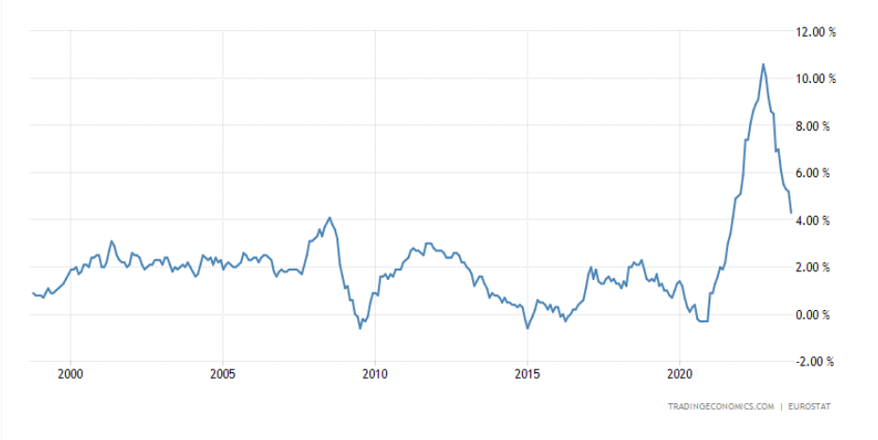
Graph 1: lnflation Rate in the European Union for the last 25 years

Slide 9
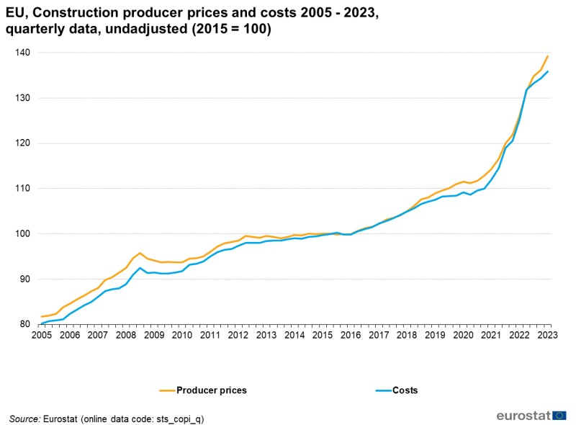
Graph 2: European Union Construction Producer Prices and Costs 2005-2023

Slide 10
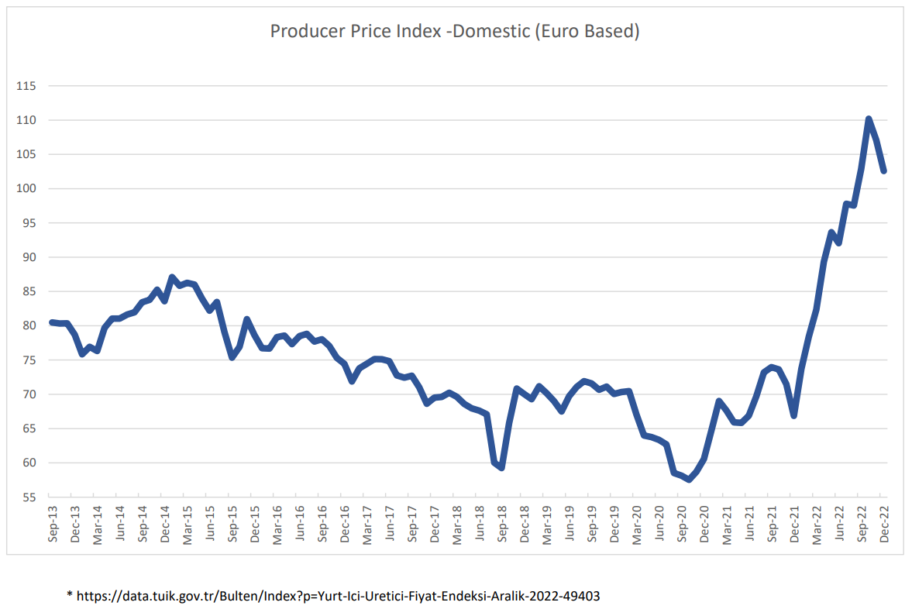
Graph 3: Producer Price lndex-Domestic (Euro Based)

Slide 11
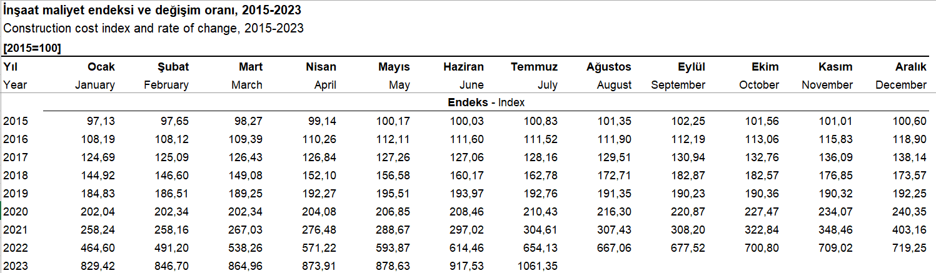



Graph 4: Construction Cost Index (Turkey)

Slide 12
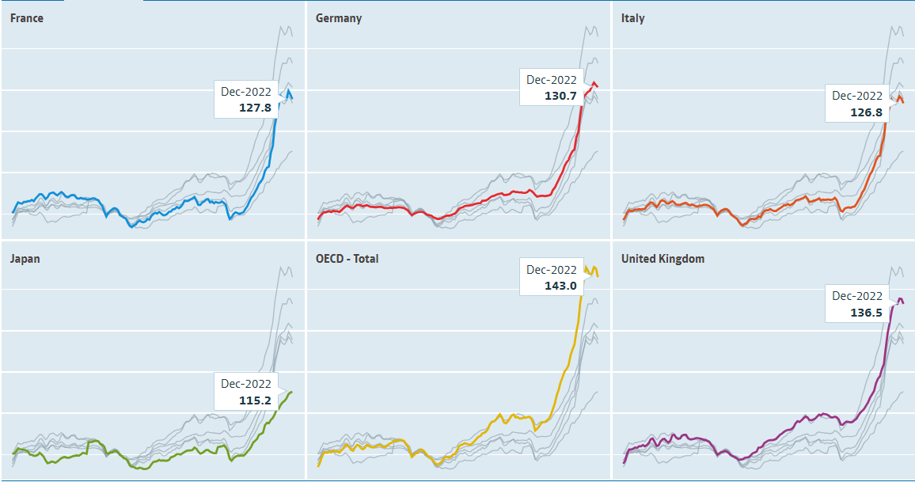
Graph 5: OECD Data on Producer Price Indices

Slide 13
Turkish Jurisprudence on Adjustment
Adjustment due to hardship is based on the principle of good faith
  3. Civil Chamber of Turkish Court of Cassation, E. 2017/8219, K. 2019/5397, T. 13.6.2019
Adjustment based on good faith principle in spite of a negative adjustment provision
  3. Civil Chamber of Turkish Court of Cassation, E. 2017/13542, K. 2018/10567, T. 24.10.2018

Slide 14
Conditions for Adjustment Request
Unforeseeability
Hardship
Non-attribution
Non-Performance or Reservation
Notification
No Contrary Agreement

Slide 15
Employer’s Defenses
No adjustment formula
Precise impact on the cost of the work
Advance payment
Contractor’s delay in procurement
Completion is delayed because of Contractor
Hedging and other financial derivative instruments
Balance of the obligations and exchange rate increase

Slide 16
Thank you
Prof. Dr. Ziya Akıncı
ziya.akinci@akincilaw.com

