Slide 1


Bridging the Gap Between Planned and Actual:
A Practical Approach to Delay Analysis
Hussain Chizari
Director - Diales
June 11, 2026 - Istanbul

Slide 2
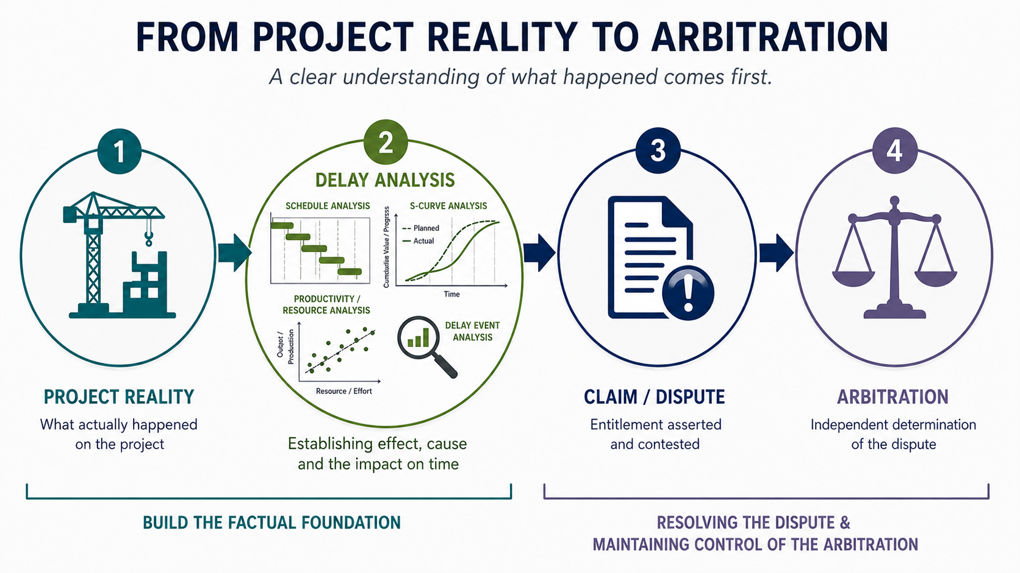
From Project Reality to Arbitration
Majority of disputes become contentious as methodologies, assumptions and challenging narratives come together to form competing factual positions.
Bridging the gap between planned and actual performance through a practical approach to delay Analysis
Notes:
Thank you James on highlighting the importance of maintaining control of Arb process and effectively responding to procedural tactics.
A key part of how well you manage the arbitral proceedings is also dependant how much the team understand what has actually happened.

Slide 3

Despite Established Guidelines – Why so many disputes?
Overreliance on detailed computer model analysis
Incorrect reporting of progress data
Overly detailed schedules and focus on discrete logic links
Misapplication of delay analysis methodologies
‘Why use a prospective delay analysis methodology to forecast what actually happened in the past?’
General failure to apply common sense

Slide 4
Before Performing An Analysis – Arguably There Are Three Types of Delay you should consider:
Prevention or ‘Stop’ | I have no access – no possession of site A key component is not available yet
Most commonly
Claimed.
Typically via prospective analysis
Going Slow | My productivity is low My efficiency is reduced – leading to drop in productivity My work-flow is ‘disrupted’
Most frequent issue, but often overlooked
Change in Sequence | I now need to work in a different work sequence or work order I have additional activities to execute
Again, often overlooked
When presenting your analysis, you need to deal with all of these types of delay

Slide 5
Performance Based Delay Analysis - Before We Start
Delay Analysis is not about Planning Software:
Majority of Planning Software are project control/planning tools.
Limitations on delay analysis. Often modelled and theoretical.
Delay Analysis should:
Be simple – Put Delay being complained of in context with delay as a whole.
Establish the ‘Compelling Story’.
A detailed dissection of what actually happened (Perhaps an APAB)
Search for dominant or primary causes
  – the Causative Potency.
Be based on common-sense.
Methodology – Analyse delay before applying liability (not analyse liability before delay) – I.e. Effect and then Cause
Walter Lilly & Company Ltd v Giles Patrick McKay
Henry Boot (UK) Ltd v Malmaison Hotel (Manchester) Ltd
SCL Delay and Disruption Protocol 2017

Slide 6

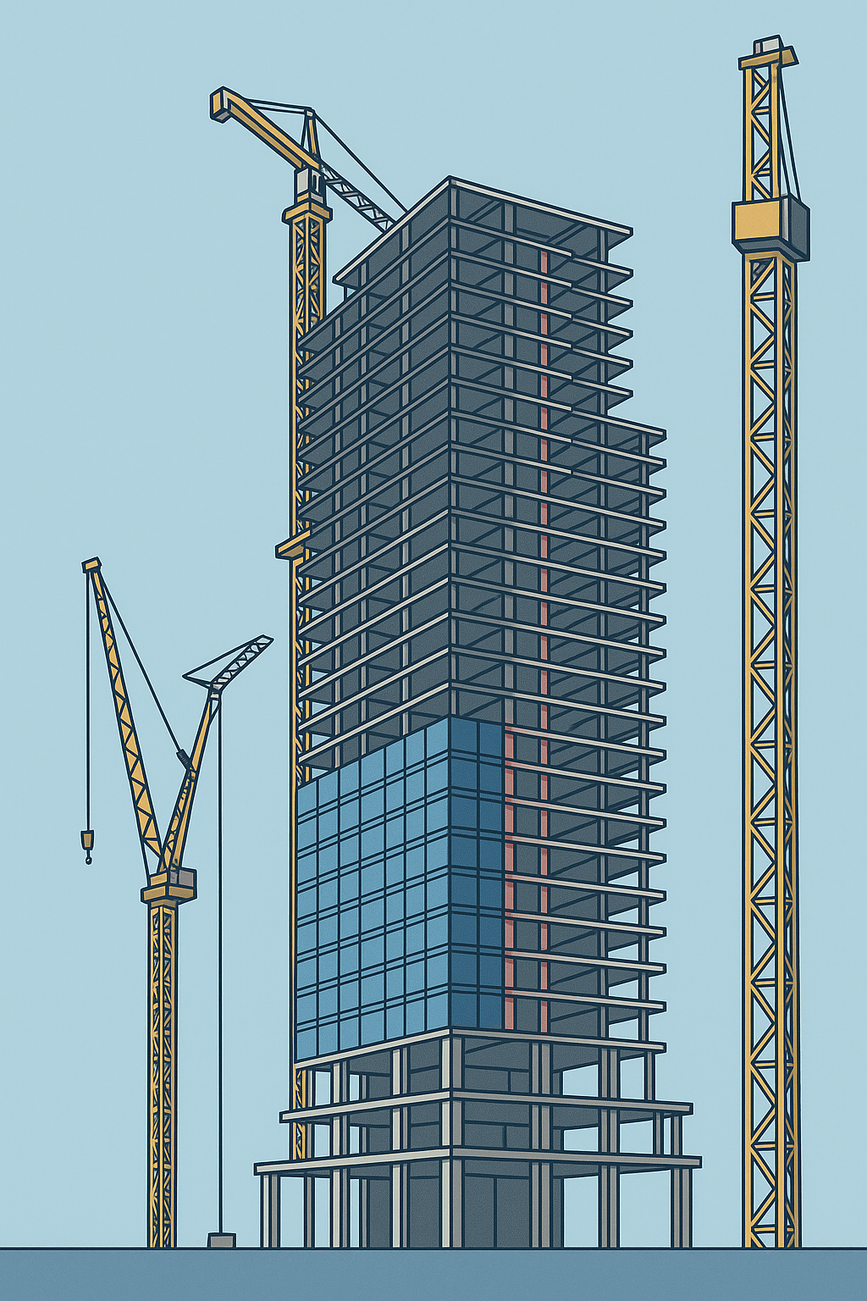
Before Starting – Understand your programme ‘Hard Points’
All Key ‘Hard Points’ in the Programme
Has the Concrete works Completed yet?
Has key plant been delivered
Has Builders’ work/Interiors started?
Has cladding started yet?
Has TOC (Takeover Certificate) been issued?
Has ‘wild air’ been provided yet?
Has power been provided yet?
Has Access been Provided

Slide 7
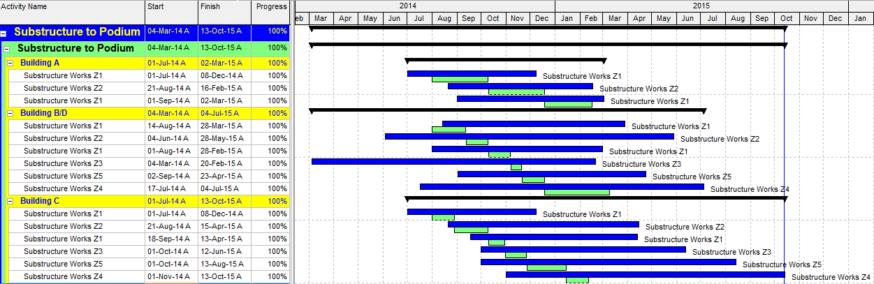
APAB in detail – First time in P6
Plan: Green
Actual: Actual
Overstretched (Overrun) Actual Blue Bars
Change in Sequence
Plan = 7 Months
Actual = 19.5
5 Months Early Start? Ahead of Plan?
Finish in Oct -15
(6 months later than planned)
As of Data Date 13-Oct-15: Progress is 100%

Slide 8
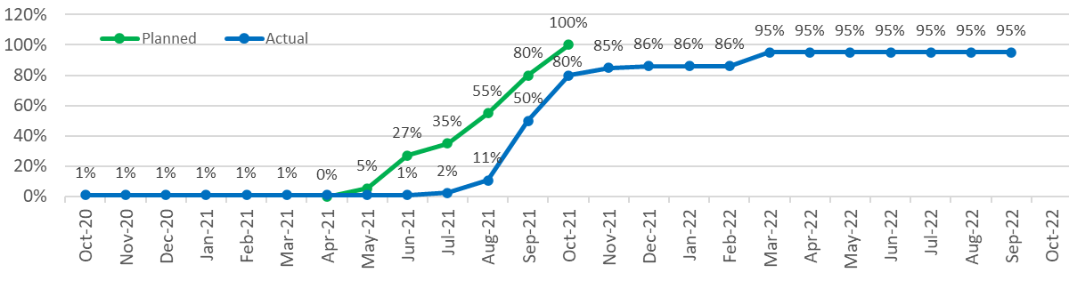
Performance Driven APAB
Potential 'False Start' - Commencement registered but little or no progress for 9 months
Tail-off until completion
Works Substantially Complete at 95%
Area Handover Jul-21
Period of Accelerated production, around 150% of planned rate
Works were registered as complete in Sep-22
2.5 Months Delay to Start
Works Substantially Complete
2 Month Overrun
Pending Access
Delay Events
Access Provided
Design Change
Sign-off /
Snagging

Slide 9
Observational notes – Delay Identification
In performing the analysis:
Compare both start and end dates between planned and actual. By activity, identify:
  A delay to the start and then growth, stretch or overrun
Remember the Lost Time should equal overrun. So, reconcile around the Data Date:
  Delay (or time lost) in the period; and
  Delay (or time to be lost) in the future; and
  Any acceleration or recovery in any period (past or future)
Put delay complained of into context with delay to delivery of the whole
Lets look at Some More Examples!

Slide 10
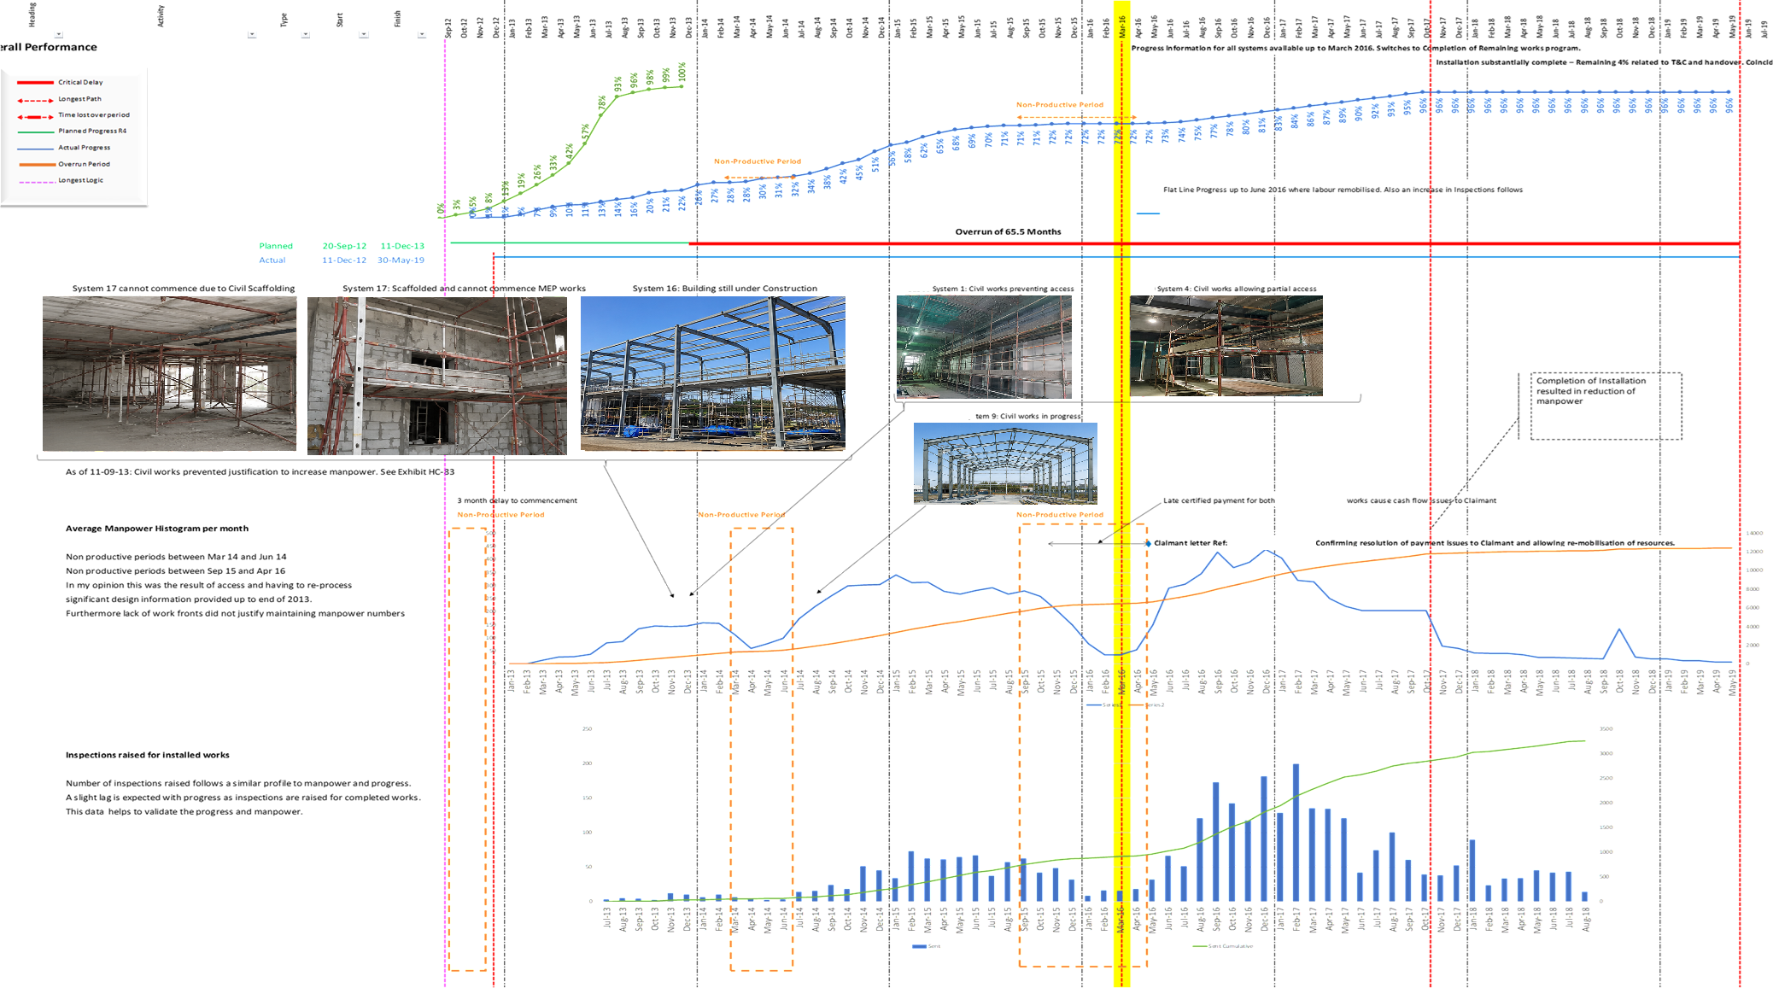
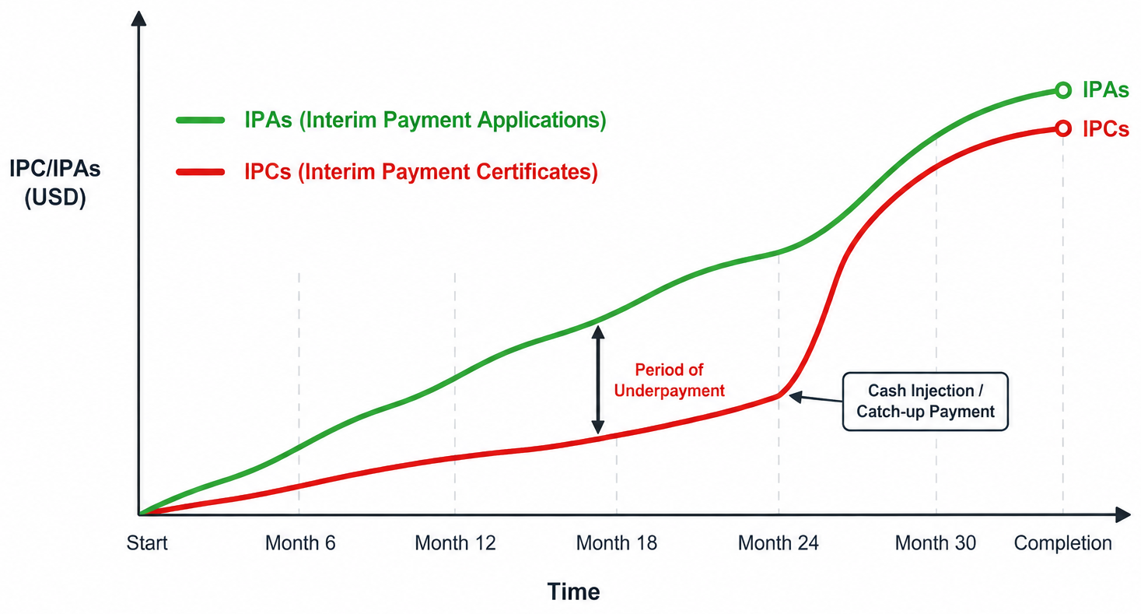
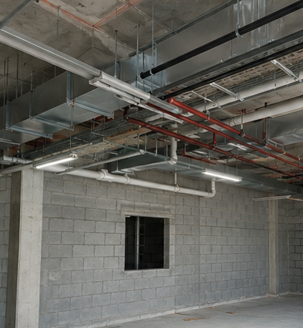
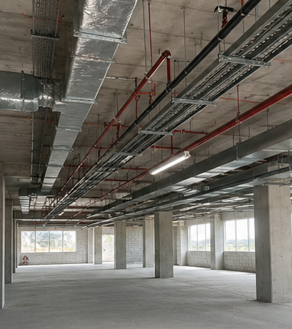
MEP Subcontractor – Delay Identification
Progress from monthly updates
Plan
Actual
Manpower histogram supported by daily allocation Sheets
Combining various date sets from Progress, Manpower and IPCs helps to develop a compelling argument

Slide 11
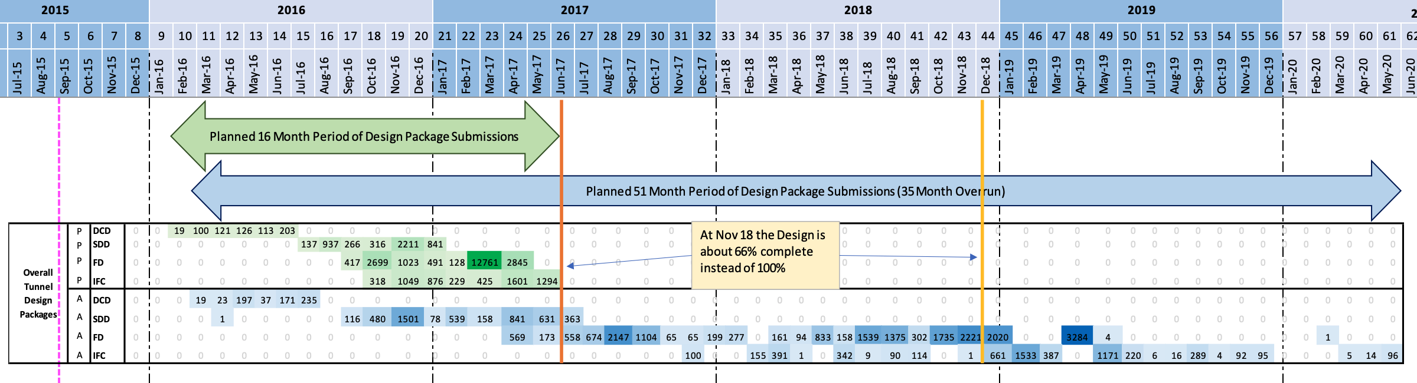
Engineering Submissions Heat Map
Base Data:
Plan - Design Programme
Actual - Engineering Submission Logs
Correlate Submissions to Approval Gateway
Concept Design approved in time
Detailed Design approved slightly late
Big Delay In Approval of Final Design
Big Delay In Approval of IFC
Approval of details left to the Final design and IFC Stage – consistent with the ‘lack of Empowerment’ issues seen in the region – the ‘please revise and resubmit’ issue

Slide 12
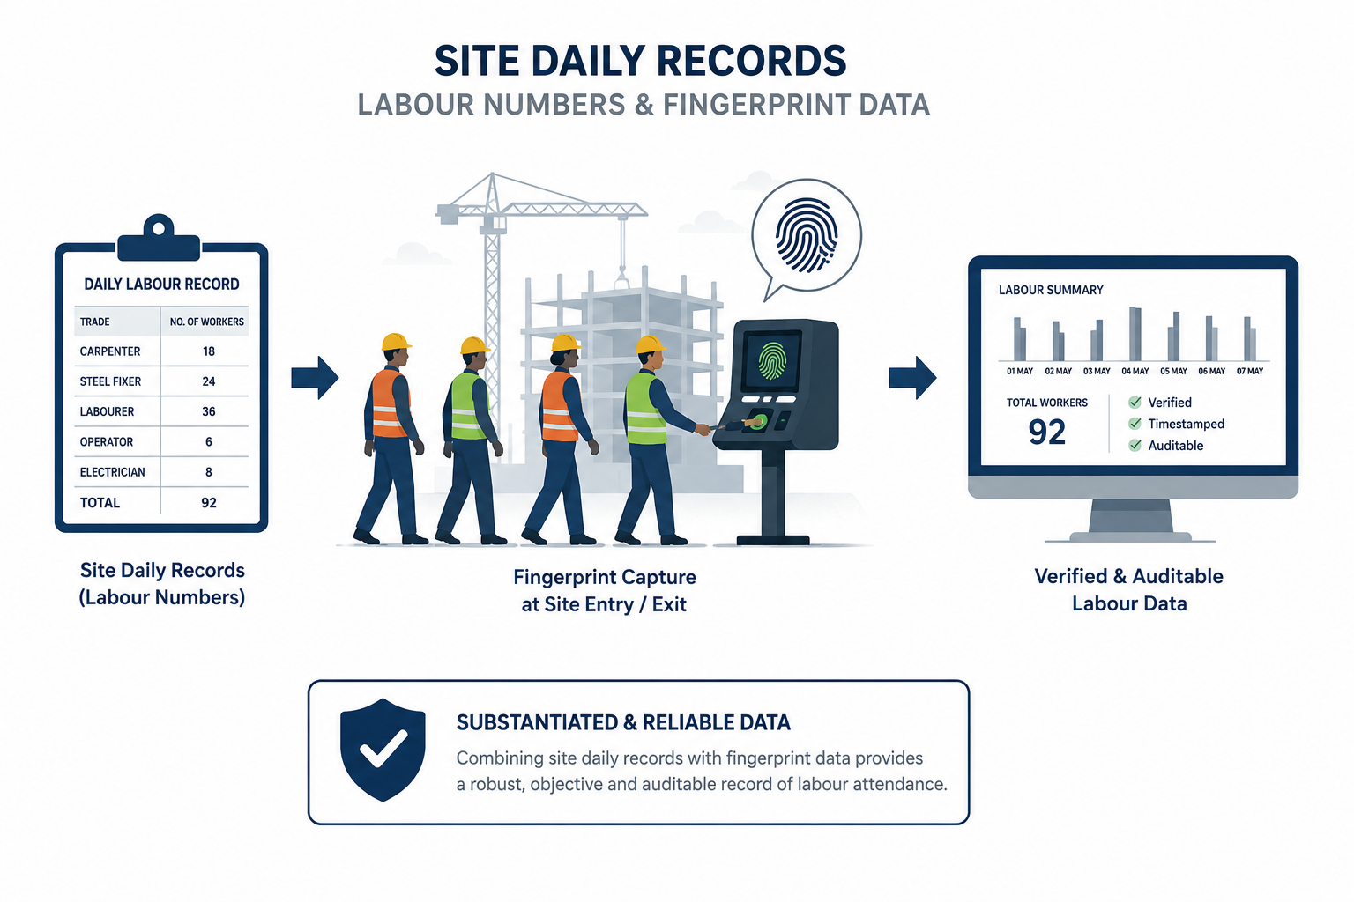
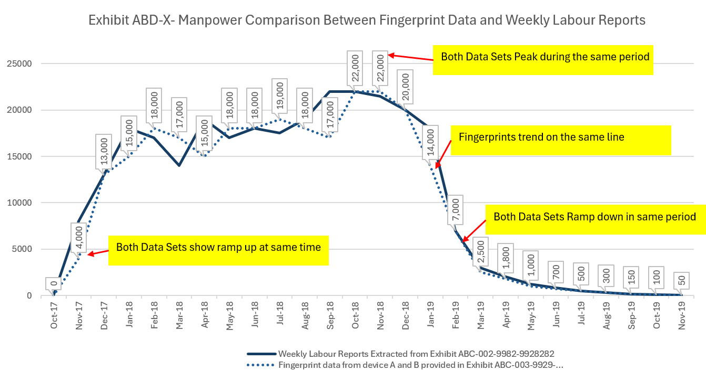
Do not simply rely on Progress Data within the schedule – LOOK FOR CORRELATIONS:
Progress data in Monthly Progress Reports (photos, schedule, submission logs)
Inspection Requests, IPC, Resources (material / labour)
Task Specific Databases – Pipe Joint Logs, Punch List Databases etc
Photos and events mapped to changes in performance in charts
Showing you have correlated multiple data sources to support a position will help exceed the other experts reliance on his ‘single source’

Slide 13
Conclusions and Take Aways
Don’t Underestimate your other Contemporary Records
Effective Project Controls and Contemporary Records is a starting point
Each Monthly Update should be a mini-delay analysis
Keep your records consistent and reasonably accurate
Do a Simple Delay Analysis
Implementing a Performance Based APAB Delay Analysis will give a different insight
Look for Hard-points within the Analysis – Understand the bigger Picture
Look for Correlation within Contemporary Records (MPRs to Submission Logs, IRs etc)
Use parallel analysis and exhibit them
Analysis must reflect reality - Make it fact based – Easy to Understand – Causation
Think beyond software – Excel is infinitely more flexible

Slide 14
Final Thoughts…….
Keep Everything Simple
Deal with Facts – you don’t need to evidence everything.
Think about your Audience – Simplify Complexity, focus on ‘Compelling Story’

